Slide 1
MSSPs & Identity w/ Azure Lighthouse
Angelica Faber
Principal Security Architect

Slide 2
Which Identity?

Slide 3




Single Identity Model
Customer 1
Customer 2
Corporate Identity
Customer 3

Slide 4

Multiple Identities Model
Customer 1
Customer 2
Corporate Identity
MSSP Identity
Cloud Solution Provider security best practices
Customer 3

Slide 5

“In Between”
Corporate Identity
Customer 1
Customer 2
Admin Identity
Protecting Microsoft 365 from on-premises attacks.
Customer 3

Slide 6
Permissions
Tenant Level
Subscription Level

Slide 7
Azure AD (tenant) and Azure RBAC (subscription)
Azure Active Directory Tenant
Active Directory
Azure AD is typically synched with on prem AD (though Admin accounts should be separated)
Enterprise Groups (and Users)
Built-in
roles
Azure Tenant
(Enrollment)
Privileged Role Administrator
Billing admin
Password Admin
Security Administrator
Security Reader
Security Operator
Root management group
https://security.microsoft.com/
https://entra.microsoft.com/
https://compliance.microsoft.com/
Management group
Azure RBAC roles
Owner
Contributor
Reader
Sentinel Contributor
Sentinel Operator
Security Admin
Security Reader
…
https://portal.azure.com/
Subscriptions
Resource group
Resource

Slide 8
GDAP
Granular Delegated Admin Privileges

Slide 9
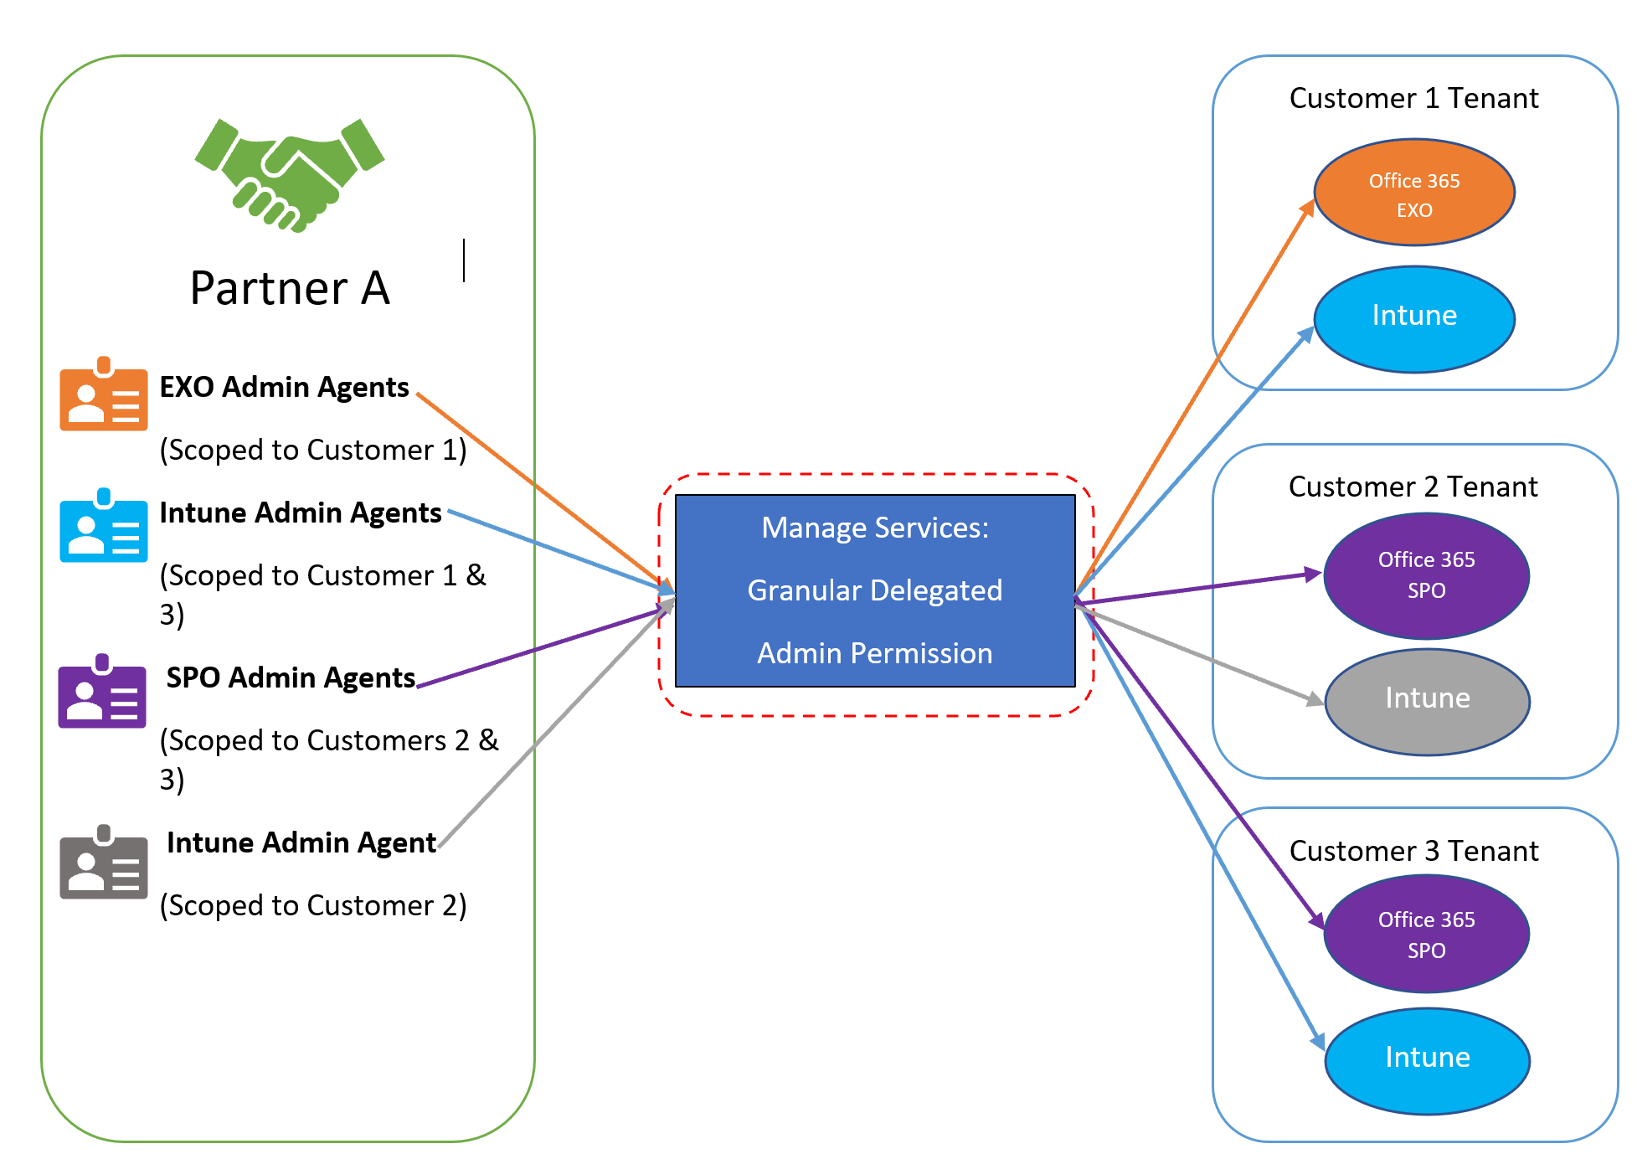
What is granular timebound delegated admin permissions (GDAP)?
Set of capabilities that enable partner users to get delegated-admin-permissions on a specific customer workload for a defined time period as per business need using principle of least privilege.
Partner defined AAD security groups in partner’s tenant
Workloads supported by granular delegated admin privileges (GDAP)

Slide 10


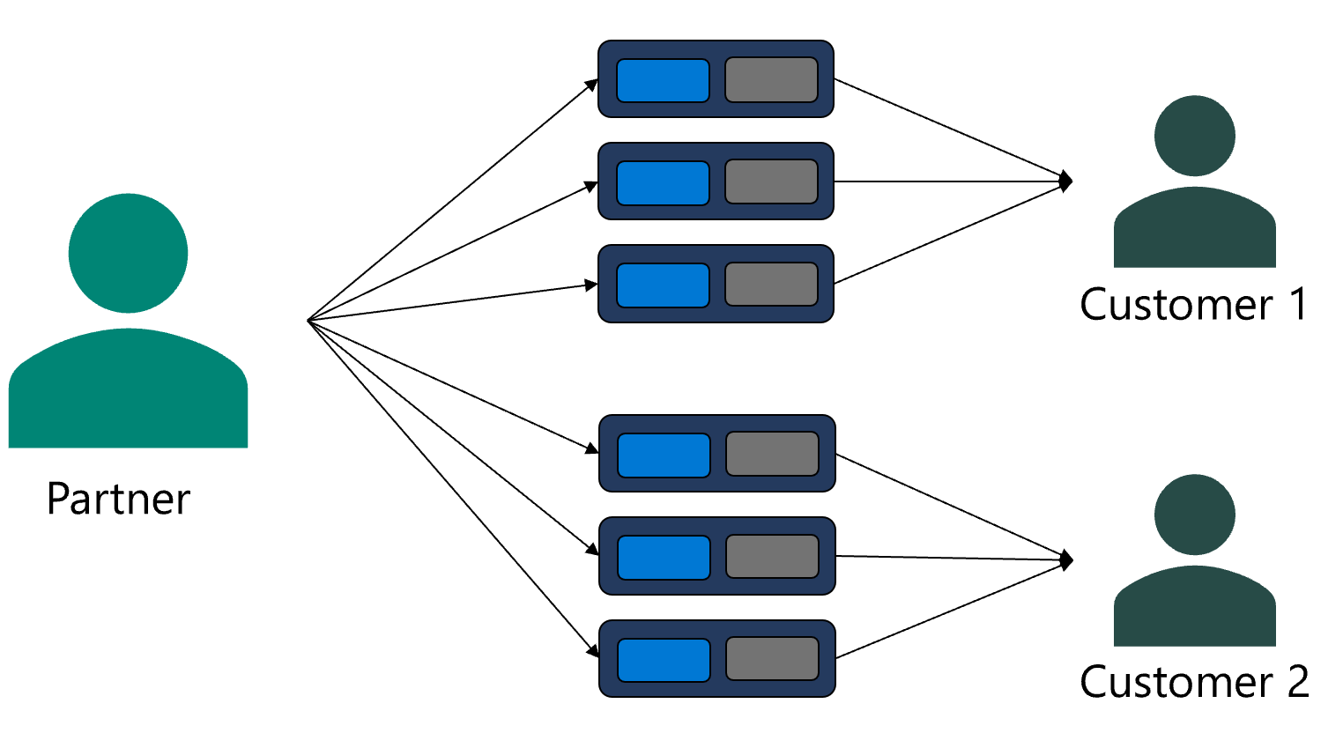
Admin Relationship – New
Consists of AAD role(s) and duration
Can be multiple between you and customer tenant
Customer can approve whole unit
Roles cannot be selectively approved
Auto expires and access is removed
Cannot be edited once approved by customer
Can be terminated by either you or customer
Independent of existing DAP or Reseller relationship
AAD Role(s)
Duration
Duration 6 Months
AAD Role(s)
Exchange admin
approve
Teams Admin
Intune Admin

Slide 11


GDAP Model
Partner Tenant
Customer 1 Tenant
Customer approves Admin Relationship(s)
Organize users and Security groups (SG) for full customization
No customer reapproval needed for SG to approved roles assignment
Restrict access at
  Customer level
  Partner tenant level
  Partner user level
  Workload level
Access auto expires at the end of duration
Partner user agents
AAD security groups
in partner’s tenant
created by partner
Admin Relationships
Relationship 1
6 Months
Alpha security group
EXO admin
SPO Admin
user 1
Intune Admin
Beta security group
Relationship 2
2 Months
Global Reader
user 2
Gamma security group
Help desk admin
Partner Tenant
Customer Tenant
Customer 2 Tenant
Relationship 3
3 Months
EXO admin
Teams Admin
Intune Admin

Slide 12
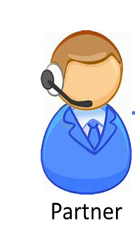

Partner and customer journey
Onetime Org to Org setup
Cannot change definition of GDAP request (roles and duration) once customer approves (Contract)
Partner Admin Agent
1
2
Create and Save GDAP request defined by AAD Role(s) & duration
Send link to customer for approval in email
Approve GDAP request
Multiple times (Ongoing as needed)
AAD Portal
Can be changed by partner
  multiple times as needed
  customer reapproval not required
Partner Admin Agent
3
4
5
6
Create users & security groups
Assign user(s) to security groups
View approved GDAP relationship
Assign approved AAD Roles in GDAP relationship to Security Groups
Partner user belonging to security group
7
8
9
AOBO links to Admin Centers conditionally enabled based on mapping of Security group they are part-of and Roles mapped
View AOBO links for customer
Administer Services
(AOBO)
View customer

Slide 13
Azure Lighthouse

Slide 14








Azure Lighthouse
Your Practices
Multi-cloud
Datacenter
Edge
Azure Lighthouse
Azure Management
Azure Arc
Customer 1
Customer 1
Customer 2
Customer 2
Customer 3
Customer 3

Slide 15
Azure Lighthouse and Azure Arc
Azure Arc extends Azure management, services, and Azure Lighthouse anywhere
Your Practices
Multi-cloud
Datacenter
Edge
Azure Lighthouse
Azure Management
Azure Arc
Customer 1
Customer 1
Customer 2
Customer 2
Customer 3
Customer 3
Windows Server | Linux | Kubernetes | SQL | Azure data services

Slide 16
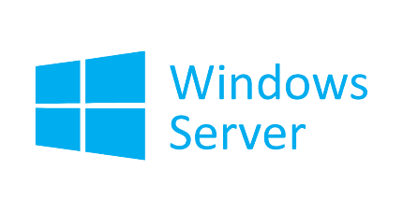


Azure Arc enabled servers
Azure Arc enabled servers are auto-enrolled with additional Azure services
Additional services
Azure Policy
Defender for Cloud
Microsoft Sentinel
Azure Monitor
Change and inventory tracking
Update management
AWS Linux 2
Just turn them on when you want to use them

Slide 17











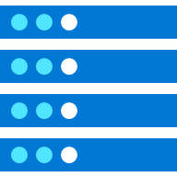








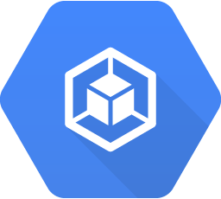


Contoso MSP Tenant Powered by Azure Lighthouse
Access Management
Portal & Dashboarding
Policy & Governance
Monitoring
Logging & Analytics
Cost Management
Security
Patch Management
BC/DR
MSP 3rd Party
Solutions Integration
Service Health
& Support
Fabrikam Azure Tenant
Parnell Aerospace Azure Tenant
App Services
Fourth Coffee Azure Tenant
Virtual Machines
Storage
Network
Kubernetes
Service
Data
Services
Cosmos DB
Functions
Parnell Aerospace
On-Premises Datacenter
Parnell Aerospace
Multi-Cloud Workloads
Azure Arc enabled infrastructure & services
Fourth Coffee
On-Premises Datacenter
Fourth Coffee
Multi-Cloud Workloads
Azure Arc
Azure Arc
SQL Server
Azure Arc
SQL Managed
Instance
Azure Arc
PostgreSQL
Hyperscale
Azure Arc
SQL Server
Azure Arc
SQL Managed
Instance
Azure Arc
PostgreSQL
Hyperscale
Bare-Metal
Servers
Windows & Linux
Servers
Kubernetes
Bare-Metal / VM
AWS
EC2
Elastic
Kubernetes
Service (EKS)
GCP
Instance
Google
Kubernetes
Engine (GKE)
Azure Arc Data Controller
Azure Arc Data Controller
Fabrikam On-Premises Datacenter
Fabrikam Multi-Cloud Workloads

Slide 18


Azure Arc-enabled servers
Connected Machine Agent
Azure Admin
Azure Arc Connected Server (On-Premises, AWS EC2, etc.)
Azure Arc Connected Machine Agent
Azure Portal
Az CLI
Azure SDK
REST API
Azure AD
Parameters passed to the Agent:
Subscription ID
Location
Resource Group
Proxy (optional)
Azure Service Principal
Authentication & Authorization
Azure Resource Manager (ARM)
Hybrid Instance Metadata Service (HIMDS)
Handles managed identity and communication with Azure AD
HTTPS/443
Hybrid Compute
Resource Provider
Guest Configuration
Provides In-Guest Policy and Guest Configuration functionality, such as assessing whether the machine complies with required policies
HTTPS/443
Guest Config
Resource Provider
Extension Manager
Manages VM extensions, including install, uninstall, and upgrade
Custom Script Extension
Log Analytics
(MMAExtension)
HTTPS/443
Log Analytics Workspace

Slide 19
Azure Policy Guest Configuration Pricing Arc-enabled servers
It is free to use most Azure Policies on Arc-enabled servers
Is Defender for Cloud deploying the policy?
Are you using Azure Automation on this machine?
Is the Azure Policy
the Azure Security Benchmark?
Is the policy
category
Guest Config?
Is the server hosted on Azure Stack HCI with
Arc Agent 1.13
or higher?
$6 / server per month
No
No
No
Yes
No
Yes
Yes
Yes
No
Yes
Free

Slide 20
Demo

Slide 21

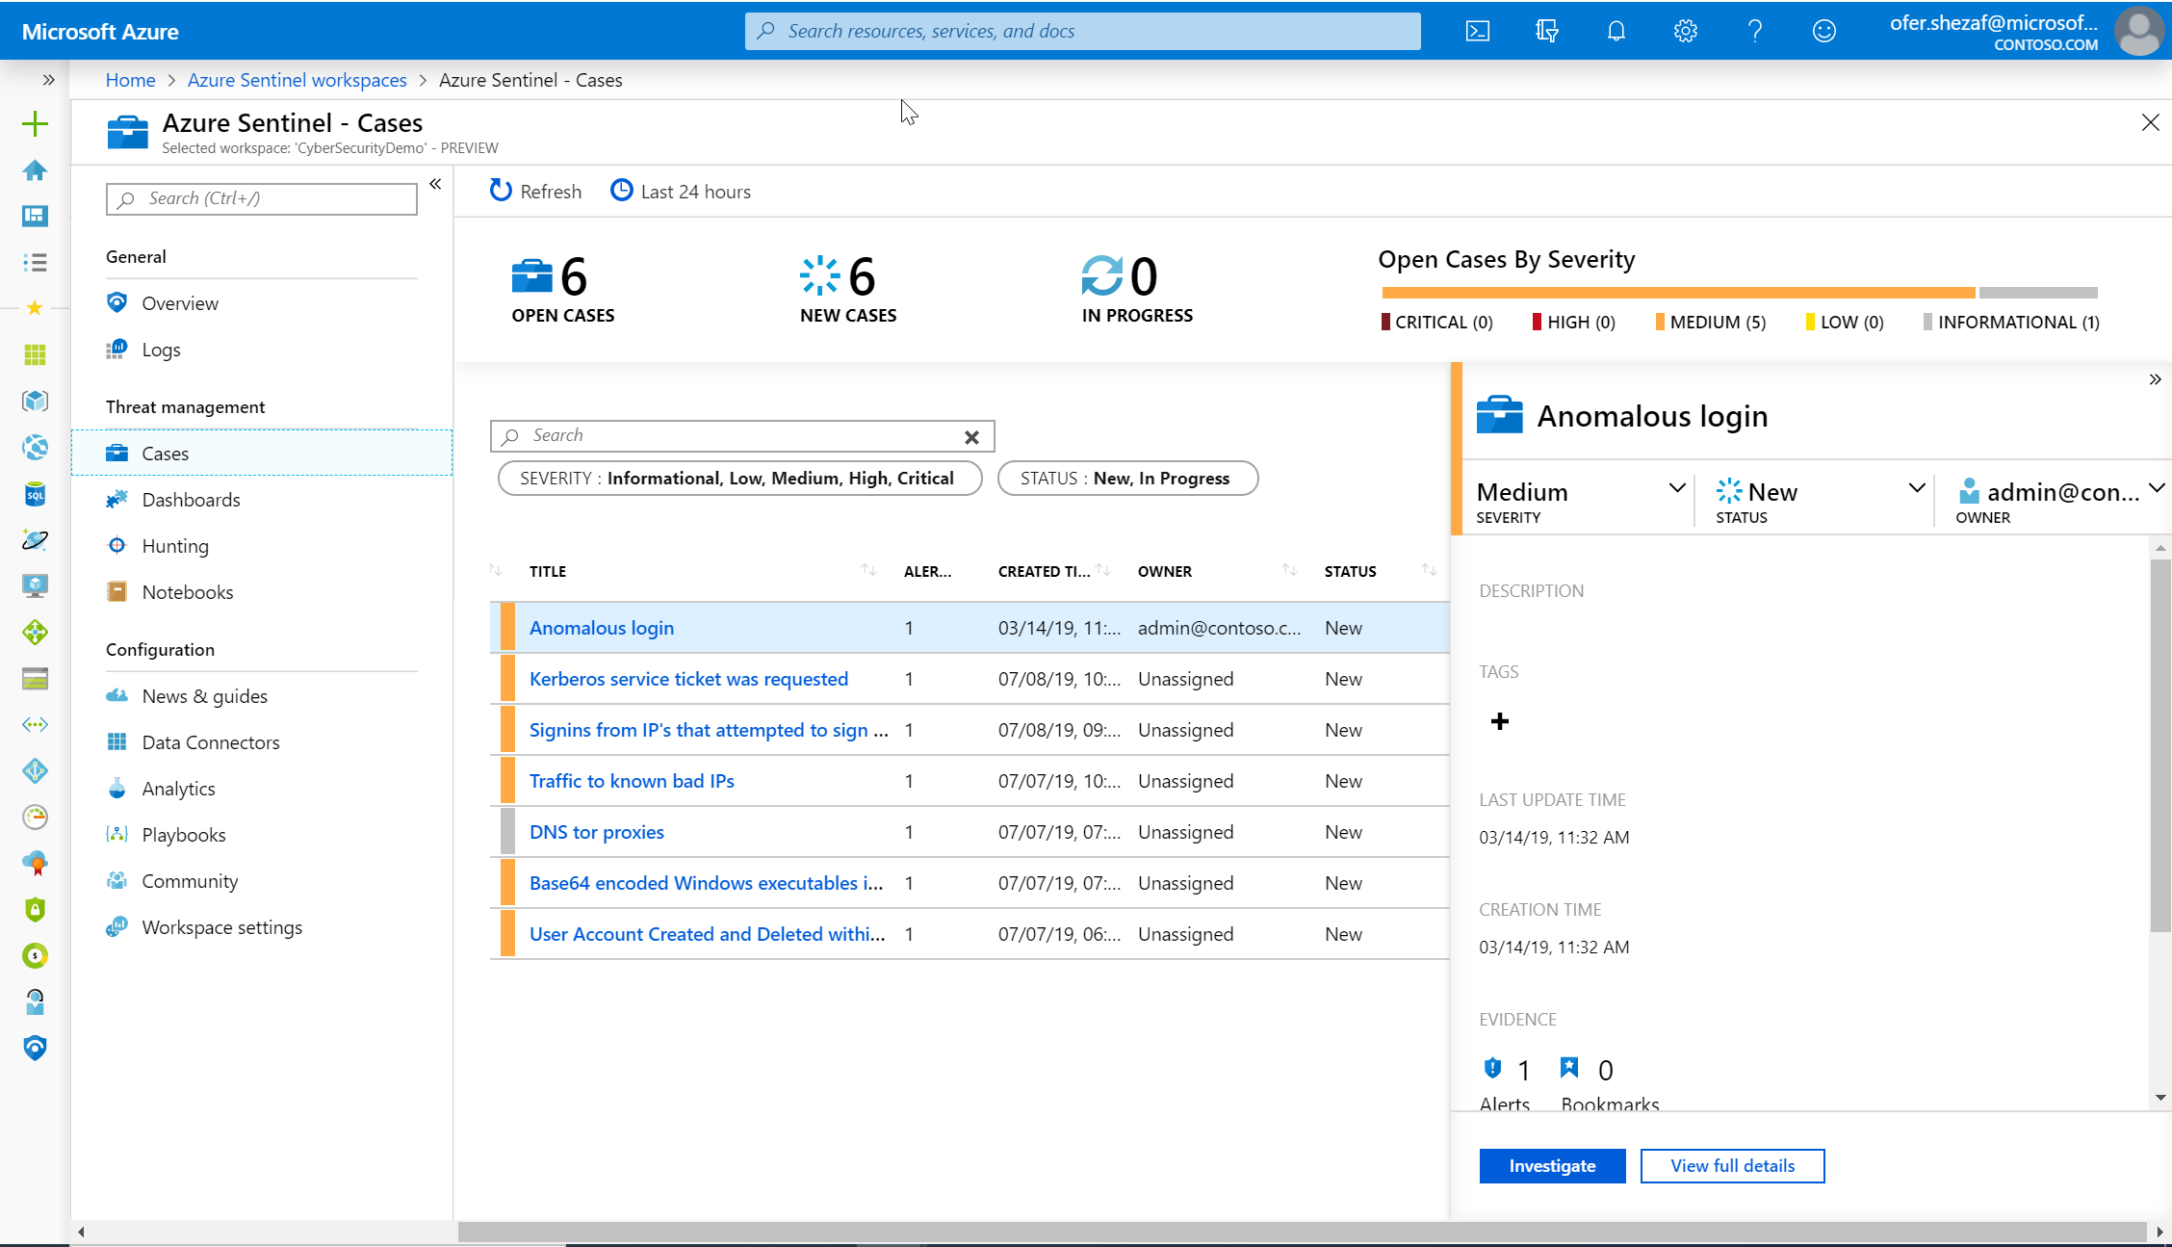



The Hybrid Model
Ticketing system/ MSSP portal
Data stays at the customer’s/subsidiary’s tenant
Central monitoring and management
The Azure Sentinel portal
Optional
Customer /
Subsidiary
Tenant
Customer /
Subsidiary
Tenant
Customer /
Subsidiary
Tenant
Azure Sentinel
Workspaces
Azure Sentinel
Workspaces
Azure Sentinel
Workspaces

Slide 22
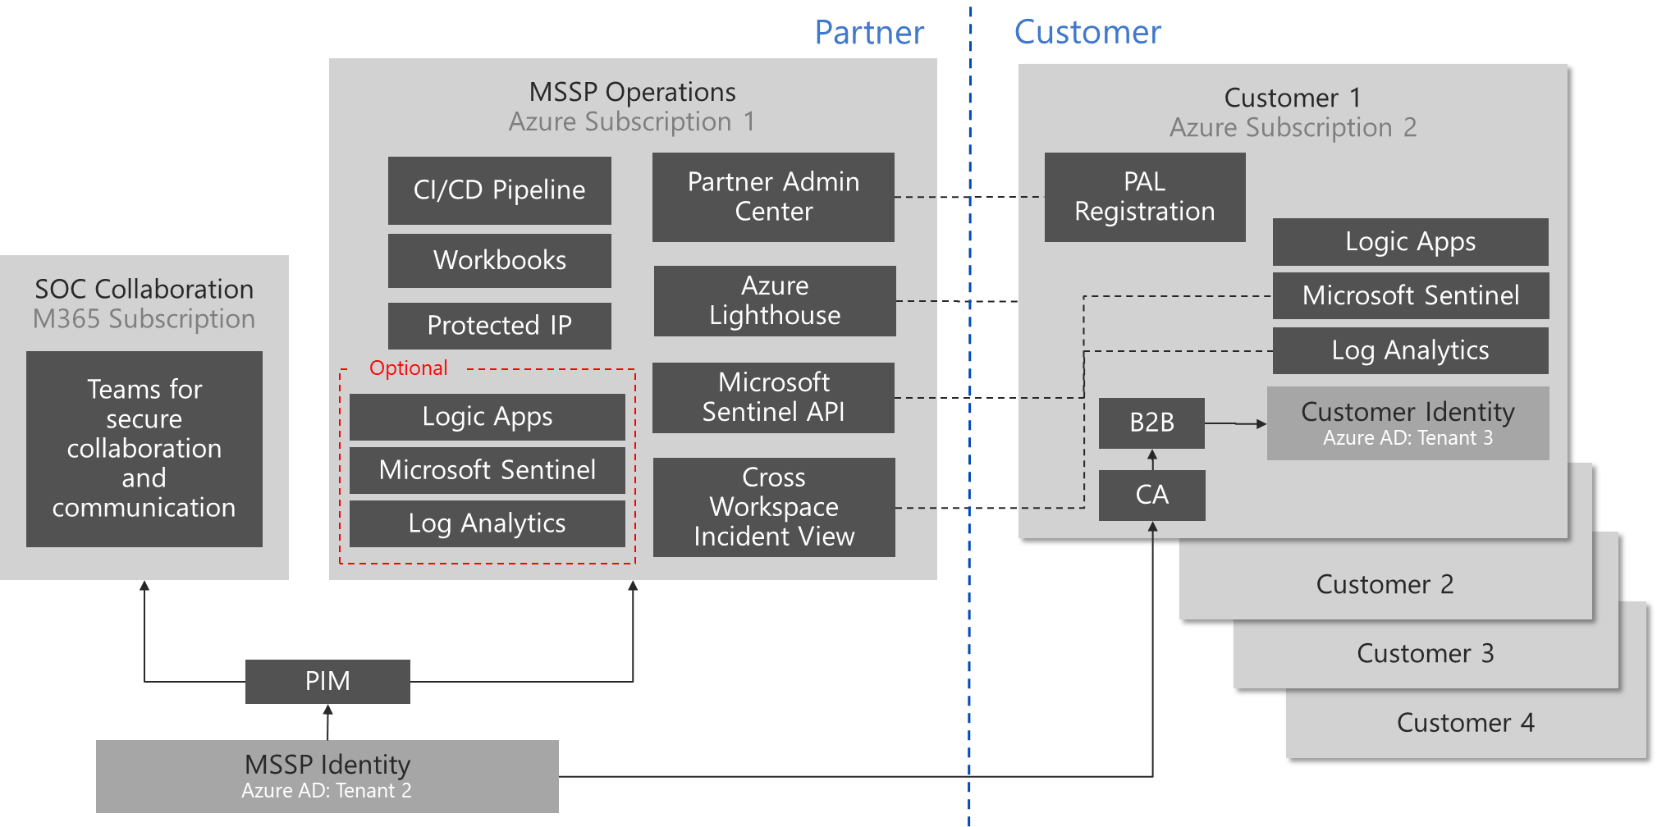
Microsoft Sentinel for MSSP
Reference Architecture
Syslog
Customer Data
On-premises
Customer Data
Azure Subscriptions
Customer Data
Office 365
Customer Data
Other Cloud Services

Slide 23
SOC Architecture for MSSP
MSSP Technologies
Partner SOC Architecture
Customer Tenants
Partner IT Architecture
SOC Collaboration
M365 Subscription
MSSP SOC Operations
Azure Subscription 1
ServiceNOW
SaaS Subscription
Customer 1
Azure Subscription
Analysts
and Hunters
PAW (Physical device)
Azure Lighthouse
Case Management
Microsoft Sentinel
SecOps (optional)
SOC Identity
Azure AD for IAM (passwordless)
Jupyter Notebooks
Identity & Access Management
Teams for secure
SOC communications
Alert management
Subscription and resources
Cross workspace Incidents
Alert forwarding to MSSP SOC
PowerBI
Internal & Customer Reporting
Analytics Rule
Ticketing integration
Workbooks
Security protection enablement
Logic Apps
Partner Internal IT
Corporate Tenants
& Subscriptions…
Cross-tenant search
Data retention / warehouse
Azure KeyVault
Security Posture Management
Corporate Office 365
(email + collaboration)
Azure DevOps + Github
(CI/CD Pipeline)
Vulnerability & Risk Assessments
Incident Response
Company Identity
Red/Blue Team Exercises
DEV / TEST
Azure Subscription 2
SALES DEMO
Azure Subscription 3
Windows Virtual Desktop
Exec / Employee Training
Microsoft Sentinel
Microsoft Sentinel
Insider Risk Management
Microsoft 365 E5
Microsoft 365 E5
Data Loss Prevention

Slide 24
MSSP billing options
CSP (Cloud Solution Provider)
  Partner pays for the subscription (15% discount) and invoices the customer, similar to traditional reselling
  Works as long as the customer does not have an EA (Enterprise agreement)
  If customer has an EA, partner will be registered under DPOR
DPOR (Digital partner of record)
  Partners can qualify for competencies and incentives
  Complementary to charging on your service

