Slide 1
Microsoft Identity Governance (IGA)
Angelica Faber

Slide 2
Agenda
Entitlements Management & Access Reviews w/Demo
Lifecycle Workflows (Preview) w/Demo
PIM w/Demo

Slide 3



What is Microsoft Entra Identity Governance?
Onboarding / Provisioning
01
02
Who has/should have access to which resources?
What are they doing with that access?
Access Lifecycle Management
Access Recertification
Identity
03
04
Are there effective organizational controls for managing access?
Can auditors verify that the controls are working?
Secure privileged access for administration

Slide 4
Identity Governance: Entitlement Management & Access Reviews

Slide 5
Secure your organization with Zero Trust
A modern security framework with identity as its foundation
Verify explicitly | Use least-privileged access | Assume breach
Data
Zero Trust
policy
Identities
Apps
Infrastructure
Context Control
Endpoints
Network
Visibility | Analytics | Automation

Slide 6


Identity Governance
The right controls that ensure secure productivity
Who has / should have access
to which resources?
What are they doing
with that access?
Are there effective organizational controls for managing access?
Can auditors verify that
the controls are working?
Identity Governance
Security
The right people have the right access to resources
Productivity
Timely access to the right resources

Slide 7








Identity & Access Lifecycle
Joiners – Movers - Leavers
User Location / Department Change
Target Applications & Services
New
Hire
Source of Truth
Azure AD
User
Termination
User Promotion
User
Resignation
(Effective dated)

Slide 8

Entitlement Management
Automate access request workflows, access assignments, reviews and expiration
User onboarded
Manage Office 365 groups, Teams, SharePoint Online sites, and Enterprise Applications.
Delegate access to non-admins using catalogs
Access packages with expiration dates and approvals ensure that access to resources are time-limited and appropriate
Easy user experiences for employees and business partners to request access
Self-service policy and workflow definition by app, group or site owners
Multi-stage approval workflow and recurring access reviews
Job changes
Ongoing auditing
& reporting
Access reviewed & revised
Requests
additional
access
Access rights provisioned

Slide 9
Access Reviews
Validation of access for apps and groups, remove excessive access, block guest access, and delete accounts.
Access review controls to track reviews for compliance or risk-sensitive applications specific to your organization
Use the insights to efficiently decide whether guests should have continued access
Configure frequency and action policies to automate the re-certification process
Schedule recurring access reviews and have decisions automatically applied after the review completes
Set policies for group lifecycle
Report status
to admin
Request sent to
users and resource
owners
Access
Reviews
Remove stale
memberships
Review current
memberships
Confirm which
memberships to keep

Slide 10
Reviewer receives email notification
Reviewer logs in to review
Access Reviews - Sample
Approval Decision
Denied
Approved
No Response
Reminders sent to reviewers
No Response
Access Review Period Ends
Access Review Period Ends
Access Review Period Ends
Role/Group Assignment is removed
Role/Group Assignment remains
Optional

Slide 11
Demo

Slide 12
Identity Governance: Lifecycle Workflows

Slide 13
Identity Governance
Lifecycle Workflows
Slide should introduce lifecycle workflows feature
Create user account
(status: disabled)
Launch custom Logic Apps workflow
Send email to hiring manager with TAP
Send welcome email to
new hire
Group assignments
Send email to onboarding DL
Generate Temporary Access Pass (TAP)
Start date
Enable user account
Add user to Teams
“New Hires” channel

Slide 14
Lifecycle Workflows: Scenario Delivery
Joiner
Leaver
Mover
New Employee
Terminations
Job changes

Slide 15
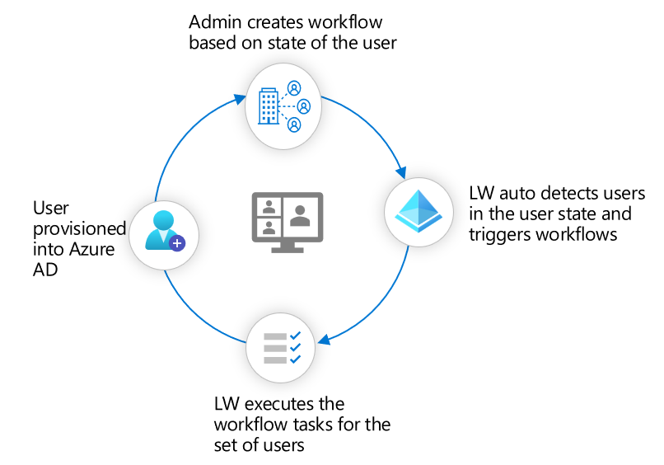
Lifecycle Workflows: How it works
IT admins can manage workflows after users provisioned into Azure AD

Slide 16
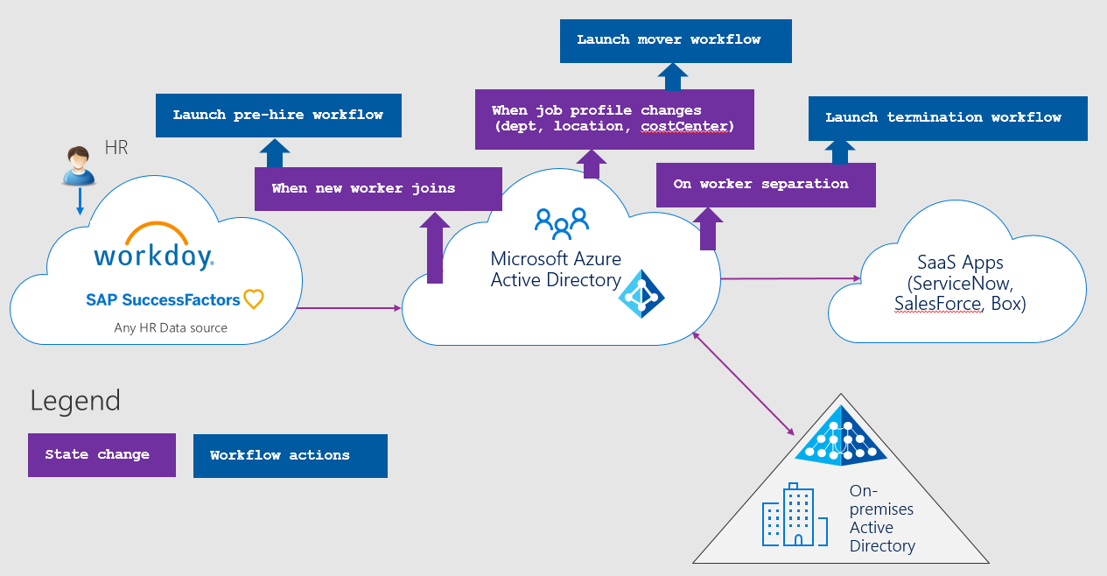
Add title for persons using screen readers
Lifecycle Workflows Overview

Slide 17
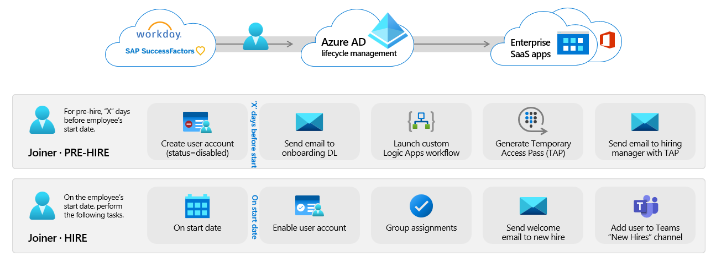
Current Capabilities
Public Preview – Joiner scenario
Now, admins can configure workflows in Azure AD to automate onboarding tasks, so new employees are productive on day one.
New MS Graph APIs for managing workflows and tasks
Customizable workflow templates for most common Joiner tasks
Support for automatic scheduled runs or manual on demand runs for selected users
Workflow versioning support and status reporting for compliance and auditing
Basic extensibility with Logic Apps and M365 Teams integration

Slide 18
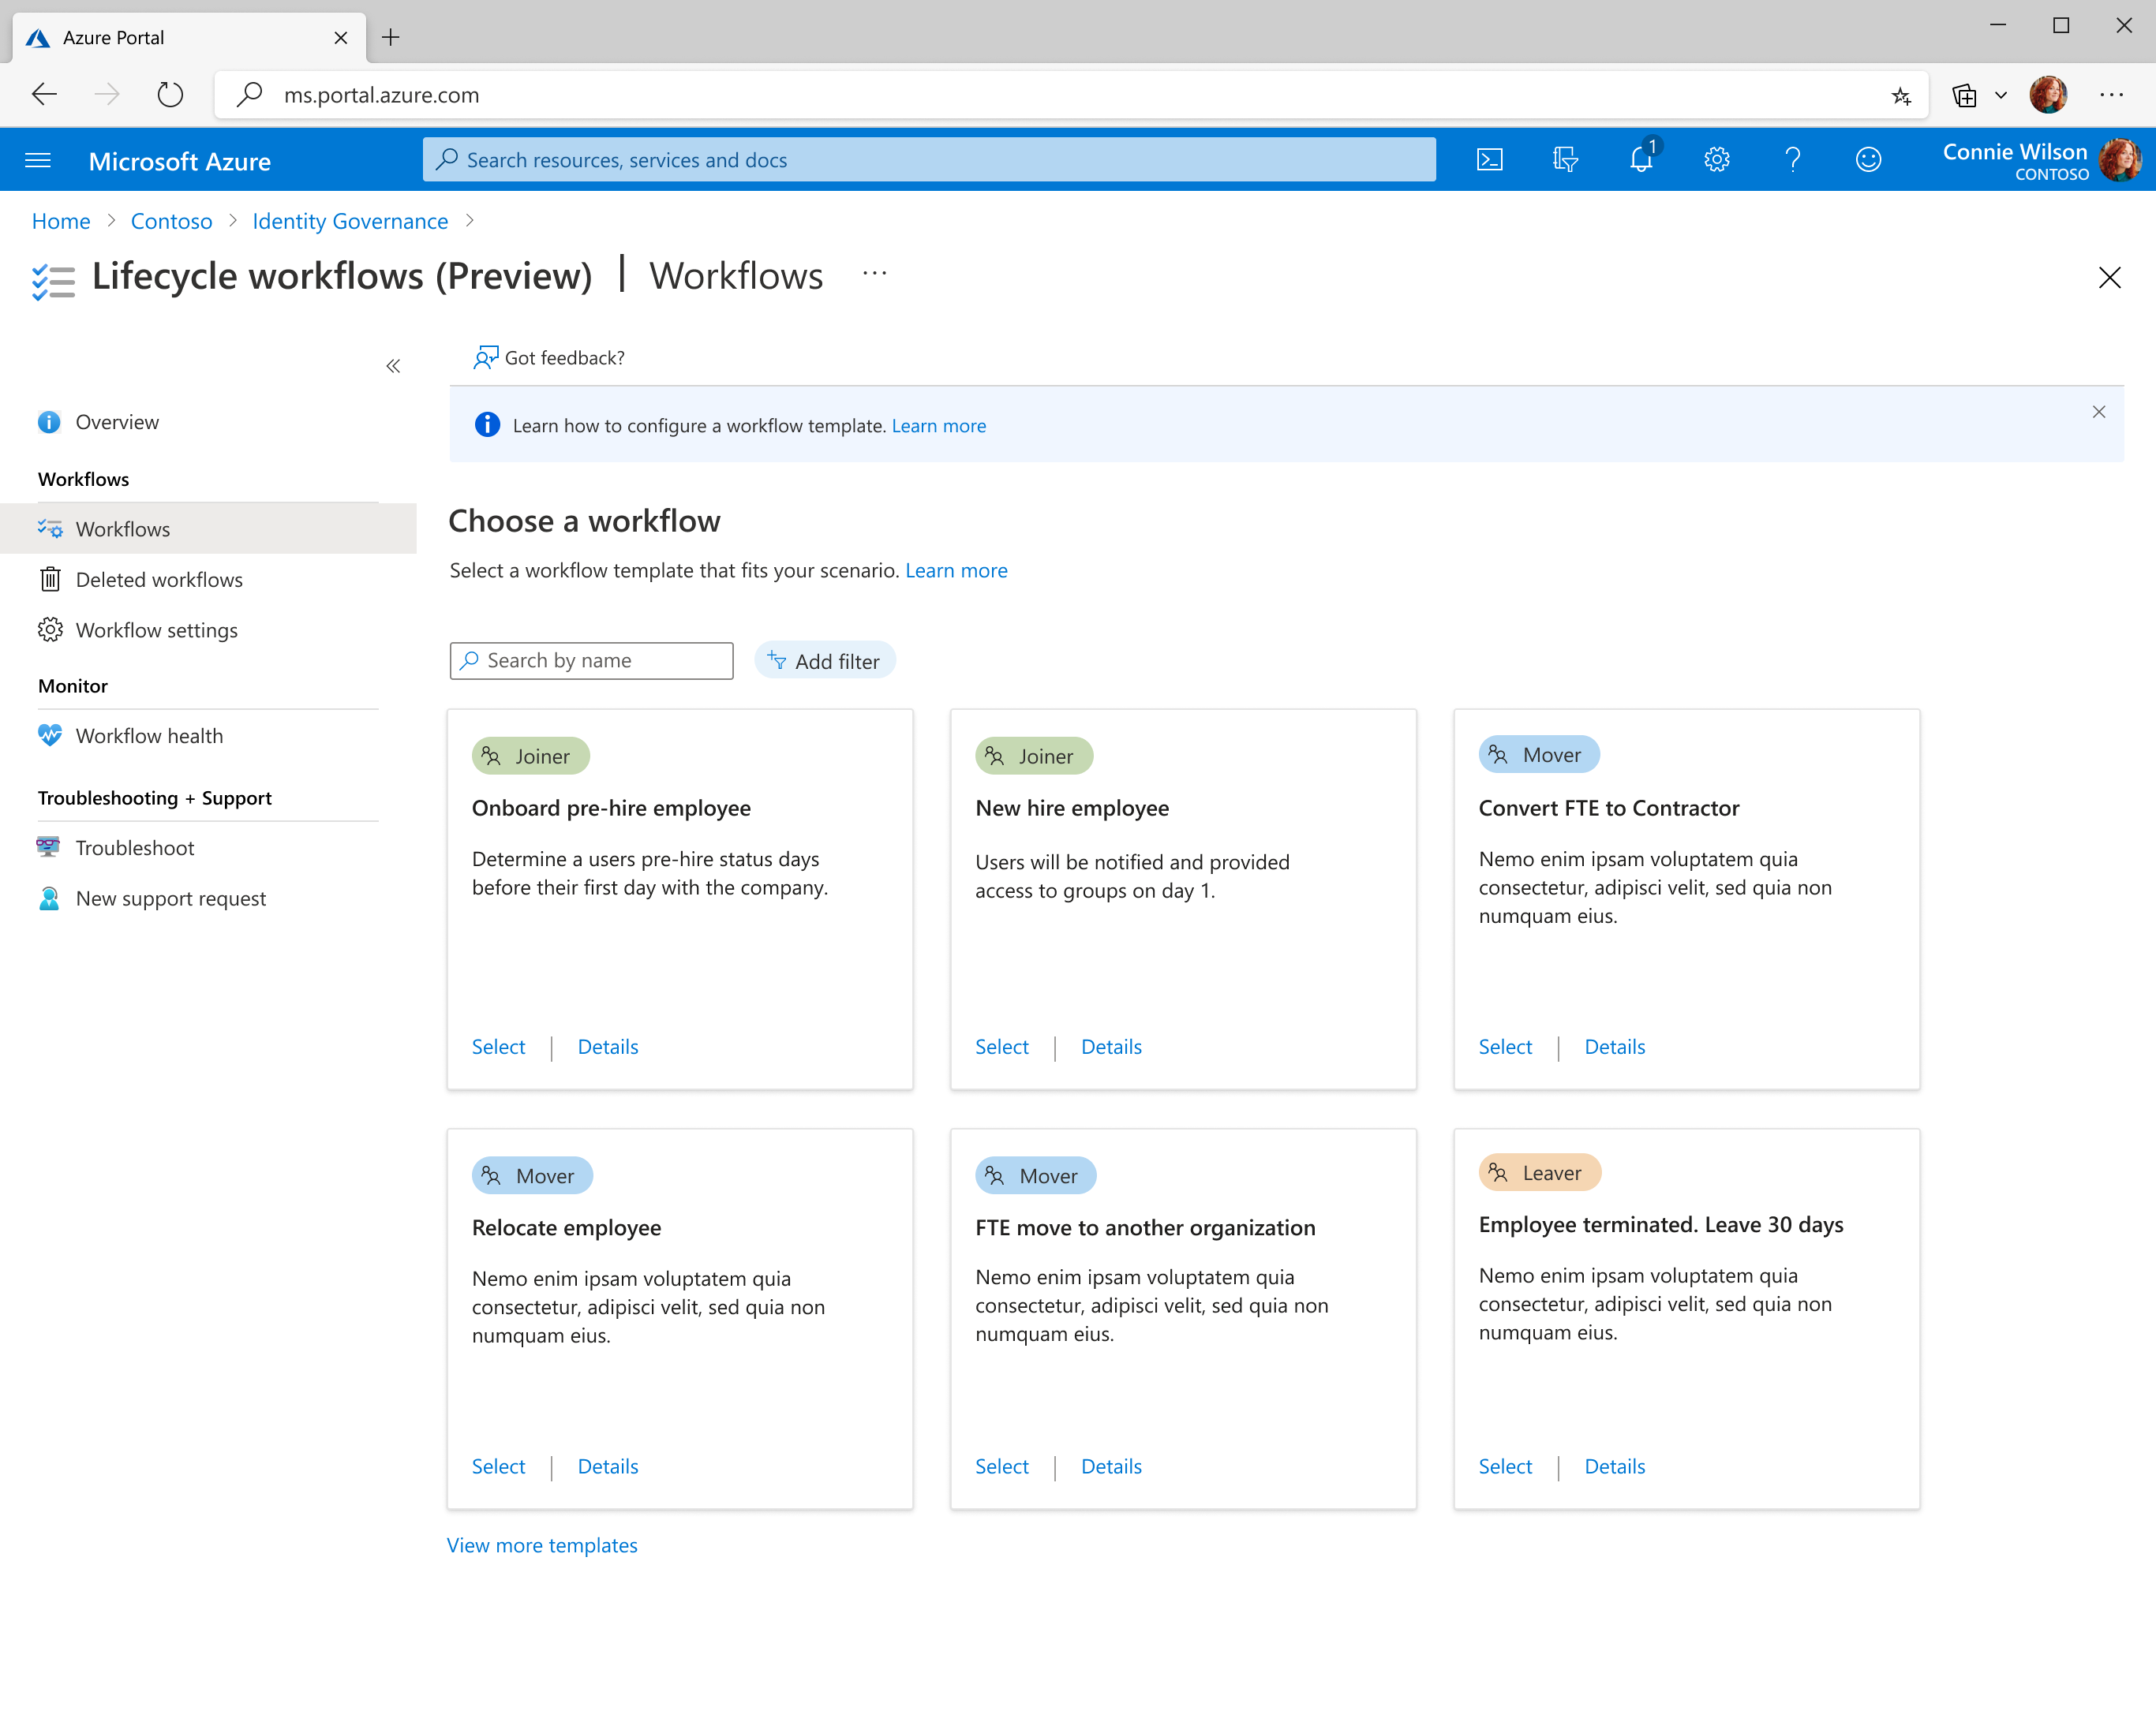
Other Capabilities
Public Preview – Joiner + Leaver scenarios
Delegated management via new Azure portal UI and Lifecycle Workflows admin role
Customizable workflow templates for most common Leaver termination tasks
Custom workflow schedule options
Rich workflow status reporting and audit logs
Expanded extensibility with Logic Apps parameters and call backs

Slide 19
Demo

Slide 20
Identity Governance: Privileged Identity Management

Slide 21

Privileged Identity Management
Management and auditing of admin roles across Azure and Office 365 services
See which users are assigned privileged roles.
Enable on-demand, "just in time" administrative access.
Set up approval flows for privilege activation.
Get alerts and view a history of administrator activation and actions.
Review administrative roles and require users to provide justification to retain membership.
Manage built-in Azure resource roles,
as well as custom (RBAC) roles.
Contoso Expenses App Moderator
Intune Role Administrator
DevTest Labs User
Security Reader
Virtual Machine User Login

Slide 22



Key Capabilities
Just-in-time
privileged access to Azure AD and Azure resources
Time-bound
access to resources using start and end dates
Approval
to activate privileged roles
Enforce MFA
to activate any role
Justification
to understand why users activate privileged role
Notification
when privileged roles are activated
Access reviews
to ensure users still need privileged roles
Audit history
Internal and external audit for regulations and standard compliance

Slide 23

How It Works?
Users need to activate their privileges to perform a task
SECURITY ADMIN
Multi-factor authentication (MFA) is enforced during the activation process
ALERT
Alerts inform administrators about out-of-band changes
Configure privileged
identity management
Users retain their privileges for a pre-configured amount of time
Identity
verification
ADMIN PROFILES
Monitor
Billing admin
Security admins can discover all privileged identities, view audit reports, and review everyone who is eligible to activate using access reviews
Global admin
Audit
USER
MFA
Read only
Service admin
Access reports
PRIVILEGED IDENTITY MANAGEMENT

Slide 24
Demo

Slide 25
Thank you!!

Slide 26












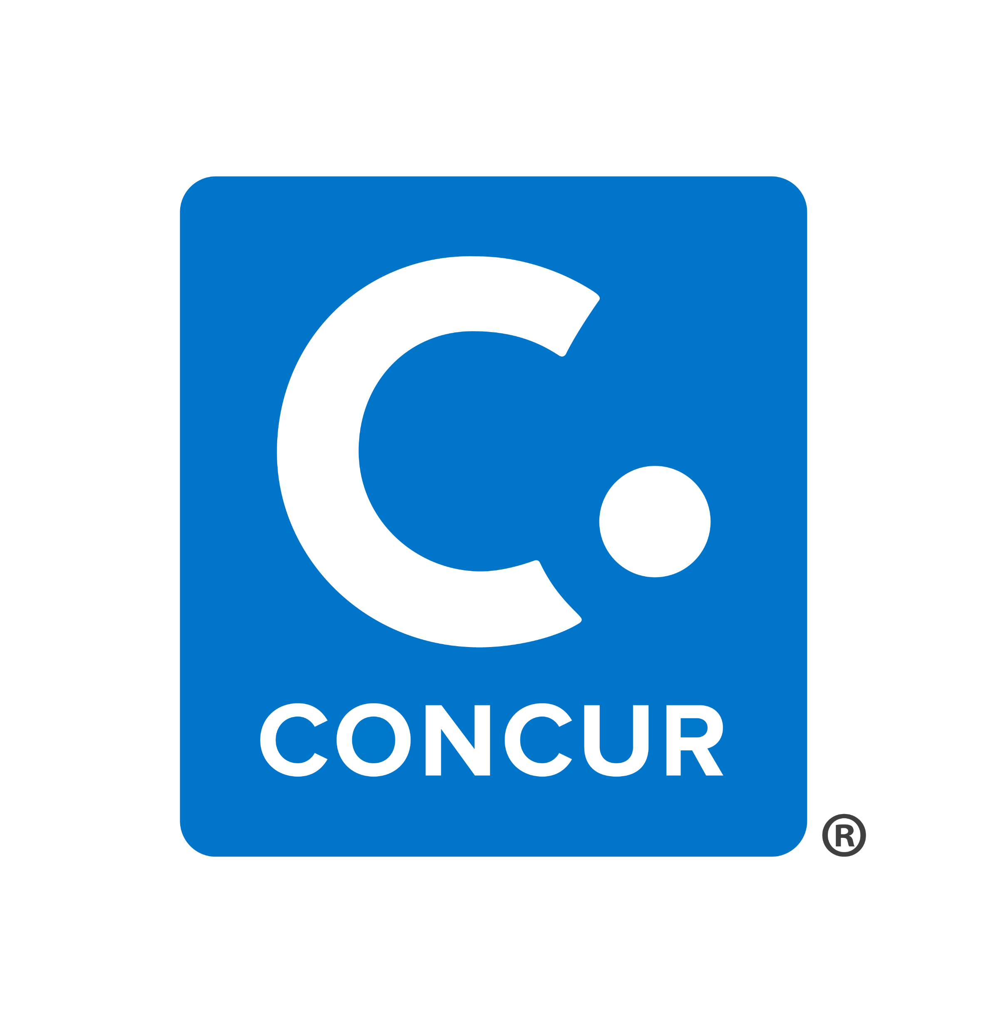






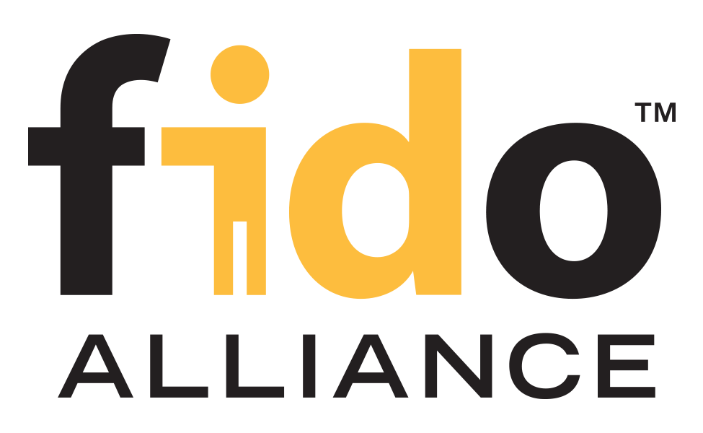


























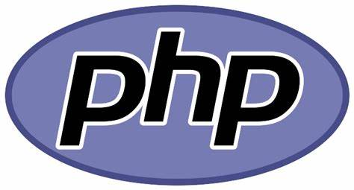

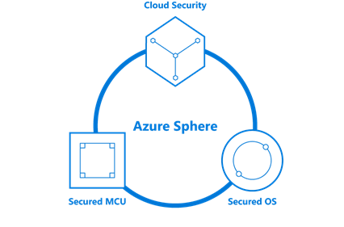










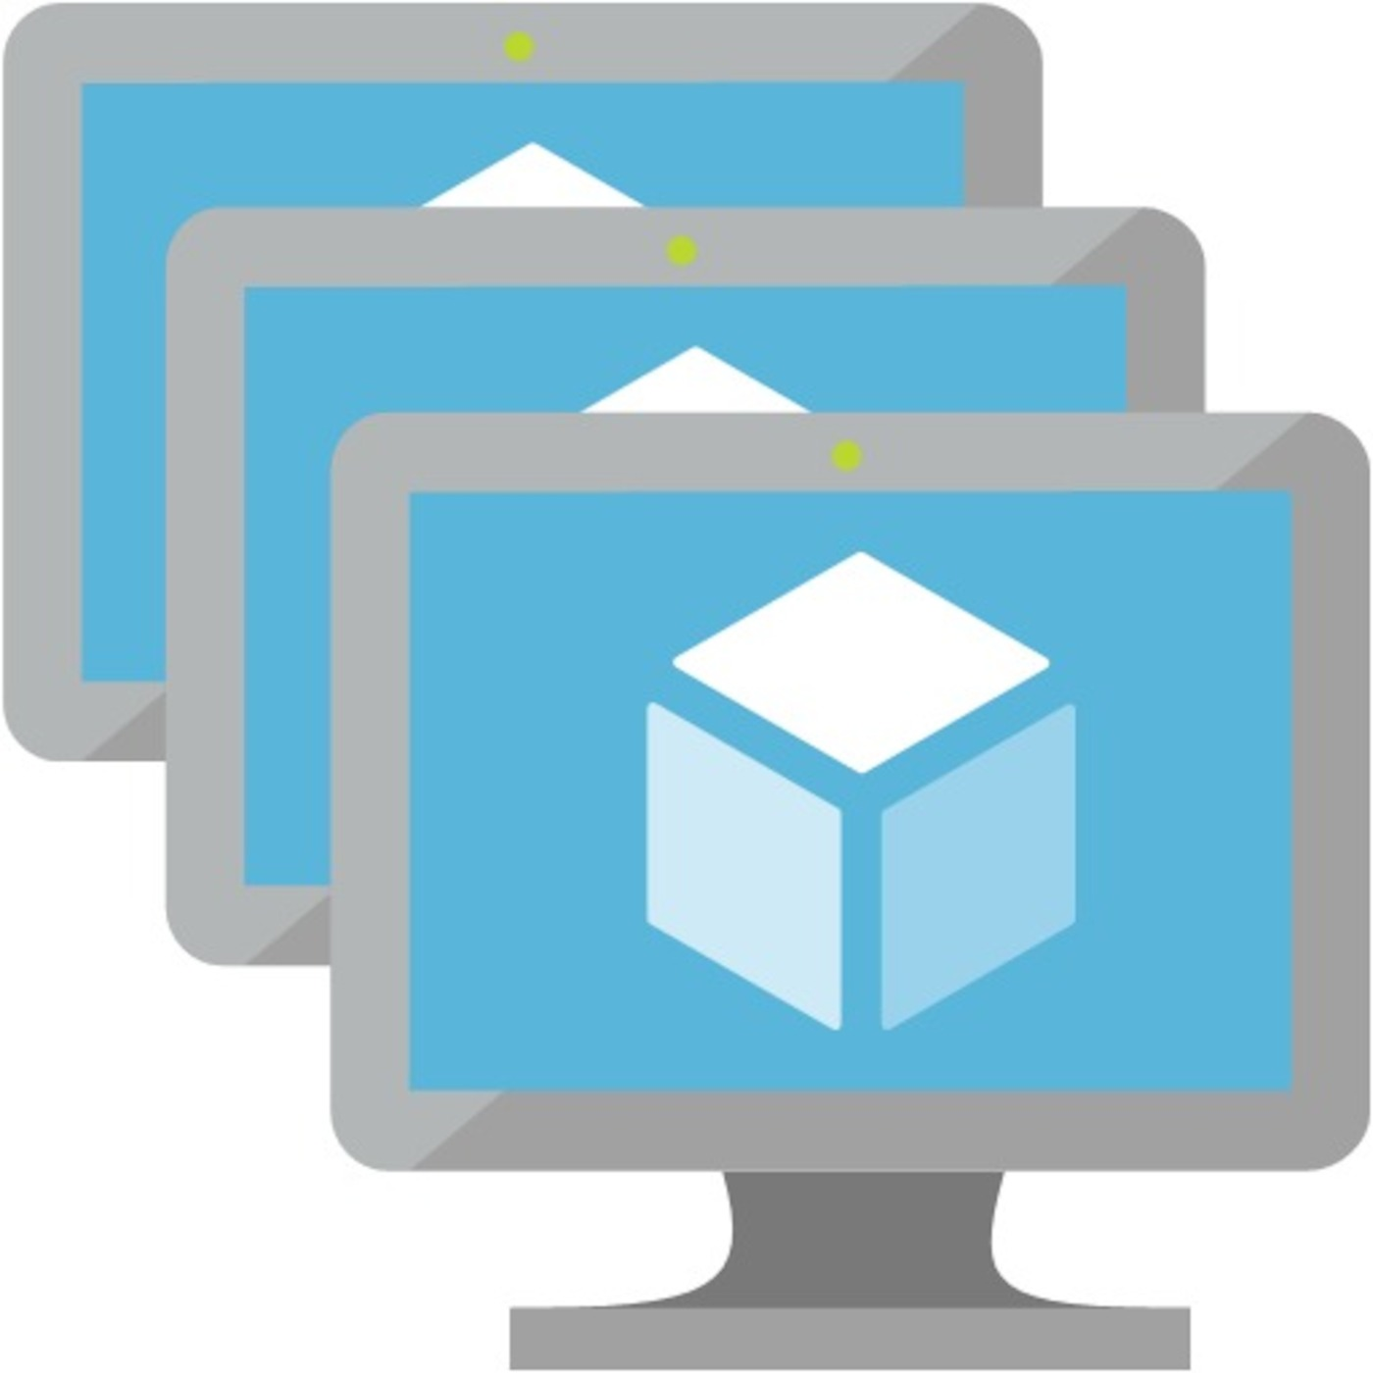



Security Operations / SOC
Software as a Service (SaaS)
Threat Experts
Detection and Response Team (DART)
MSSP/MDR
Cybersecurity Reference Architecture
Security modernization with Zero Trust Principles
December 2021 – https://aka.ms/MCRA
Microsoft Defender for Cloud Apps
App Discovery & Risk Scoring (Shadow IT)
Threat Detection & Response
Policy Audit & Enforcement
Session monitoring & control
Information Protection &
Data Loss Prevention (DLP)
Microsoft Sentinel – Cloud Native SIEM, SOAR, and UEBA for IT, OT, and IoT
Cloud
Azure, AWS, GCP, On Premises & other 3rd party clouds
Endpoint
& Server/VM
Office 365
Email and Apps
Identity
Cloud &
On-Premises
SaaS
Cloud Apps
+ More
OT, IoT, SQL, and more
Other Tools, Logs, & Data Sources
Microsoft Defender – Extended Detection and Response (XDR)
Threat & Vulnerability Management
Integrated data classification
Threat analytics on top attacks
Advanced Detection & Remediation | Automated Investigation & Remediation | Advanced Threat Hunting
This is interactive!
Present Slide
Hover for Description
Click for more information
Security Guidance
Security Documentation
Microsoft Best Practices
Azure Security Top 10 |
Benchmarks | CAF | WAF
This is interactive!
Present Slide
Hover for Description
Click for more information
Identity & Access
Conditional Access – Zero Trust Access Control decisions based on explicit validation of user trust and endpoint integrity
Endpoints & Devices
Hybrid Infrastructure – IaaS, PaaS, On-Premises
Information Protection
Azure Active Directory
Microsoft Endpoint Manager
Unified Endpoint Management (UEM)
Defender for Cloud – Cross-Platform Cloud Security Posture Management (CSPM)
Azure Purview
Passwordless & MFA
Secure Score
Microsoft Azure
Compliance Dashboard
Microsoft Information Protection (MIP)
Hello for Business
Intune
Configuration Manager
On Premises Datacenter(s)
3rd party IaaS & PaaS
Discover
Protect
Authenticator App
Azure Marketplace
Azure Firewall
& Firewall Manager
Monitor
Classify
FIDO2 Keys
NGFW
Classification Labels
Identity Protection
Leaked cred protection
Behavioral Analytics
Extranet
Edge DLP
Azure WAF
File Scanner
(on-premises and cloud)
IPS/IDS
DDoS Protection
Azure AD PIM
Microsoft Defender for Endpoint
Unified Endpoint Security
Azure AD App Proxy
Beyond User VPN
Proxy
Express Route
Azure Key Vault
Endpoint Detection & Response (EDR)
S3
Identity Governance
Private Link
Azure Bastion
Data Governance
Azure AD B2B & B2C
Web Content Filtering
Azure Arc
Threat & Vuln Management
Intranet
Azure Lighthouse
Advanced eDiscovery
Defender for Identity
Endpoint Data Loss Protection (DLP)
Azure Stack
Azure Backup
Active Directory
Security & Other Services
Compliance Manager
Securing Privileged Access – Secure Accounts, Devices, Intermediaries, and interfaces to enable and protect privileged users
Privileged Access Workstations (PAWs) - Secure workstations for administrators, developers, and other sensitive users
Microsoft Compliance Score – Prioritize, measure, and plan improvement actions against controls
Microsoft Secure Score – Measure your security posture, and plan/prioritize rapid improvement with included guidance
Windows 10 & 11 Security
IoT and Operational Technology (OT)
Defender for Cloud – Cross-Platform, Cross-Cloud XDR
Multi-asset detection and response for infrastructure and
platform as a service (IaaS & PaaS), Proactive Threat defenses
People Security
App control
Exploit protection
Behavior monitoring
Next-generation
protection
Network protection
Credential protection
Full Disk Encryption
Attack surface
reduction
Azure Sphere
Microsoft Defender for IoT
Attack Simulator
Insider Risk Management
Communication Compliance
ICS, SCADA, OT
Internet of Things (IoT)
Industrial IoT (IIoT)
Asset & Vulnerability management
Threat Detection
& Response
GitHub Advanced Security – Secure development and software supply chain
Threat Intelligence – 8+ Trillion signals per day of security context
Service Trust Portal – How Microsoft secures cloud services
Security Development Lifecycle (SDL)

Slide 27
Security Operations / SOC
Software as a Service (SaaS)
Threat Experts
Detection and Response Team (DART)
MSSP/MDR
Cybersecurity Reference Architecture
Security modernization with Zero Trust Principles
December 2021 – https://aka.ms/MCRA
Microsoft Defender for Cloud Apps
App Discovery & Risk Scoring (Shadow IT)
Threat Detection & Response
Policy Audit & Enforcement
Session monitoring & control
Information Protection &
Data Loss Prevention (DLP)
Microsoft Sentinel – Cloud Native SIEM, SOAR, and UEBA for IT, OT, and IoT
Cloud
Azure, AWS, GCP, On Premises & other 3rd party clouds
Endpoint
& Server/VM
Office 365
Email and Apps
Identity
Cloud &
On-Premises
SaaS
Cloud Apps
+ More
OT, IoT, SQL, and more
Other Tools, Logs, & Data Sources
Microsoft Defender – Extended Detection and Response (XDR)
Threat & Vulnerability Management
Integrated data classification
Threat analytics on top attacks
Advanced Detection & Remediation | Automated Investigation & Remediation | Advanced Threat Hunting
This is interactive!
Present Slide
Hover for Description
Click for more information
Security Guidance
Security Documentation
Microsoft Best Practices
Azure Security Top 10 |
Benchmarks | CAF | WAF
This is interactive!
Present Slide
Hover for Description
Click for more information
Identity & Access
Conditional Access – Zero Trust Access Control decisions based on explicit validation of user trust and endpoint integrity
Endpoints & Devices
Hybrid Infrastructure – IaaS, PaaS, On-Premises
Information Protection
Azure Active Directory
Microsoft Endpoint Manager
Unified Endpoint Management (UEM)
Defender for Cloud – Cross-Platform Cloud Security Posture Management (CSPM)
Azure Purview
Passwordless & MFA
Secure Score
Microsoft Azure
Compliance Dashboard
Microsoft Information Protection (MIP)
Hello for Business
Intune
Configuration Manager
On Premises Datacenter(s)
3rd party IaaS & PaaS
Discover
Protect
Authenticator App
Azure Marketplace
Azure Firewall
& Firewall Manager
Monitor
Classify
FIDO2 Keys
NGFW
Classification Labels
Identity Protection
Leaked cred protection
Behavioral Analytics
Extranet
Edge DLP
Azure WAF
File Scanner
(on-premises and cloud)
IPS/IDS
DDoS Protection
Azure AD PIM
Microsoft Defender for Endpoint
Unified Endpoint Security
Azure AD App Proxy
Beyond User VPN
Proxy
Express Route
Azure Key Vault
Endpoint Detection & Response (EDR)
S3
Identity Governance
Private Link
Azure Bastion
Data Governance
Azure AD B2B & B2C
Web Content Filtering
Azure Arc
Threat & Vuln Management
Intranet
Azure Lighthouse
Advanced eDiscovery
Defender for Identity
Endpoint Data Loss Protection (DLP)
Azure Stack
Azure Backup
Active Directory
Security & Other Services
Compliance Manager
Securing Privileged Access – Secure Accounts, Devices, Intermediaries, and interfaces to enable and protect privileged users
Privileged Access Workstations (PAWs) - Secure workstations for administrators, developers, and other sensitive users
Microsoft Compliance Score – Prioritize, measure, and plan improvement actions against controls
Microsoft Secure Score – Measure your security posture, and plan/prioritize rapid improvement with included guidance
Windows 10 & 11 Security
IoT and Operational Technology (OT)
Defender for Cloud – Cross-Platform, Cross-Cloud XDR
Multi-asset detection and response for infrastructure and
platform as a service (IaaS & PaaS), Proactive Threat defenses
People Security
App control
Exploit protection
Behavior monitoring
Next-generation
protection
Network protection
Credential protection
Full Disk Encryption
Attack surface
reduction
Azure Sphere
Microsoft Defender for IoT
Attack Simulator
Insider Risk Management
Communication Compliance
ICS, SCADA, OT
Internet of Things (IoT)
Industrial IoT (IIoT)
Asset & Vulnerability management
Threat Detection
& Response
GitHub Advanced Security – Secure development and software supply chain
Threat Intelligence – 8+ Trillion signals per day of security context
Service Trust Portal – How Microsoft secures cloud services
Security Development Lifecycle (SDL)

Slide 28


Defend across attack chains
Insider and external threats
December 2021 – https://aka.ms/MCRA
Defender for
Office 365
Defender for IoT (& OT)
Azure AD
Identity Protection
Defender for
Cloud Apps
IoT Device Exploitation
Disrupt OT Environment
Phishing
mail
Open attachment
Brute force account or use stolen account credentials
Attacker accesses sensitive data
Exfiltration of data
Defender for Endpoint
Defender for
Identity
Exploitation
and Installation
Command
and Control
Attacker collects
reconnaissance & configuration data
Domain compromised
Click a URL
User account is compromised
Browse
a website
Microsoft Defender for Cloud
Attacker attempts lateral movement
Privileged account compromised
Microsoft Sentinel
EXTERNAL THREATS
Leading
indicators
Insider risk
management
History of violations
INSIDER RISKS
Data leakage
Distracted and careless
Disgruntled or disenchanted
Insider has access to sensitive data
Anomalous activity detected
Potential sabotage
Subject to stressors

Slide 29
ANIMATED SLIDE
Defend across attack chains
Insider and external threats
December 2021 – https://aka.ms/MCRA
Defender for
Office 365
Defender for IoT (& OT)
Azure AD
Identity Protection
Defender for
Cloud Apps
IoT Device Exploitation
Disrupt OT Environment
Phishing
mail
Open attachment
Brute force account or use stolen account credentials
Attacker accesses sensitive data
Exfiltration of data
Defender for Endpoint
Defender for
Identity
Exploitation
and Installation
Command
and Control
Attacker collects
reconnaissance & configuration data
Domain compromised
Click a URL
User account is compromised
Browse
a website
Microsoft Defender for Cloud
Attacker attempts lateral movement
Privileged account compromised
Microsoft Sentinel
EXTERNAL THREATS
Leading
indicators
Insider risk
management
History of violations
INSIDER RISKS
Data leakage
Distracted and careless
Disgruntled or disenchanted
Insider has access to sensitive data
Anomalous activity detected
Potential sabotage
Subject to stressors

Slide 30
Workload Identities

Slide 31
What are workload identities?
Definition: A workload identity is an identity used by a software workload (such as an application, service, script, or container) to authenticate and access other services and resources.
In Azure Active Directory (Azure AD), workload identities are:
An application is an abstract entity, or template, defined by its application object.
A service principal is the local representation, or application instance, of a global application object in a specific tenant.
A managed identity is a special type of service principal that eliminates the need for developers to manage credentials. (System-assigned or User-Assigned)

Slide 32
How are workload identities used?
Here are some ways that workload identities in Azure AD are used:
An app that enables a web app to access Microsoft Graph based on admin or user consent. This access could be either on behalf of the user or on behalf of the application.
A managed identity used by a developer to provision their service with access to an Azure resource such as Azure Key Vault or Azure Storage.
A service principal used by a developer to enable a CI/CD pipeline to deploy a web app from GitHub to Azure App Service.

Slide 33
Application Type | Interactive Application (signed-in user) | Background Service or Daemon Process
Permission Type | Delegated Permissions | Application Permissions
Consent by | Users can consent to delegated permissions. Admins can consent to higher privileged permissions or permissions that apply to *all* users. | An admin must consent.
Effective Permissions
Delegated Permissions
User Assigned Permissions
Application Permissions
=
Effective Permissions
Effective Permissions
Permissions for MSIs are assigned via PowerShell (New-AzureADServiceAppRoleAssignment) or CLI, not the portal.

Slide 34
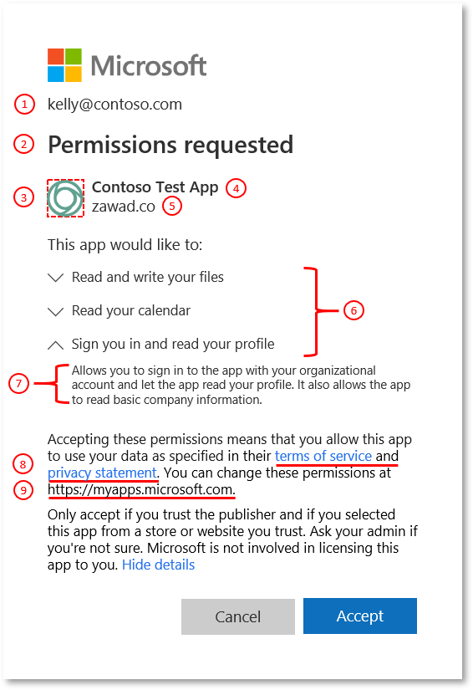
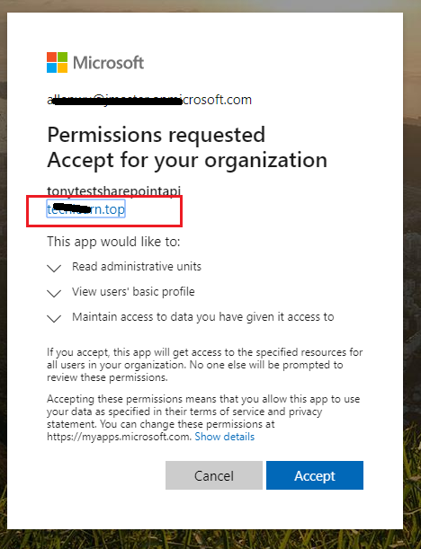

Slide 35
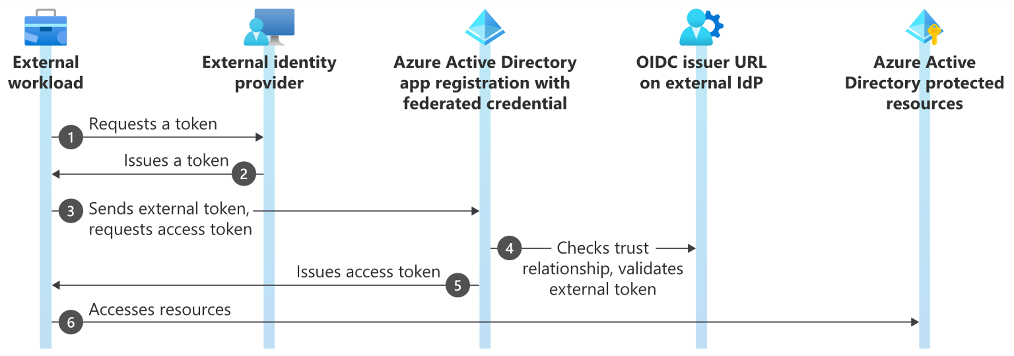
Workload Identity Federation
Allows you to access Azure Active Directory (Azure AD) protected resources without needing to manage secrets

Slide 36
Demo

Slide 37







AWS SSO
MyApps
AWS Management Account
Identity Governance
AWS Child Account
Azure Active Directory
App1 - AWS SSO
AWS SSO
Conditional Access
AWS Child Account

Slide 38
AWS Single Account
MyApps
AWS Management Account
Identity Governance
App1 – Mgmt. Account
AWS Child Account
Azure Active Directory
App2 – Child Account
Conditional Access
AWS Child Account
App3 – Child Account

