Slide 1
Maximizing Customer Success with Azure AI and Security Copilot: How to Prepare for Optimal Results
Zachary (Zach) Riffle, Rick Kotlarz, and Angelica Faber

Slide 2
Agenda
Introduction to AI/ML
What are Large Language Models (LLMs)?
Overview of ChatGPT and GPT models
Today's Threat Landscape
Overview of Security Copilot
Partner Opportunities
  Microsoft Sentinel Integration with OpenAI
  Microsoft Sentinel Integration with Azure OpenAI
  Additional Considerations
Updates to Azure OpenAI
Q&A

Slide 3
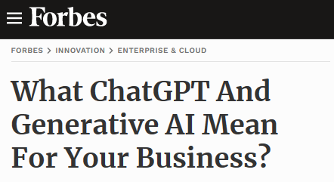
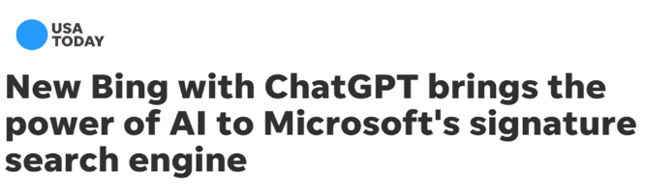
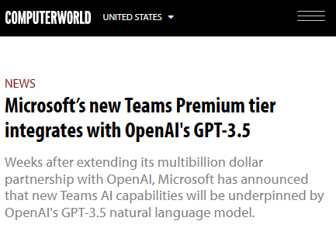
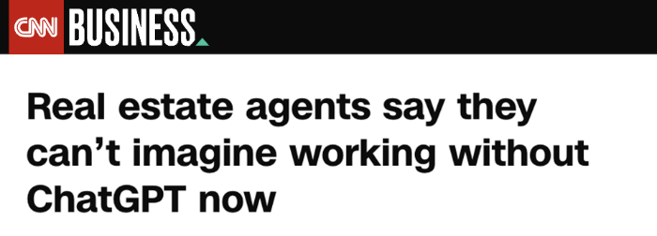
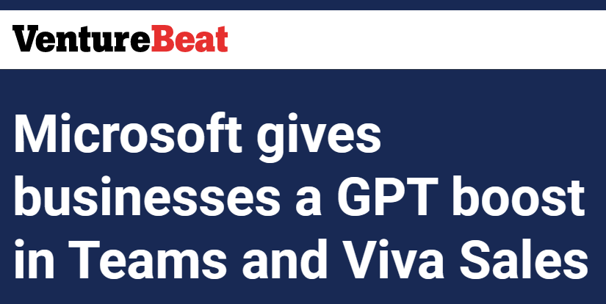
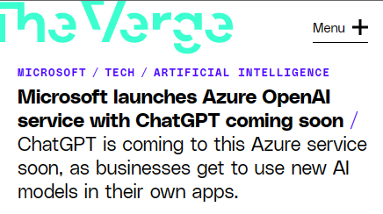
The AI technology is here

Slide 4
AI and ML
AI = Vision
ML = Actual / “Product”

Slide 5
History of AI
Artificial Intelligence
Artificial Intelligence
  The field of computer science that seeks to create intelligent machines that can replicate or exceed human intelligence
1956
Machine Learning
Machine Learning
  Subset of AI that enables machines to learn from existing data and improve upon that data to make decisions or predictions
1997
Deep Learning
Deep Learning
  A machine learning technique in which layers of neural networks are used to process data and make decisions
2017
Generative AI
Generative AI
  Create new written, visual, and auditory content given prompts or existing data
2021

Slide 6
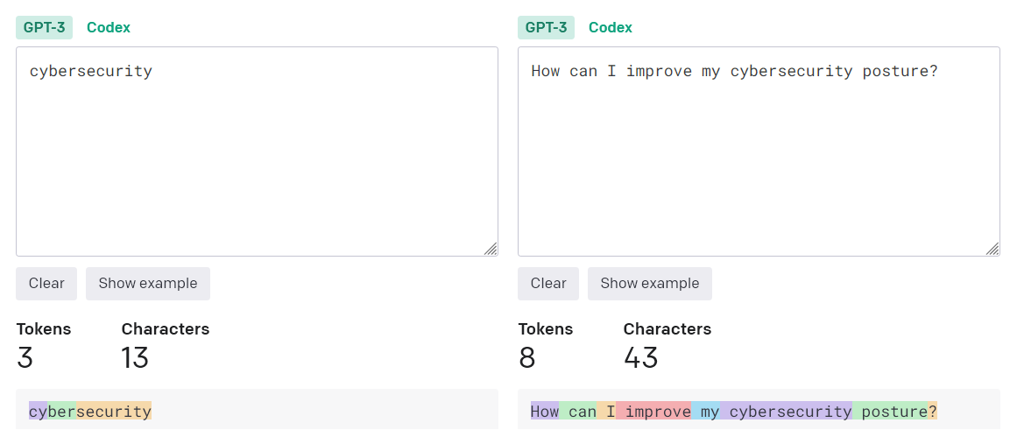
Vocabulary
Token (e.g., a character or word)
One token generally corresponds to ~4 characters of text (English)

Slide 7
Vocabulary
Model (e.g., patterns or relationships in your data)
Large Language Models (i.e., “language calculators”)
  Large: More data than can be manually labeled
  Language: Match context and words (e.g., word prediction, creative writing)
  Model: Semi-supervised learning

Slide 8
Vocabulary
Generative Pre-trained Transformer (GPT)
  Generative: Generates new content
  Pre-Trained: Trained on data before fine-tuning
  Transformer: Understands relationships b/w words
"Few-shot" learning
Reinforcement Learning from Human Feedback (RLHF)

Slide 9
Choosing a use case
Use cases to avoid
Not suitable for open-ended, unconstrained content generation.
Sending automated AI advice or generatively developed content directly to a decision-maker without human review.
Avoid scenarios where use or misuse of the system could result in significant physical or psychological injury to an individual.
Carefully consider use cases in high stakes domains or industry.
Use cases to evaluate
Start small and build from there. Azure OpenAI is an Azure Service that has both generative and non-generative capabilities.
Use cases involving text analysis, summarization, forms or content generation are the sweet spot.
Information discovery and
knowledge mining.

Slide 10
ChatGPT
Chat-GPT: AI Chatbot, developed by OpenAI, trained to perform conversational tasks and creative tasks
Backed by GPT-3.5 model (gpt-35-turbo), GPT-4 models
Trained over 175 billion machine learning parameters
Conversation-in and message-out
Note: Chat Completion API for GPT-4 models
GPT-4 is multimodal (e.g., images + text)

Slide 11
Comparison of GPT model versions
  GPT-3.5
  GPT-4
Should be first choice for most use cases
Optimize inference time and performance
Suitable for a large range of use cases
Most economical GPT model in Azure OpenAI Service
Increased context awareness
Improved problem solving and reasoning capabilities
Increased token limit - works well for longer content
Iterative refinement:
  Paste in code errors & GPT-4 will fix for you
  Iterate on stories

Slide 12
ChatGPT (GPT-3 / GPT-4) Prompt Format
The system message
Example prompt
The system message is included at the beginning of the prompt.
This message is used to prime the model and you can include a variety of information including:
A brief description of the assistant
The personality of the assistant
Instructions for the assistant
Data or information needed for the model
-> system
You are an Xbox customer support agent whose primary goal is to help users with issues they are experiencing with their Xbox devices. You are friendly and concise. You only provide factual answers to queries, and do not provide answers that are unrelated to Xbox.
-> user
Why won’t my Xbox turn on?
-> assistant
There could be a few reasons why your Xbox isn't turning on….
-> user
I confirmed the power cord is plugged in but it’s still not working
User and assistant messages
After the system message, you can include a series of messages
between the user and the assistant.
Blue = system message
Green = user message
Yellow = assistant message

Slide 13
Other ChatGPT Strategies
Write clear instructions (e.g., include steps, examples)
Provide reference text (e.g., articles, websites)
Split complex tasks into simpler subtasks
Give GPTs time to “think”
Use external tools
Test changes (e.g., new instructions, designs)
“If outputs are too long, ask for brief replies. If outputs are too simple, ask for expert-level writing. If you dislike the format, demonstrate the format you’d like to see.”

Slide 14
Azure OpenAI Service
Large pretrained foundation AI models
custom-tunable with your parameters and your data
GPT-3.5
GPT-4
Codex
DALL·E 2 (preview)
GPT-3.5
GPT-4 (preview)
Codex
DALL·E 2 (preview)
Generative Text Models, with varying capabilities and uses
Specialized Generative Coding Model
Generative Image Model

Slide 15
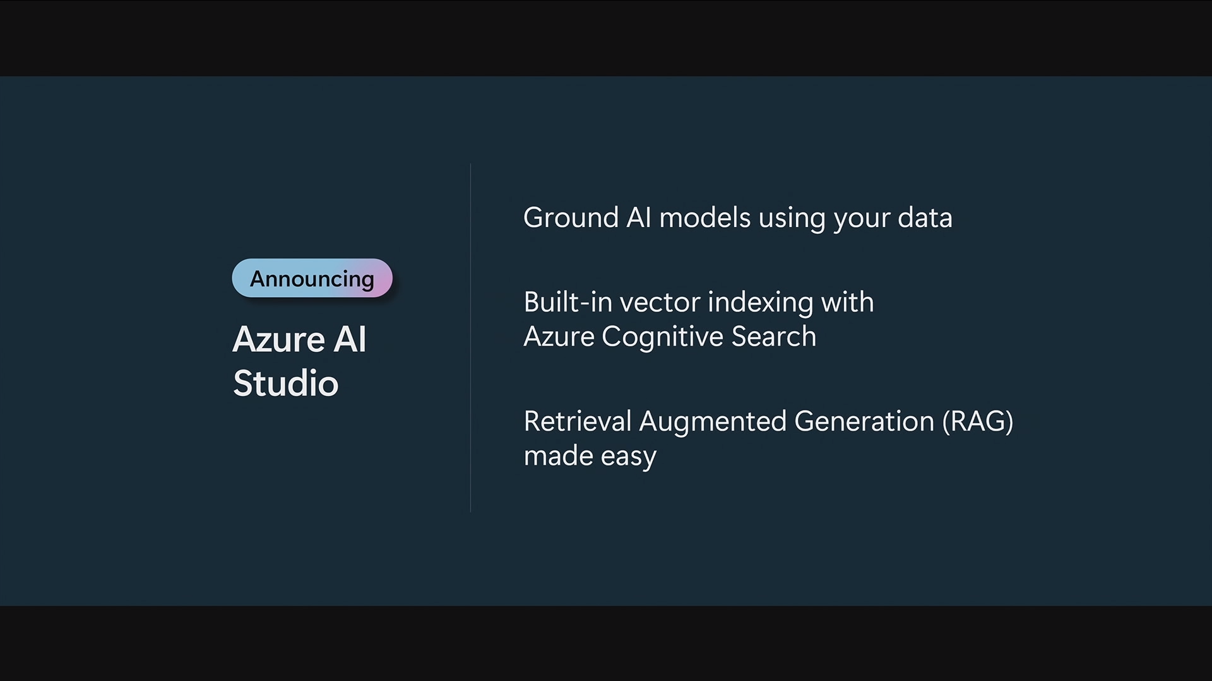
Microsoft Build 2023: Next generation AI for developers with the Microsoft Cloud

Slide 16
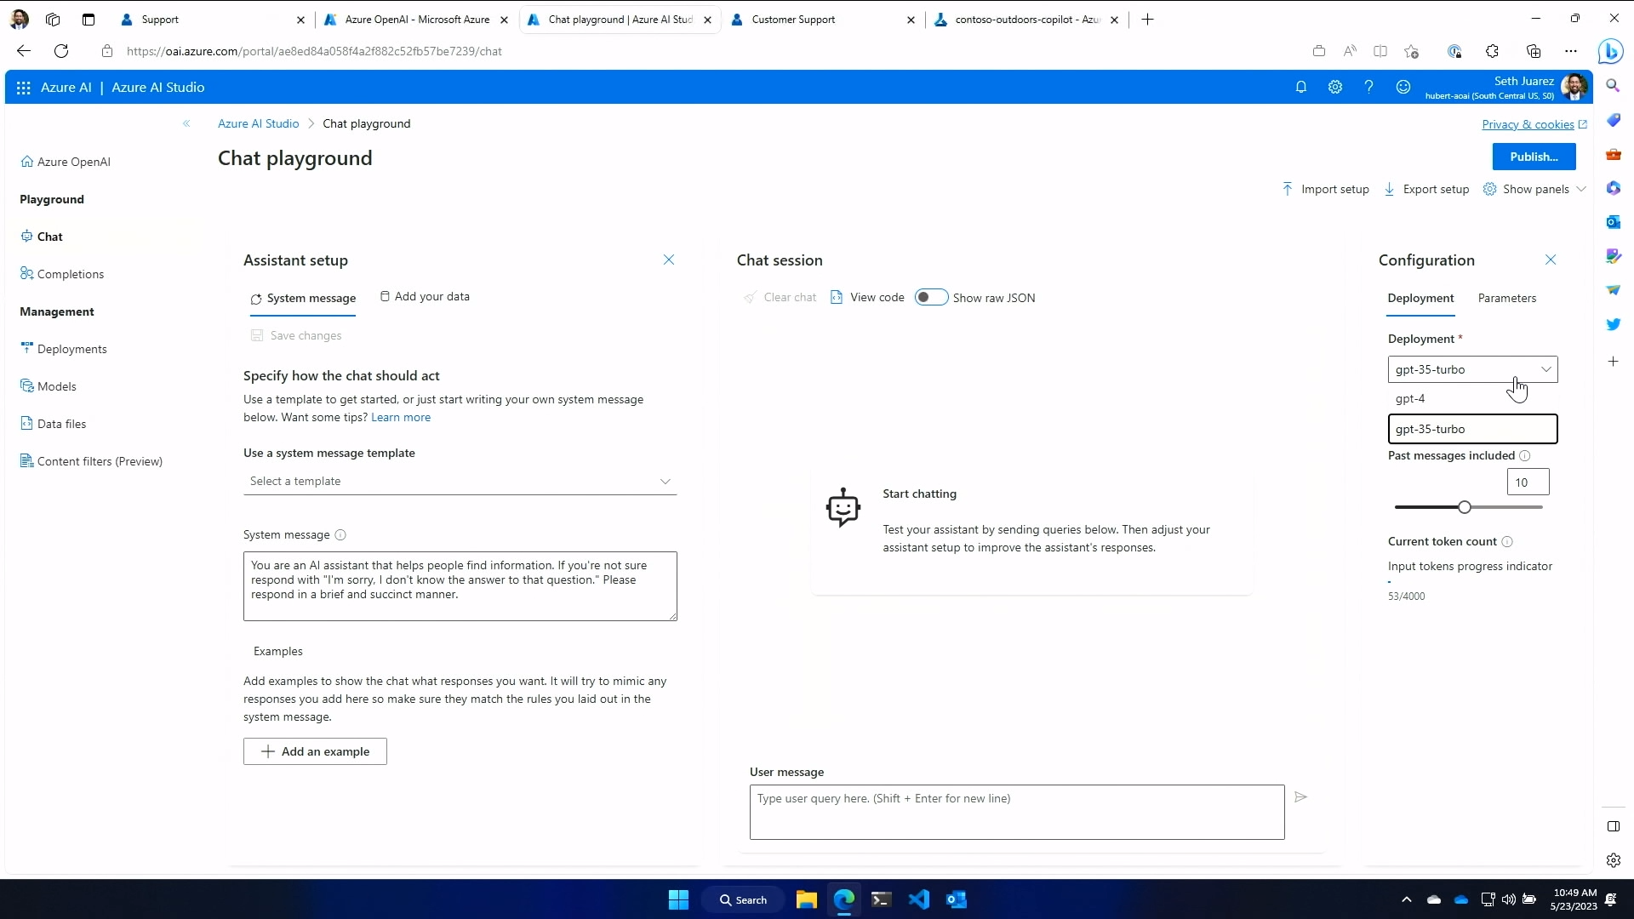

Slide 17
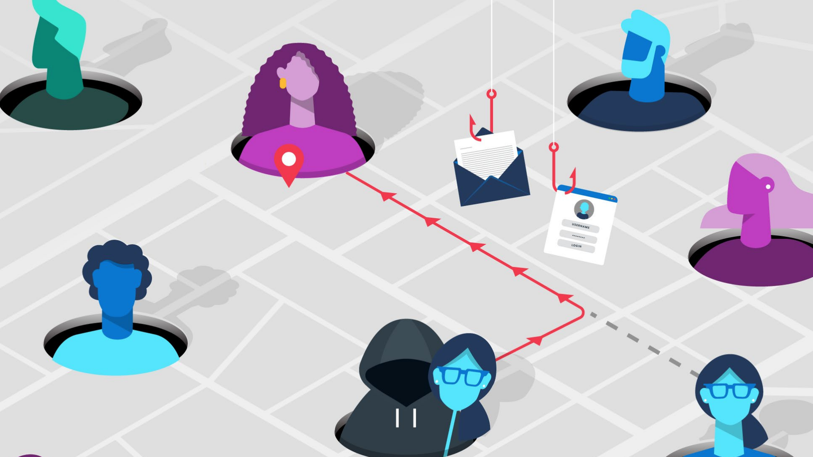
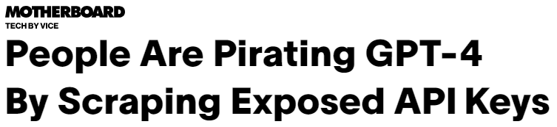
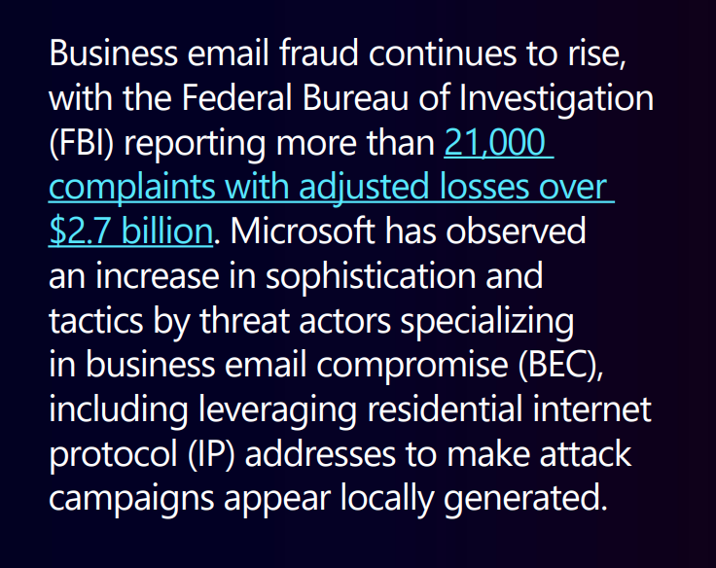
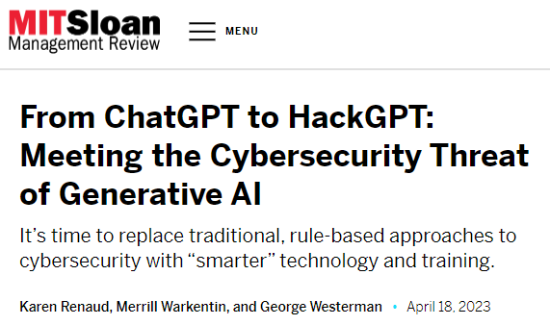
Today’s Threat Landscape

Slide 18
Azure OpenAI - Security
Built in Azure enterprise security and management mechanisms
  Link – Role Based Access Controls (RBAC)
  Link – Managed identities
  Link – Virtual networking (VNET)
  Link – Private Endpoints / Private Links
  Link – Monitoring Data
Azure OpenAI specific
  Link – Dual API keys
  Link – API endpoints enforce HTTPS / TLS 1.2
  Link – Azure OpenAI Service encryption of Data-At-Rest
  Link – Content Filtering
Additional consideration
  Link – Azure API Management (APIM)

Slide 19
Azure OpenAI - Compliance
Azure OpenAI Service currently meets the following
  CSA STAR Attestation
  ISO 27001:2013
  ISO 27017:2015
  ISO 27018:2019
  ISO 27701:2019
  SOC 1, 2, 3
  HIPAA BAA
  Germany C5
Microsoft Azure - Compliance Offerings (May 2023)
https://aka.ms/AzureCompliance

Slide 20
Microsoft
Security Copilot
Enables response in minutes,
not hours
Simplifies the complex with natural language prompts, easy reporting
Defending at machine speed
Catches what others miss with deeper understanding of events
Addresses talent shortage
by extending human expertise

Slide 21
OpenAI
Microsoft
Security
+
Cyber-trained
model with
security skills
End-to-end security
tooling
Most
advanced
general models
Hyperscale
AI
infrastructure
+
+
Evergreen threat
Intelligence
65T signals

Slide 22
Your data is your data
Microsoft Security Copilot
Your data is not used to train the foundation AI models
Your data is protected by
the most comprehensive enterprise compliance and security controls

Slide 23





Integrated into our six product families
Rounded corner guide
Microsoft
Defender
Microsoft
Purview
Microsoft
Security Copilot
Microsoft
Sentinel
Microsoft
Priva
Microsoft
Entra
Microsoft
Intune
Microsoft Security Experts

Slide 24
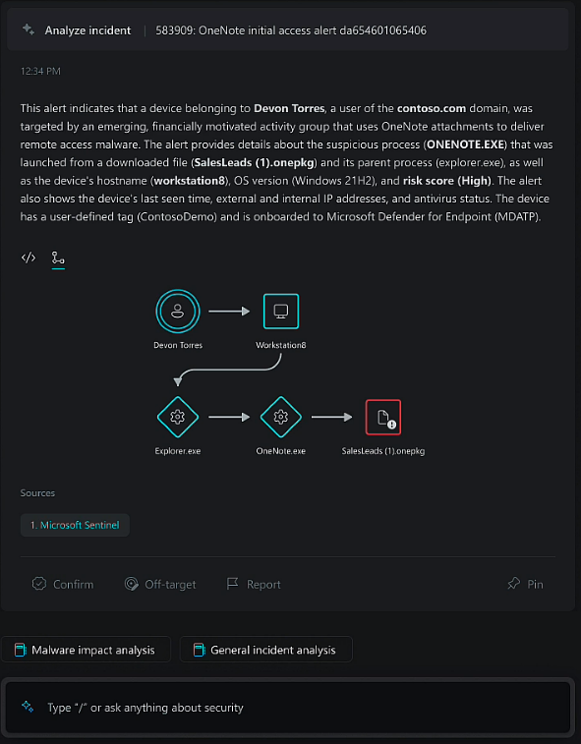
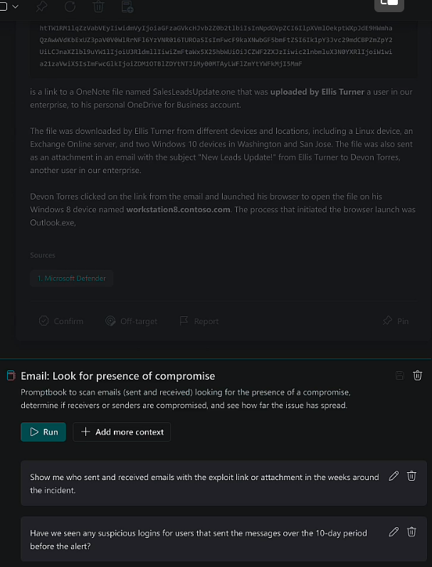
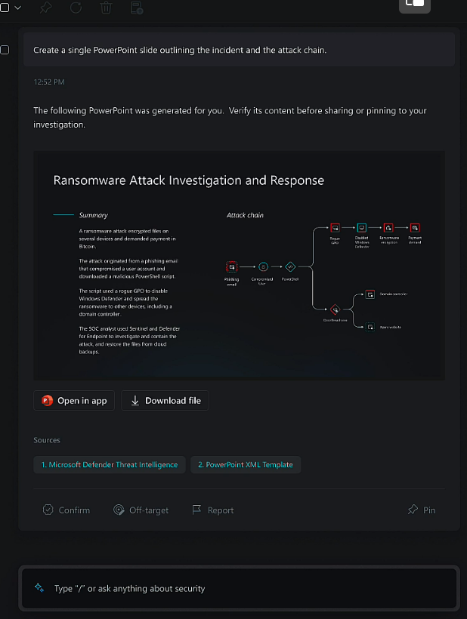
Security Copilot Scenarios
Incident Response
Detect ongoing attacks, estimate range, and receive remediation guidance based on real-world security incident proven strategies
Threat Hunting
Find out if your organization is at risk from known vulnerabilities and exploits. Examine each resource in your environment for signs of a security breach.
Security Reports
Summarize events, incidents, or threats in minutes and prepare the information in directly shareable individual reports for the desired audience.

Slide 25






Demos Architecture
Azure
Microsoft Sentinel
Log Analytics
workspace
OpenAI
Azure
Microsoft Sentinel
Azure AI – Cognitive Services
Log Analytics
workspace
Azure OpenAI Service

Slide 26
Demo of Sentinel and OpenAI Integration

Slide 27
What can you do now to prepare?
Azure Cognitive Services - Azure Open AI
Request access
Plan for integration
Understand OpenAI API roles
Review relevant Azure Cognitive Search documentation
Improve prompt engineering skills
Microsoft Security Copilot
Improve prompt engineering skills

Slide 28
Additional Considerations
Assist a Human in Completing Work – It’s a Copilot, integrations are driven by/drive human engagement, not background runtime processing of large amounts of data
Have High Customer Value – The cost of Generative AI is orders of magnitude per transaction higher than your average feature today and depend on a constrained hardware supply (GPUs)
Will be Regularly Used – The best integrations will be used regularly so it is ongoing value, not a one-time value like a configuration assistant
Work with Constrained Context - The model has a token limit for both input and output for the entire session
Leverage Model Creativity – The model is probabilistic and not deterministic; the best integrations are cases where that’s additive to the user experience

Slide 29
Links
Understanding and improving your prompt engineering skills
YouTube: Trusting Your Co-Pilot – John Savill - Microsoft CSA
Prompt engineering techniques with Azure OpenAI - Microsoft Learn
GPT best practices: Six strategies for getting better results - OpenAI API
Azure OpenAI Service FAQ - Azure Cognitive Services | Microsoft Learn
Microsoft’s AI Customer Commitments – The Microsoft Official Blog
Reddit AMA event
Azure Cognitive Search AMA: Vector search, Azure OpenAI Service, Generative Apps, Plugins. (Scheduled 29-June-2023)
Microsoft Partner Resources
Microsoft Security Copilot (This slide deck will be posted here)

Slide 30
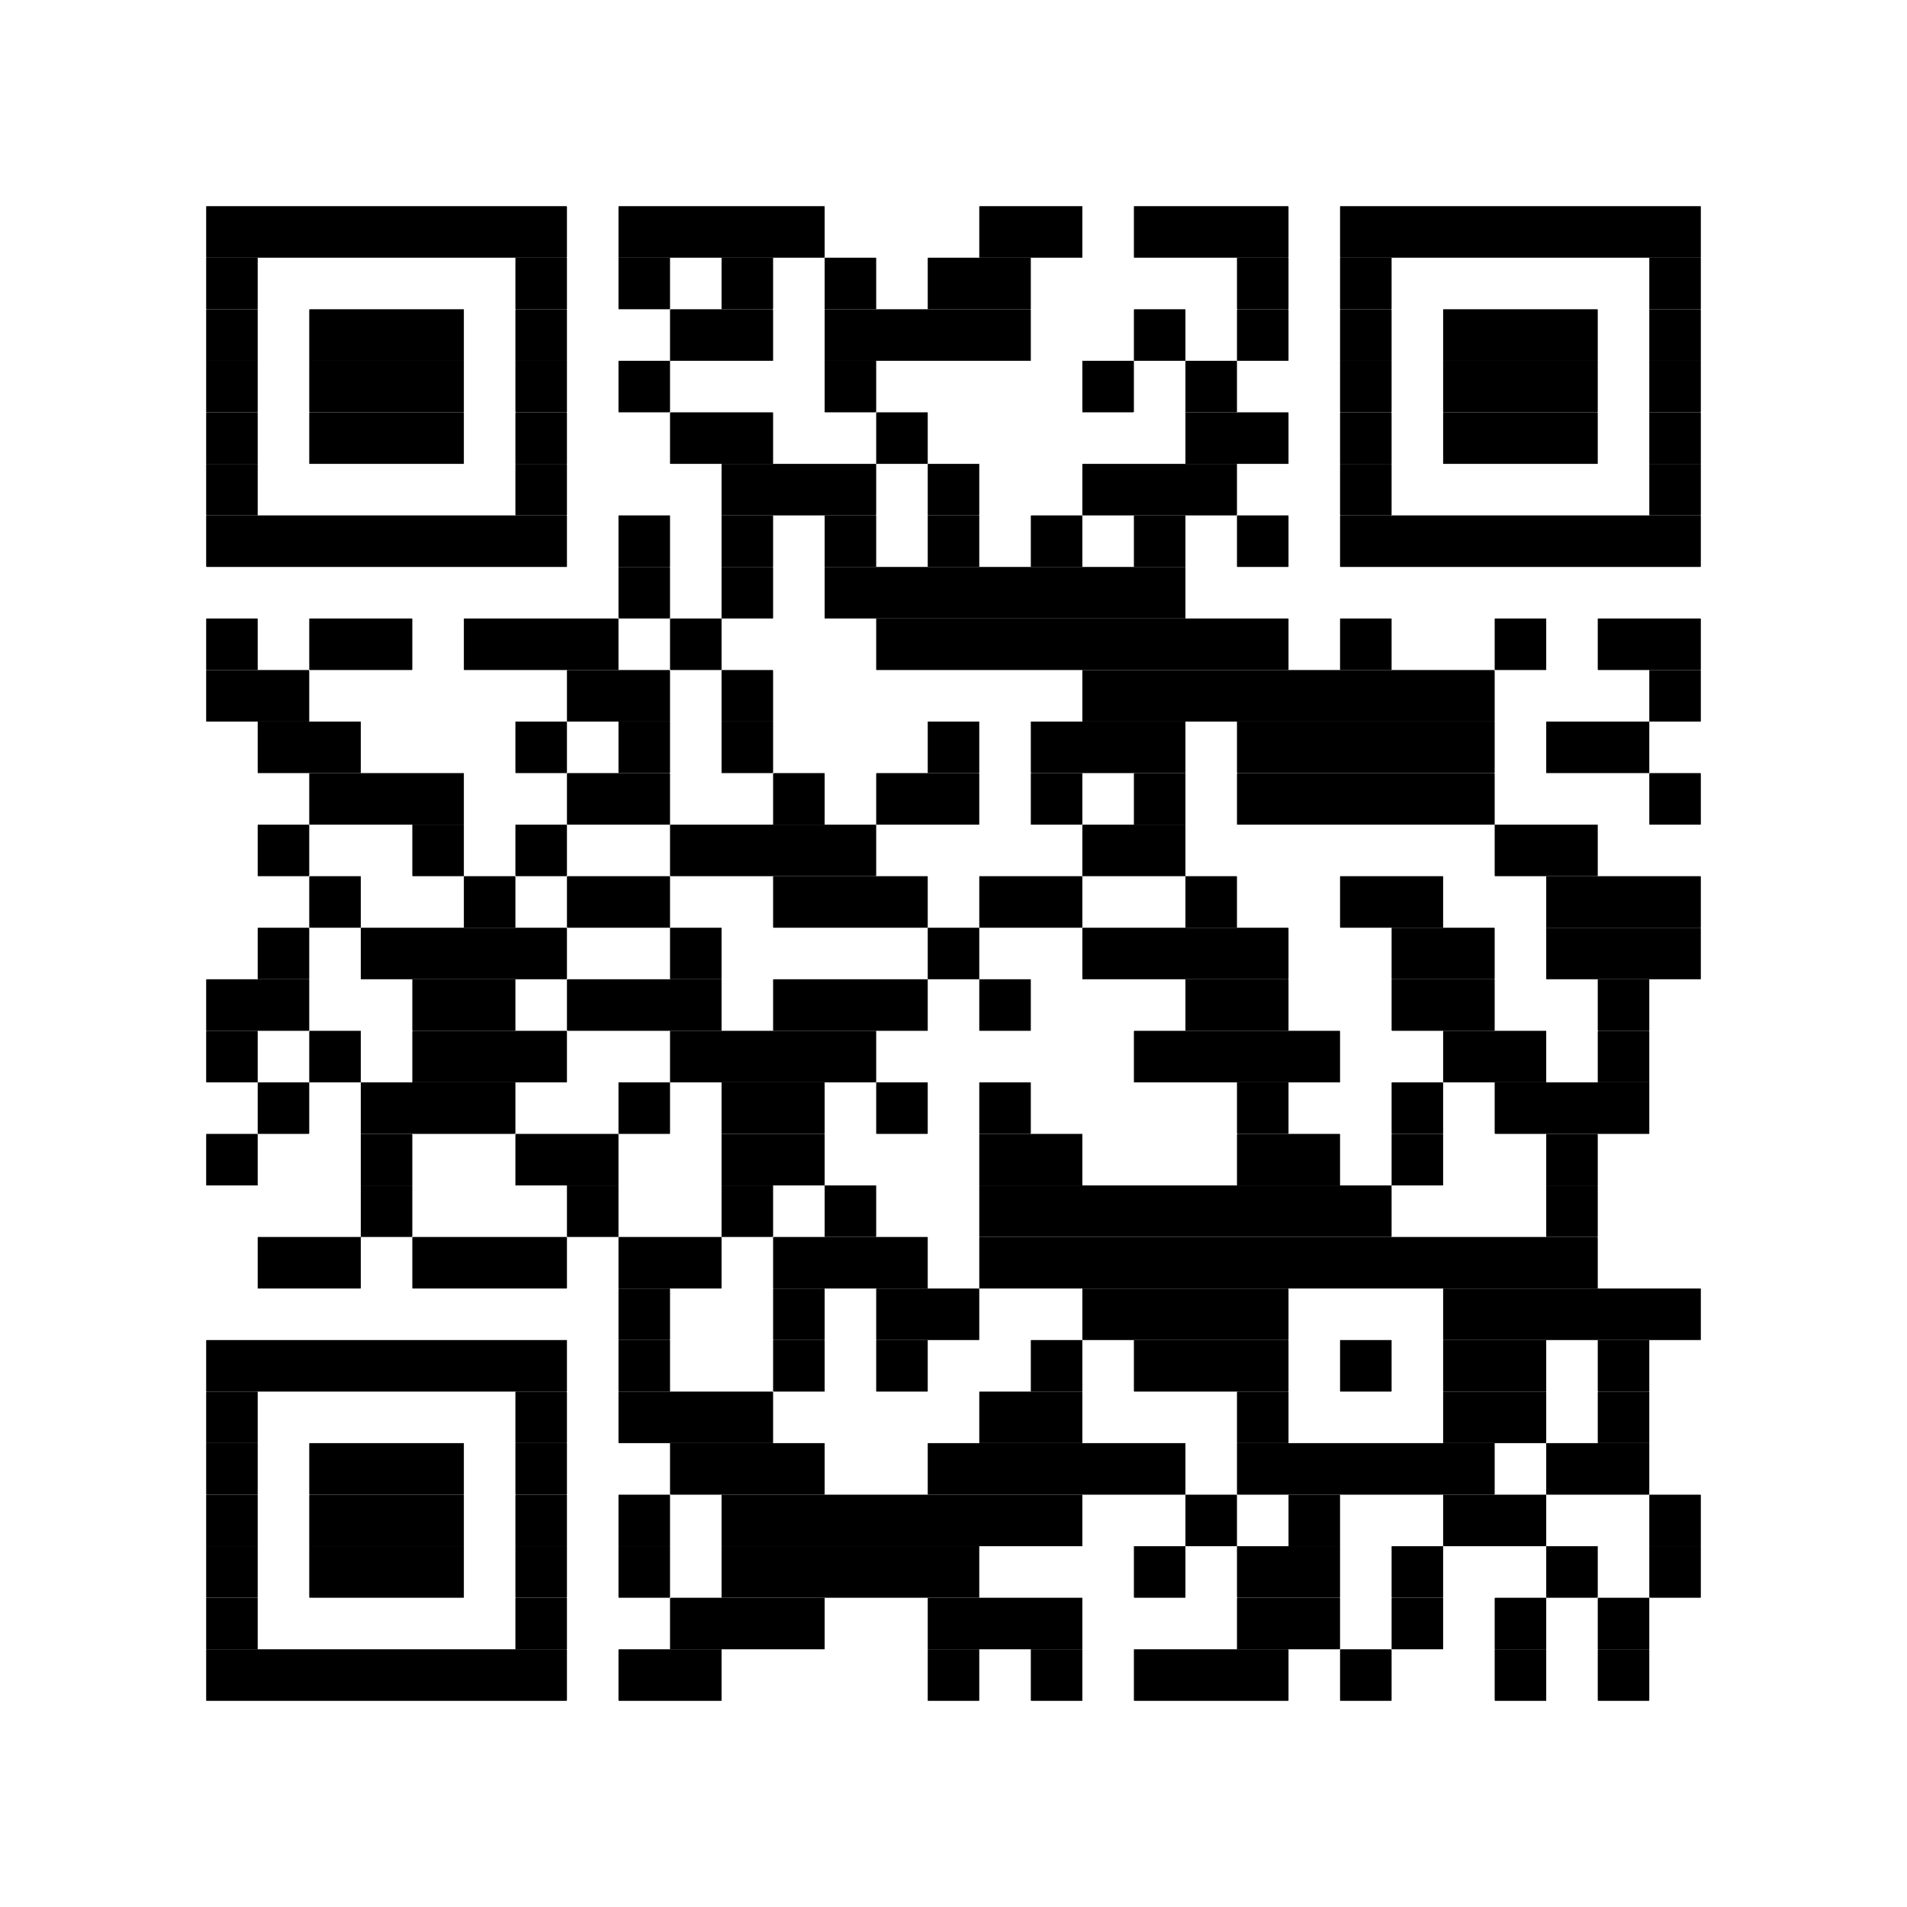
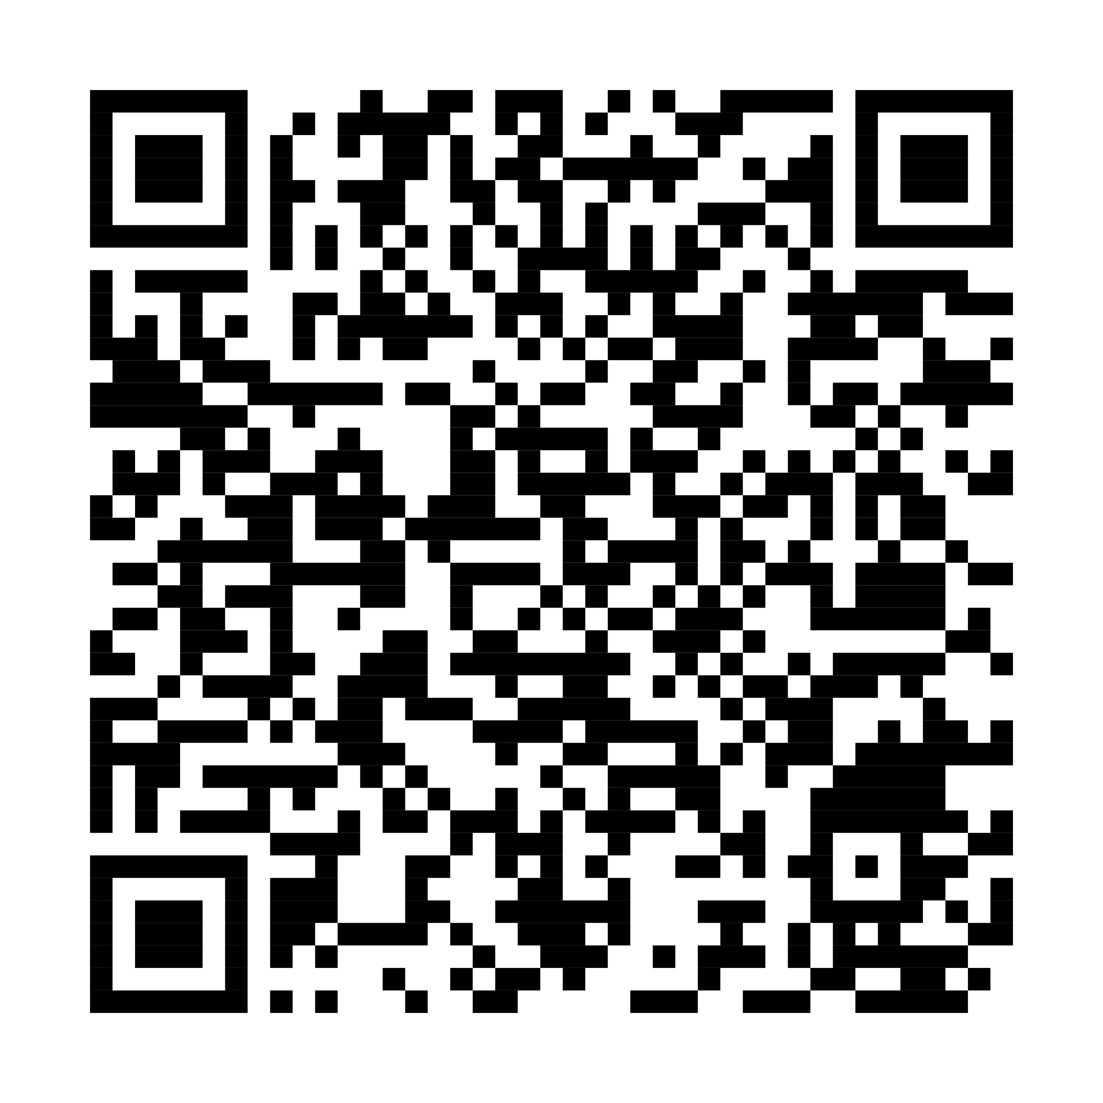
Thank you
Microsoft AI
Security Copilot

Slide 31
Q&A

Slide 32
Appendix slides

Slide 33
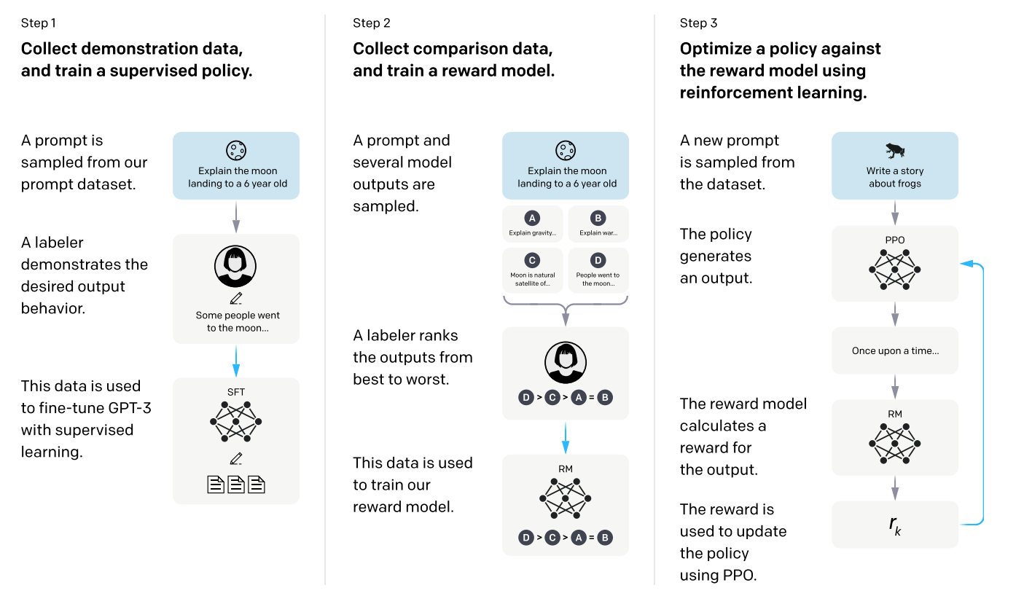
Reinforcement Learning from Human Feedback (RLHF)
https://openai.com/blog/chatgpt
Notes:
Fine-tuning is the process of training a pre-trained model on a specific task or dataset to further improve its performance.
RLHF = Reinforcement learning from human feedback is a method in AI where an agent learns through interactions with a human expert who provides feedback or rewards to guide the agent's decision-making process.
ChatGPT uses RLHF.
Source:
https://cdn.openai.com/papers/Training_language_models_to_follow_instructions_with_human_feedback.pdf
https://openai.com/blog/chatgpt

Slide 34
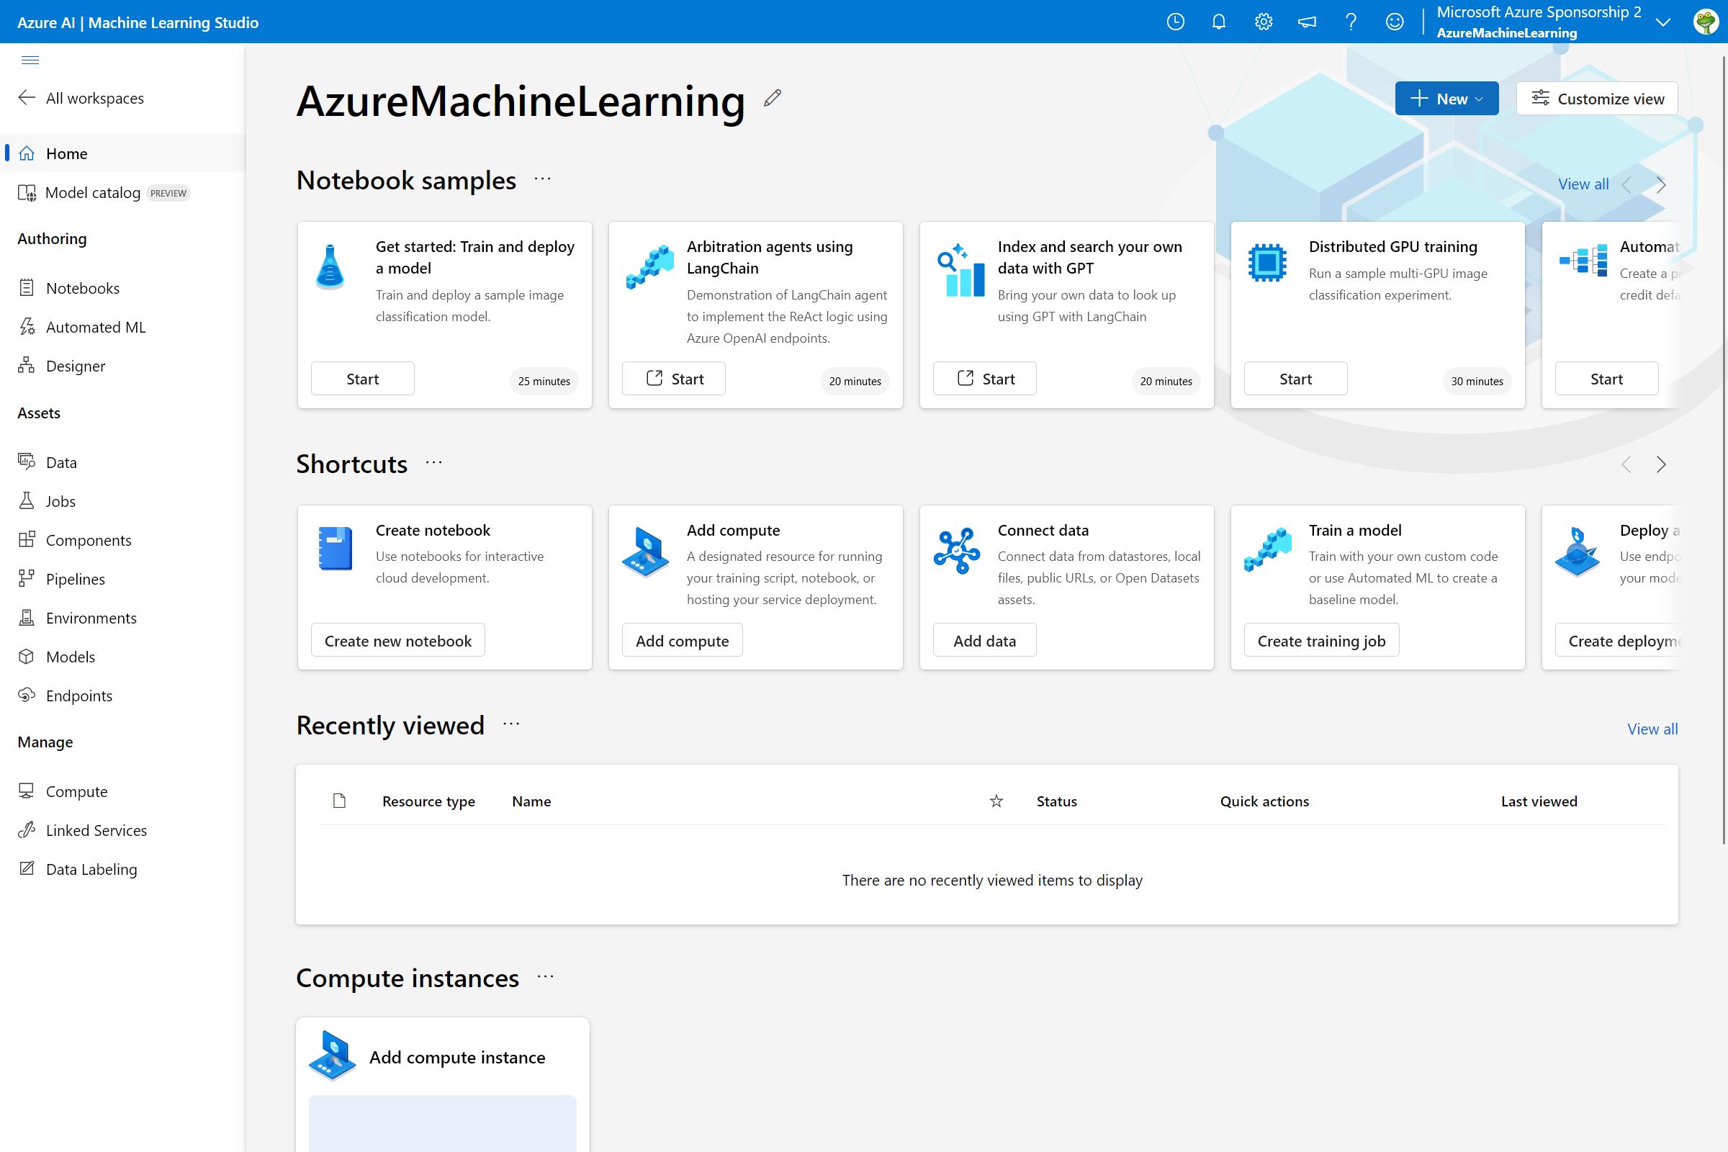
Notes:
Extra slide in case we want to talk about this tool – Also if we’re pressed on time, we could have this as an Appendix slide.
Our Azure Machine Learning studio supports various notebooks to kick start your AI/ML journey

Slide 35
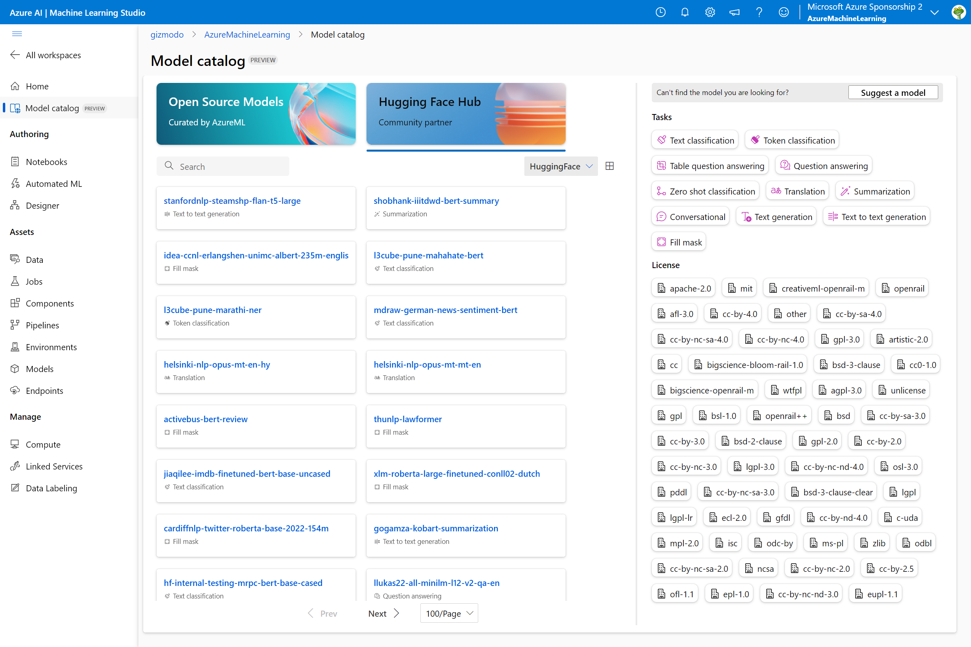
Notes:
Extra slide in case we want to talk about this tool – Also if we’re pressed on time, we could have this as an Appendix slide.
Additionally, we have a "Model catalog" that allows you to leverage dozens of Open-Source models that are curated by AzureML and within our community partner Hugging Face.

