Slide 1
Automation options - Summary
Component | API | PowerShell | ARM | Terraform | Repositories
Onboarding | ✓ | ✓ | ✓ | ✓ | ✗
Connectors | ✓ | ✓ | ✓ | ✓ | ✗
Analytics Rules | ✓ | ✓ | ✓ | ✓ | ✓
Hunting Queries | ✓ | ✓ | ✓ | ✓ | ✓
Workbooks | ✗ | ✗ | ✓ | ✗ | ✓
Playbooks | ✓ | ✓ | ✓ | ✓ | ✓
Watchlists | ✓ | ✗ | ✓ | ✗ | ✗
KQL functions | ✓ | ✓ | ✓ | ✓ | ✗
Automation Rules | ✓ | ✗ | ✓ | ✗ | ✓

Slide 2
SecurityInsights APIs
Actions | Data Connectors Check Requirements | IP Geodata | Sentinel Onboarding States
Alert Rule Templates | Domain Whois | Incident Comments | Source Control
Alert Rules | Entities | Incident Relations | Source Controls
Automation Rules | Entities Get Timeline | Incidents | Threat Intelligence Indicator
Bookmark | Entities Relations | Metadata | Threat Intelligence Indicator Metrics
Bookmark Relations | Entity Queries | Office Consents | Threat Intelligence Indicators
Bookmarks | Entity Query Templates | Operations | Watchlist Items
Data Connectors | Entity Relations | Product Settings | Watchlists
Notes:
OperationalInsights - Azure Monitor API

Slide 3
PowerShell module(s)
Az.SecurityInsights | Built and supported by Microsoft
 | Released in 2021
 | Based on Azure SDK for .NET
 | Part of the Azure (Az) module: Az.SecurityInsights
 | Samples: Azure-Sentinel/Tools/Az.SecurityInsights-Samples at master · Azure/Azure-Sentinel (github.com)
AzSentinel | Community developed
 | Wrapper around OperationalInsights and SecurityInsights APIs

Slide 4
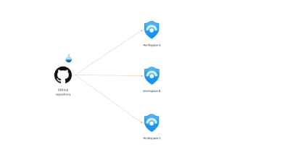
Sentinel Repositories (Preview)
Supports GitHub and Azure DevOps
Automated Content Management
ARM template format
Content Types:
Analytic rules
Automation rules
Hunting queries
Parsers
Playbooks
Workbooks

