Slide 1
Intro to Kubernetes
Notes:
This deck is a template for What The Hack lectures.
It is recommended that Coaches deliver mini-lectures ahead of each Challenge that set context for the challenge and introduce & explain any key technologies.
At a minimum, it is handy to have a slide with the key goals of each challenge to display on the screen when running the hack in-person.

Slide 2
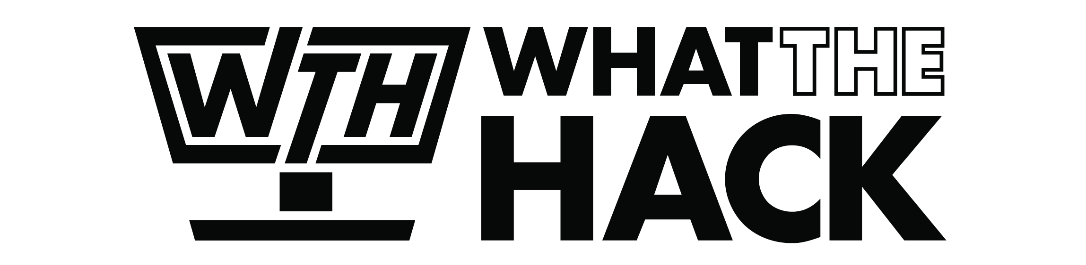
Intro to Kubernetes
Welcome & Intros
<Coach Name>
<Coach Name>
<Coach Title>
<Coach Title>
<Coach Name>
<Coach Name>
<Coach Title>
<Coach Title>
Notes:
Coaches/Presenters for THIS hack/lecture event should be listed on this slide.
Original contributors to the hack content & these slides include:
Please list original contributors to this hack here in the speaker notes and give them credit when delivering this content.
<Original Author 1>
<Original Author 2>
…
<Original Author N>

Slide 3
Challenge Scenario
Customer has existing web app, they want to modernize it and run it in containers in the cloud
Fab Medical conference website
Customer is asking you to help them with this process
Get them into Kubernetes in Azure and help them operationalize it.

Slide 4
Fab Medical App
Simple Node.js application
Two components:
  content-Web
    Web site with 4 pages (home, sessions, speakers, and stats)
    Each page hits a backend API to retrieve its content from a JSON datasource
  content-API
    3 functions that return pre-canned JSON data
    “V2” of content-api is also provided where data is stored/retrieved from MongoDB or CosmosDB.

Slide 5
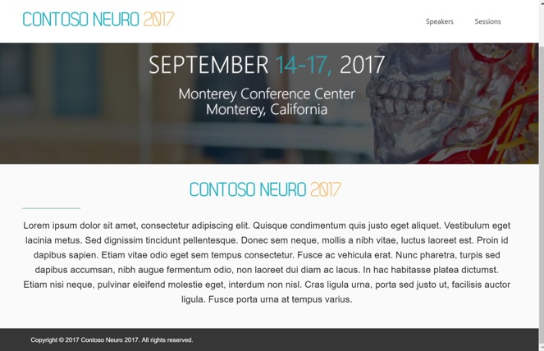
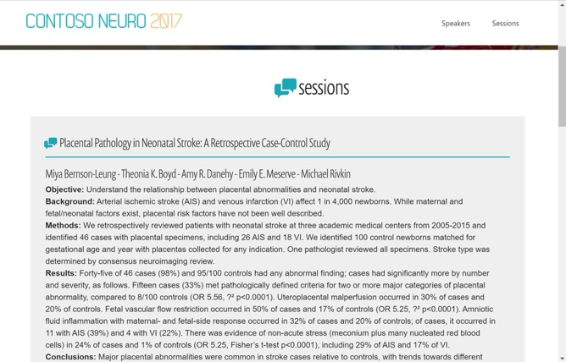

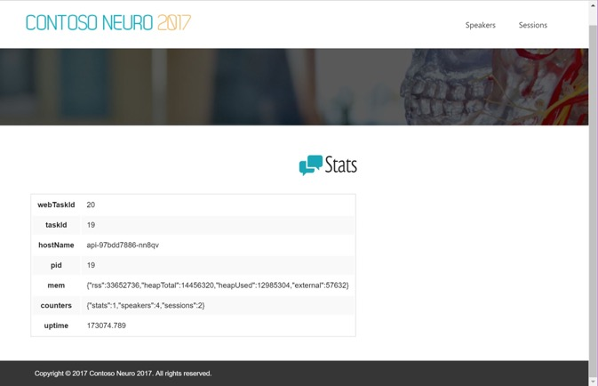
Fab Medical Website
Index.html
Sessions.html
Speakers.html
Stats.html

Slide 6
Journey to Kubernetes
Here’s our roadmap for the hack
Containerizing an existing app
What is a Container Registry
What is Container Orchestrator? (Hint: It’s what you’re here for today!)
Kubernetes Fundamentals (Pods, Deployments, & Services, oh my!)
HA & Scaling
Software updates & rollbacks
Storage
DevOps with Helm
Networking
Monitoring

Slide 7
Challenge Zero
Ready, Set, GO!!! Get your machine ready!
Install the recommended tool-set:
  Azure Cloud Shell
    http://shell.azure.com
    Azure CLI, Kubernetes CLI, Docker
  Bash terminal on Mac, Linux or Windows
    Optional choice if you want to run local
  Visual Studio Code
    Optional if you want to edit in an IDE
  Node.js
    Optional if you want to run the native app
Notes:
Convince the audience they should become developers and install tools locally!

Slide 8
Introducing Containers

Slide 9
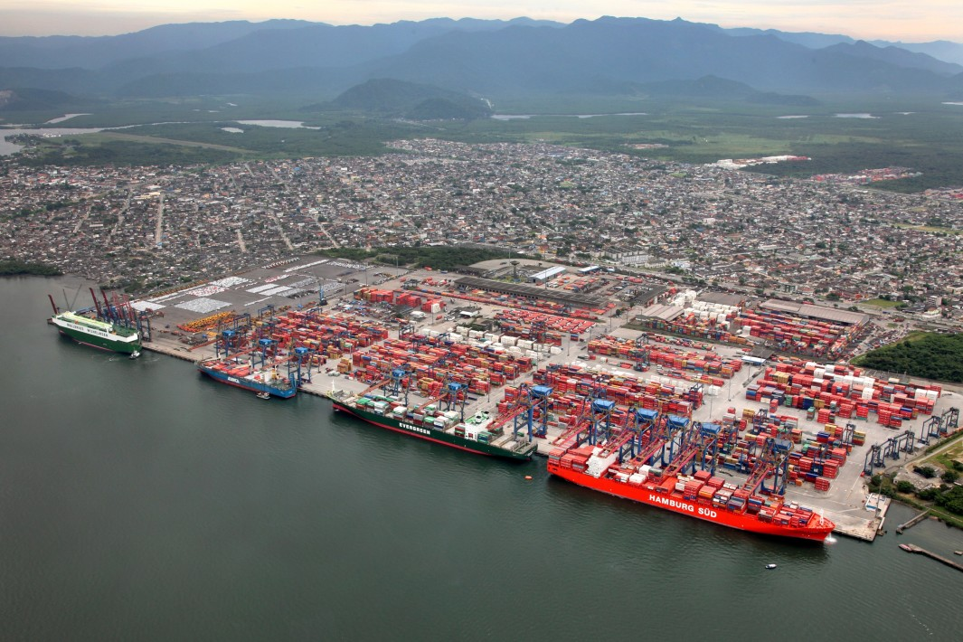
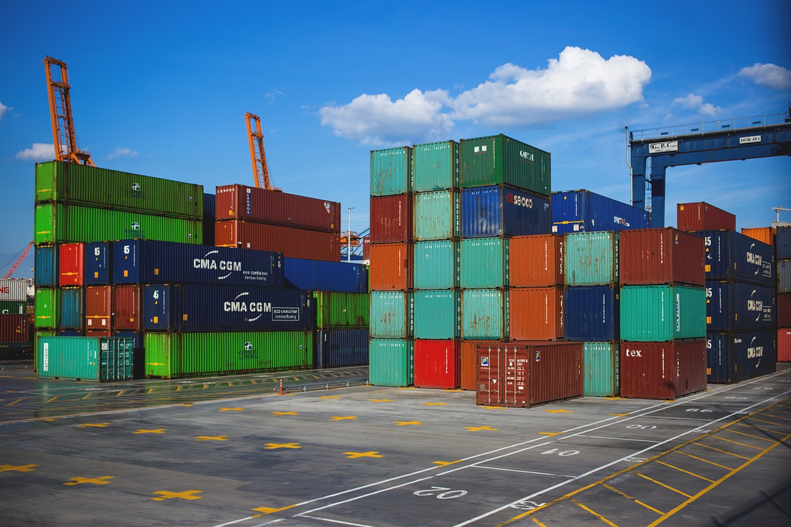
Review: What is a Container?
Containers are an application-centric way to deliver high-performing, scalable applications on the infrastructure of your choice.

Slide 10
What is a Container?
VM
VM
VM
VM
App A
App B
App C
Guest OS
Guest OS
Guest OS
Guest OS
Hypervisor
Hypervisor
Host OS
Host OS
Server
Server
Notes:
Let’s start by reviewing what a Virtual Machine is…
We have a physical server which runs a Host OS (Linux or Windows)
The Host OS runs a Hypervisor (Hyper-V, VMWare, etc)
The Hypervisor can then run one or more Virtual Machines.
A Virtual Machine (the yellow box) is given an isolated & allocated set of resources from the underlying physical server (CPU, Memory, Storage)
The Virtual Machine runs a “Guest OS” (Windows or Linux)
The VM can then have software installed on to it.
The VM is stored as an IMAGE file, which can then be transferred and run on any other physical server with the same hypervisor.
In Azure, image files are called VHDs. In AWS they are called AMIs.
VM Characteristics:
VMs are portable.
Multiple VMs running on the same physical servers enable organizations to achieve greater density and use of those physical resources.
VMs are the “unit of deployment” which enabled Cloud Computing to be possible.
VMs take multiple minutes to deploy and start up
Typically, VMs are dedicated to having a single app.
This is to avoid functional conflicts that happen between apps.
For example:
If App A & App B are deployed onto the same VM and use a shared library, if one app updates the shared library, it could cause the other app to fail.
Let’s take a look at containers and the benefits they bring to the table…

Slide 11
What is a Container?
VM
VM
VM
VM
App A
App B
App C
Guest OS
Guest OS
Guest OS
Container Engine
Guest OS
Hypervisor
Hypervisor
Host OS
Host OS
Server
Server
Notes:
On the right, we have a single VM with a Guest OS on it.
We add a “container engine”.
The container engine acts similar to a hypervisor within the OS, except instead of VMs, it lets us run containers.

Slide 12
What is a Container?
VM
VM
VM
VM
App A
App B
App C
Container
App A
Guest OS
Guest OS
Guest OS
Bins/Libs
Container Engine
Guest OS
Hypervisor
Hypervisor
Host OS
Host OS
Server
Server
Notes:
Here’s a container (in the blue blox).
Containers are a method of operating system virtualization that allow you to run an application and its dependencies in resource-isolated processes
A container allows you to package up an application and all of its dependencies (libraries, etc) into an IMAGE file.
Like a VM, the great thing about Containers are that they are PORTABLE.
Once you have a container image, you can deploy that container to any VM with the same container engine and it should “just work”.
When you run a container, it starts up almost instantly. Usually within seconds, not minutes.
This brings a lot of benefits… (next slide)

Slide 13
What is a Container?
VM
VM
VM
VM
App A
App B
App C
Container
Container
Container
App A
App B
App C
Guest OS
Guest OS
Guest OS
Bins/Libs
Bins/Libs
Bins/Libs
Container Engine
Guest OS
Hypervisor
Hypervisor
Host OS
Host OS
Server
Server
Notes:
Apps don’t step on each other (because they each have their own copy of any shared libraries)
Apps/containers can be updated independently of each other.
This allows us to slice up the OS and run multiple apps on a single VM! Achieving better density and use of resources.
NOTE:
While apps won’t step on each other functionally, they CAN compete for resources within the VM (CPU/Memory)
Containers are OS-specific. While portable, in general:
Windows containers can only run on Windows VMs
Linux containers can only run on Linux VMs*
* - It IS technically possible to run Linux containers on Windows with developer tools, however, they are usually run on Linux VMs in production environments.
Every container has an isolated view and gets
Own root directory
eth0 network interface
its own PID0
Kernel features to accomplish this:
cgroups: limiting what you can use
namespaces: limiting what you can view
When running containers on a VM, you need to manually configure access to them with a tool like HAProxy or Nginx.

Slide 14

What is a Container?
VM
VM
VM
VM
App A
App B
App C
Container
Container
Container
App A
App B
App C
Guest OS
Guest OS
Guest OS
Bins/Libs
Bins/Libs
Bins/Libs
Container Engine
Guest OS
Hypervisor
Hypervisor
Host OS
Host OS
Server
Server
Notes:
Let’s replace the generic term “Container Engine” with “docker”
“docker” has become the defacto industry standard for running containers.
“docker” lower case D is an open source project that has become the industry standard for running containers.
Docker (upper case D) is a commercial company.
Explain what docker vs. Docker is.
Explain that containerd, a new open container engine implementation is gaining a lot of traction as seen at KubeCon
Microsoft is actually replacing docker with containerD in AKS.

Slide 15

What is a Container?
VM
VM
VM
VM
App A
App B
App C
Container
Container
Container
App A
App B
App C
Guest OS
Guest OS
Guest OS
Bins/Libs
Bins/Libs
Bins/Libs
Guest OS
Hypervisor
Hypervisor
Host OS
Host OS
Server
Server
Notes:
Microsoft is actually replacing docker with containerD in AKS.

Slide 16
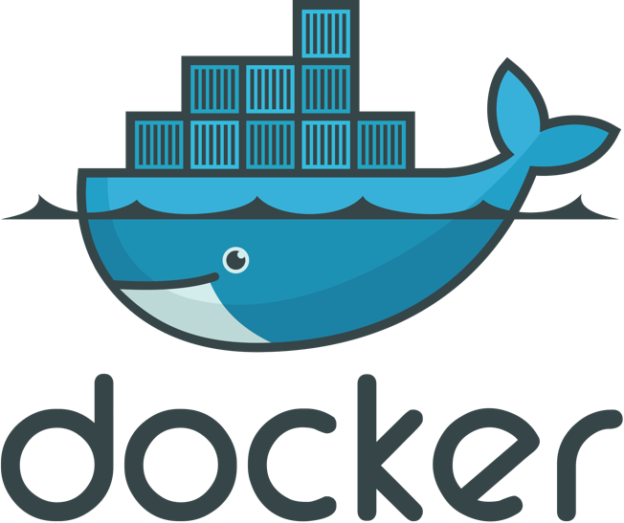

What is Docker?
A brief Docker demo…
Notes:
Show Docker images on the machine
Show Docker images running on the machine
Quick demo a Dockerfile?

Slide 17
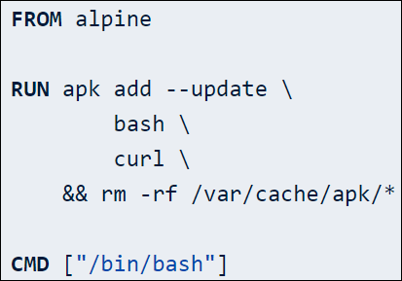
Docker File
Image Name
Captures the Steps to build a container
Is a version-able asset in your DevOps flows
  Configuration As Code
Re-use of Existing Container Images (Private or Public)
Initializes a new build stage and sets the base image
Execute commands in a new layer on top of the current image and commit results
Provide defaults for an executing container
Process started in an executing container
Notes:
Old skule Unix/C Makefiles
DSL to build
FROM, RUN, CMD
Also: copy files, open ports, attach storage

Slide 18
Challenge 1
Containerize your app!
Deploy Docker Build Agent VM via ARM template
Run and verify that you can access V1 of the app
Create a Dockerfile for the content-api app
Create Docker images for both the API & Web app
Run the containers and verify that you can access the app

Slide 19
What is a Container Registry?

Slide 20
What is a Container Registry
Discover your containers
A place to store, list, and share your container images
Like an “app store” for container images
DockerHub is a registry hosted by Docker. Many companies publish their containers there.
Most cloud providers offer their own Cloud Registries “as-a-service”
Azure has the… “Azure Container Registry”!
Docker tools can publish to a container registry
Docker can run a container image from a registry

Slide 21
What is a Container Registry?
VM
Container
Container
Container
Container Registry
App A
App B
App C
Container Image
Container Image
Bins/Libs
Bins/Libs
Bins/Libs
Container Image
Container Engine
Container Image
Guest OS
Container Image
Hypervisor
Container Image
Host OS
Server
Notes:
Let’s take a look at this visually.
Here you see the docker container engine communicates with the Container Registry to PUSH or PULL container images.

Slide 22

What is a Container Registry?
VM
Container
Container
Container
Container Registry
Azure Container Registry
hub
App A
App B
App C
Container Image
Container Image
Bins/Libs
Bins/Libs
Bins/Libs
Container Image
Container Engine
Container Image
Guest OS
Container Image
Hypervisor
Container Image
Host OS
Server
Notes:
DockerHub is the public container registry from Docker
Azure Container Registry is a PaaS service from Azure that gives you a private registry to use with in an organization.
ACR is compatible with the docker CLI tool, so all of the standard docker commands (push, pull, etc) work with ACR.
This can be done securely using AAD authentication.

Slide 23
Challenge 2
Publish your containers to a registry
Create an Azure Container Registry
Set up your permissions properly
Publish your content-api & content-web containers to ACR

Slide 24
Container Orchestrators

Slide 25
Okay, I’ve got containers.
And a registry.
Now what?!

Slide 26
I’m going to want more VMs with containers!
VM
VM
Container
Container
Container
Container
Container
Container
App A
App B
App C
App A
App B
App C
Bins/Libs
Bins/Libs
Bins/Libs
Bins/Libs
Bins/Libs
Bins/Libs
Container Engine
Container Engine
Guest OS
Guest OS
Hypervisor
Hypervisor
Host OS
Host OS
Server
Server
Notes:
I’m going to want to optimize and scale!

Slide 27
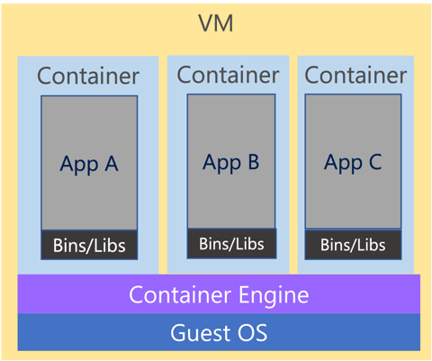
And more… and more!

Slide 28
And more… and more… CHAOS!
Notes:
You can imagine there are a lot of problems as you run containers at scale:
Scheduling (how many instances of each container to run and where)
Scaling up/down
Replacing dead containers
Version updates
Etc
You’re going to need help with this!

Slide 29
What is a Container Orchestrator?

Slide 30
What is a Container Orchestrator?
Container Orchestrator
Notes:
Let’s introduce a container orchestrator to the picture!
What is a container orchestrator?
It’s just another piece of software…

Slide 31
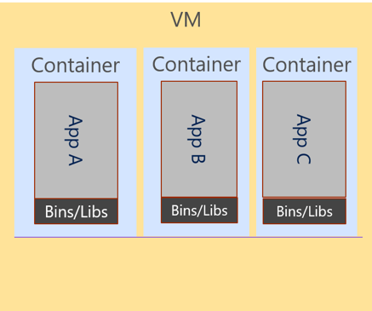
What is a Container Orchestrator?
Cluster
Container Orchestrator
Notes:
It is software that acts as a control plane to manage a “cluster” of VMs and the deployment of containers on it.
All of those scale problems mentioned earlier can be handled by a container orchestrator.

Slide 32
What is a Container Orchestrator?
Cluster
VM
Container Orchestrator
Guest OS
Hypervisor
Host OS
Server
Notes:
The Container Orchestrator is just another piece of software that runs on a VM itself.

Slide 33
What is a Container Orchestrator?
Container orchestrators group hosts together to form a cluster, and fulfill these requirements:
Are fault tolerant
Can scale on demand
Use resource optimally
Discover other applications automatically
Accessible from the external world
Updates and roll-backs without downtime
Notes:
Container orchestrators help with a long list of challenges

Slide 34
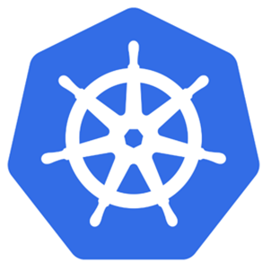
Kubernetes is a Container Orchestrator!
Cluster
VM
Kubernetes
Guest OS
Hypervisor
Host OS
Server
Notes:
Kubernetes IS a container orchestrator.
There have been quite a few other container orchestrators on the market.
DC/OS/Mesosphere
Docker Swarm
Azure Service Fabric is a container orchestrator!
K8S: This is the orchestrator we focus on and safe to say it is the de-facto standard for container orchestrators

Slide 35
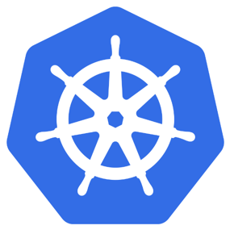
What is Kubernetes?
"Kubernetes is an open-source system for automating deployment, scaling, and management of containerized applications."
Kubernetes comes from the Greek word κυβερνήτης:, which means helmsman or ship pilot, ie: the captain of a container ship.

Slide 36
Kubernetes has a “Control Plane” & Cluster of “Nodes”
Cluster
VM
Control Plane Node
Kubernetes
Node
Node
Node
Node
Node
Node
Guest OS
Hypervisor
Host OS
Server
Notes:
The Kubernetes control plane has historically been referred to as the “master” or “master node”.
You may see references to it in documentation this way.
However, it is commonly referred to as the “Control Plane” lately
From here on out, we shall use the Kubernetes vocabulary.
Node = VM

Slide 37
Azure Kubernetes Service (AKS)
AKS reduces the complexity and operational overhead of managing Kubernetes by offloading much of that responsibility to Azure.
You only pay for the agent nodes within your clusters, not for the control plane nodes

Slide 38
AKS is Kubernetes (Control Plane) as a Service
Cluster
Kubernetes
Control Plane
Node
Node
Node
Node
Node
Node
Notes:
The nodes running your containers are regular Azure VMs that you pay an hourly rate for. You will see these referred to as “worker nodes” or “agent nodes”.
A group of nodes of the same type (VM SKU size) is referred to as a “nodepool” in Kubernetes. AKS implements all nodes as Azure VMs in an Azure VM Scale Set. Thus, in Kubernetes:
Node = Azure VM
Nodepool = Azure VM Scale Set

Slide 39
Azure Kubernetes Service (AKS)
Azure Kubernetes Service (AKS)
Get started easily
$ az aks create -g myResourceGroup -n myCluster --generate-ssh-keys
\ Running ..
$ az aks install-cli
Downloading client to /usr/local/bin/kubectl ..
$ az aks get-credentials -g myResourceGroup -n myCluster
Merged "myCluster" as current context ..
$ kubectl get nodes
NAME STATUS AGE VERSION
aks-mycluster-36851231-0 Ready 4m v1.8.1
aks-mycluster-36851231-1 Ready 4m v1.8.1
aks-mycluster-36851231-2 Ready 4m v1.8.1
Notes:
AKS has integrated the Kubernetes CLI (kubectl) with the Azure CLI.
These next two slides are examples of how they work together.
Pay no attention, as you will discover this in the next challenge!

Slide 40
Azure Kubernetes Service (AKS)
Azure Kubernetes Service (AKS)
Manage an AKS cluster
$ az aks list –o table
Name Location ResourceGroup KubernetesRelease ProvisioningState
------------------ ---------- -------------- ------------------- -------------------
myCluster westus2 myResourceGroup 1.7.7 Succeeded
$ az aks upgrade -g myResourceGroup -n myCluster –-kubernetes-version 1.8.1
\ Running ..
$ kubectl get nodes
NAME STATUS AGE VERSION
aks-mycluster-36851231-0 Ready 12m v1.8.1
aks-mycluster-36851231-1 Ready 8m v1.8.1
aks-mycluster-36851231-2 Ready 3m v1.8.1
$ az aks scale -g myResourceGroup -n myCluster --agent-count 10
\ Running ..

Slide 41
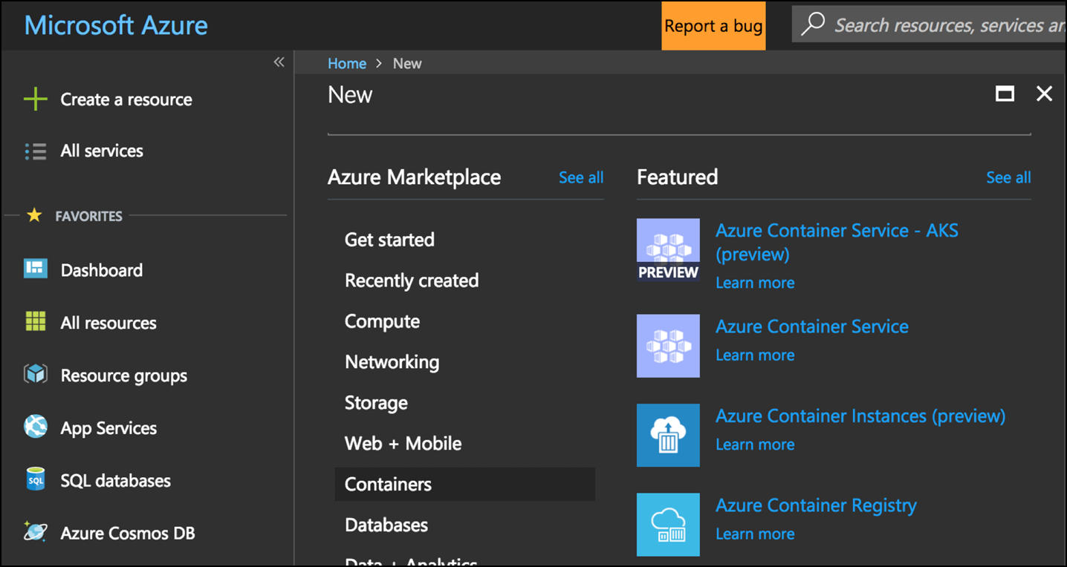
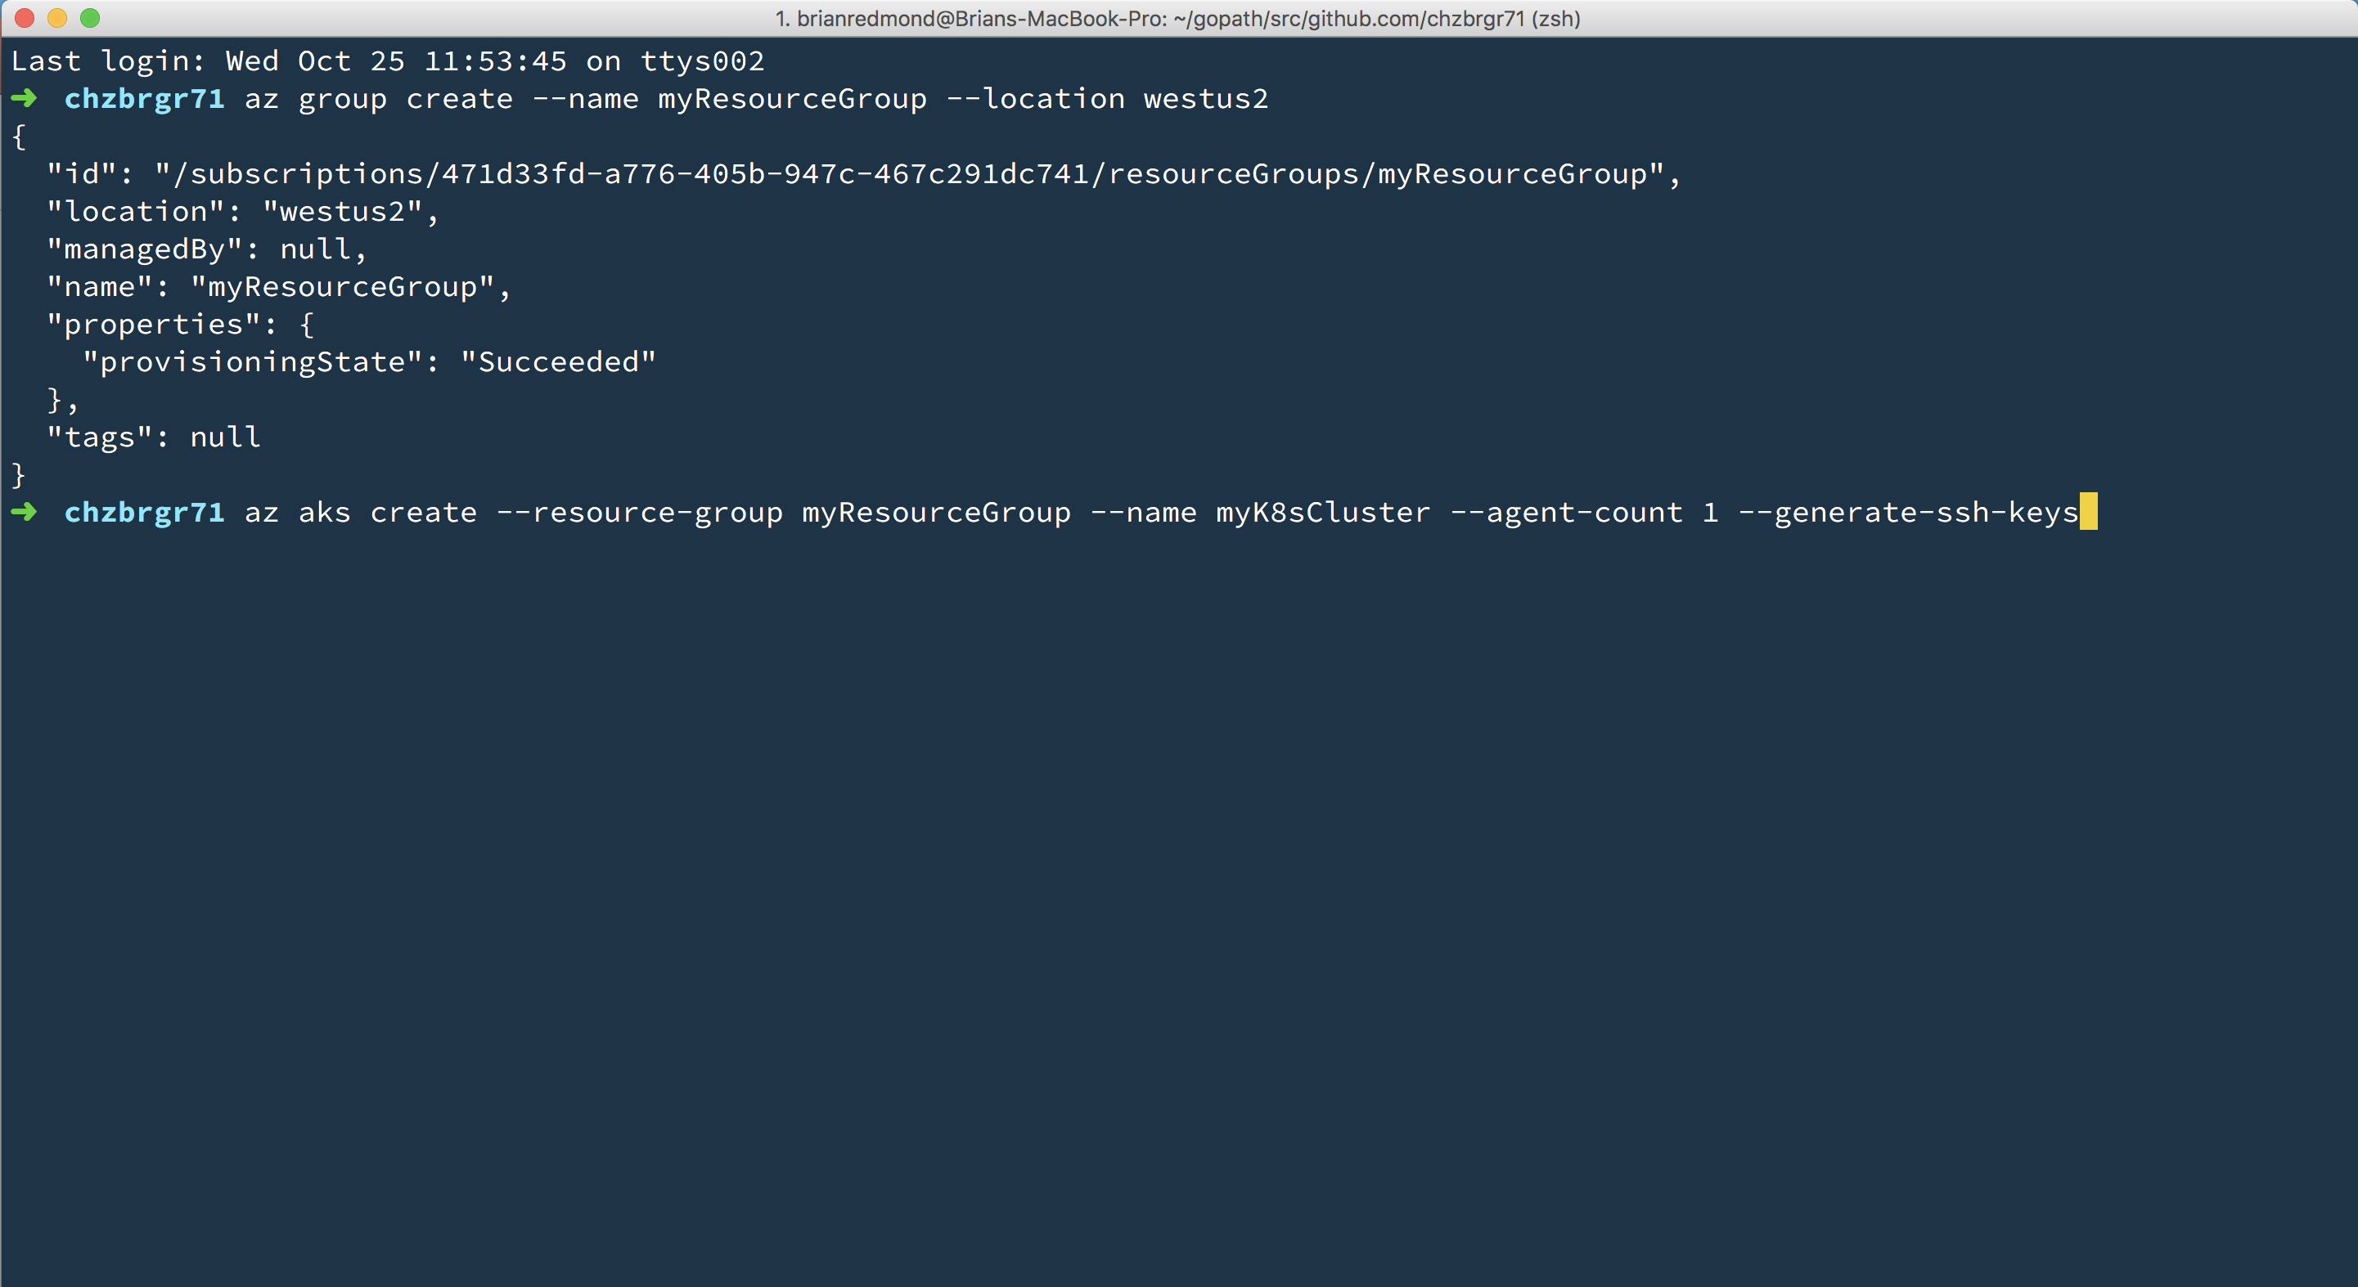
Azure Kubernetes Service (AKS)
Azure Kubernetes Service (AKS)
Create AKS via Portal, Azure CLI, or ARM template

Slide 42
Demo
AKS Cluster Creation

Slide 43
Challenge 3
Your First Kubernetes Cluster
Get “kubectl” installed
Create a new, multi-node AKS cluster from the command line
Use kubectl to prove that the cluster is a multi-node cluster and is working

Slide 44
Kubernetes Fundamentals
Pods, Deployments, Services…. Oh My!

Slide 45
Kubernetes @ 10,000ft
Cluster
Kubernetes
Control Plane
Node
Node
Node
Node
Node
Node
Notes:
Kubernetes is full of many complexities.
Sometimes, to learn something really complex, you need to start by focusing on the simplest parts…

Slide 46
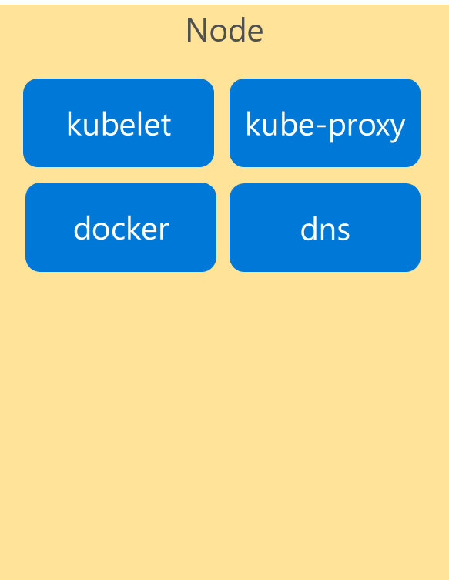
Kubernetes Architecture Components
Cluster
Control Plane
Node
api-server
kubelet
kube-proxy
controller-manager
docker
dns
etcd
scheduler
*Azure Managed
Notes:
If we look inside the VM nodes in a Kubernetes clusters, we’ll see a whole set of services that are running on each.
These are containers themselves!
These services are how Kubernetes handles management of the nodes and things that run on them.
I’m going explain these now briefly…

Slide 47
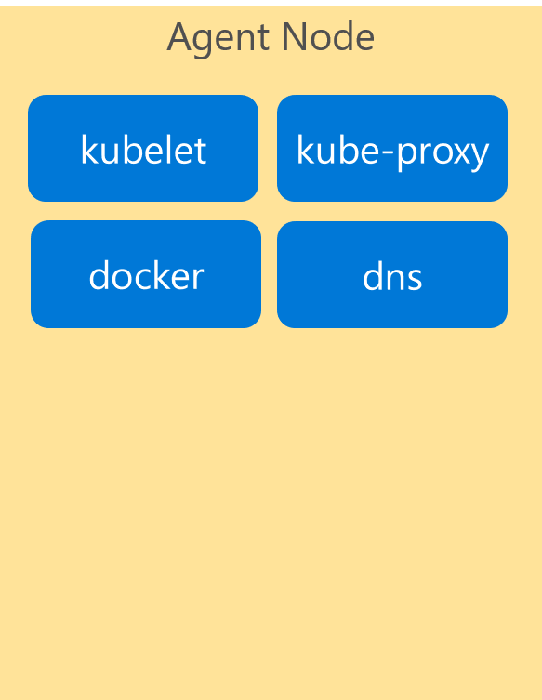
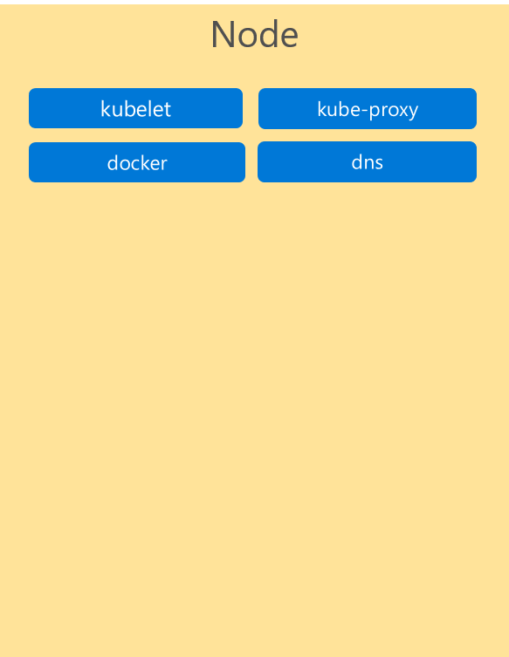
Kubernetes Architecture Components
Cluster
Control Plane
Node
Kube stuff
Kube stuff
api-server
kubelet
kube-proxy
docker
dns
controller-manager
etcd
scheduler
*Azure Managed
Notes:
…by telling you to forget about ALL of them for now!
They’re just the stuff that makes Kubernetes run.
You can read all about them in the docs, and probably will learn more about them as you become more familiar with the system.
But for today… we want to focus on the core components and concepts.
IF you focus on these, you’ll get lost.
Let’s keep it simple for now.

Slide 48
Kubernetes Architecture Components
Where do the Containers go?
Container
Container
Container
App A
App B
App C
Bins/Libs
Bins/Libs
Bins/Libs
Notes:
Containers are the only thing that run.
<click>

Slide 49
Kubernetes Architecture Components
Introducing… Pods!
Pod
Pod
Pod
Container
Container
Container
App A
App B
App C
Bins/Libs
Bins/Libs
Bins/Libs
Containers go inside Pods!
Notes:
K8S wraps container in a layer of metadata
A POD

Slide 50
Kubernetes Architecture Components
Pods
Cluster
Control Plane
Node
Kube stuff
Kube stuff
api-server
kubelet
kube-proxy
docker
dns
controller-manager
Pod
App A
Pod
App B
Pod
App C
etcd
scheduler
*Azure Managed
Notes:
Here are some pods running on one node in our cluster

Slide 51
Kubernetes Architecture Components
Pods
Cluster
Control Plane
Node
Kube stuff
Kube stuff
kubelet
kube-proxy
api-server
docker
dns
Pod
App A
Pod
App B
Pod
App D
controller-manager
Pod
App A
Pod
App B
Pod
App C
etcd
scheduler
Pod
App C
Pod
App C
*Azure Managed
Notes:
Here are some pods running across multiple nodes on our cluster…
You can see we have different numbers of each type of pod running.
One benefit of Kubernetes is that it is easy to independently scale each container/app.

Slide 52
Pods – What are they?
Metadata. They’re just metadata!
Metadata that describes how the containers are configured.
pod
pod
ratings-web
Label(s) | app=ratings-web
Container-image | my.azurecr.io/ratings-web
Port | 3000
(VolumeMount) | /mnt/share
(Resources) | <cpu/memory>
ratings-api
Label(s) | app=ratings-api
Container-image | my.azurecr.io/ratings-api
Port | 3001
(VolumeMount) | /mnt/share
(Resources) | <cpu/memory>
pod
otherApp
Label(s) | app=otherApp
Container-image | other.azurecr.io/otherApp
Port | 4045
(VolumeMount) | /mnt/share
(Resources) | <cpu/memory>
Notes:
Pods are metadata that define how the container will be hosted.
What is that metadata
Image – link to the container registry & container name
Port – port number this pod should listen to traffic on
Storage/resources
Label=important => Labels are the most important concept in Kubernetes.
Kubernetes keeps a database of all of the configuration information.
The “label” you give to a Pod makes it possible for Kubernetes to keep track of all instances of that type of pod running in the cluster.
<click>more<click>more

Slide 53
Deployments
More Metadata
Metadata that describes how to deploy a pod
Deployment
ratings-web
replicas | 2
pod
ratings-web
Label(s) | app=ratings-web
Container-image | my.azurecr.io/ratings-web
Port | 3000
(Volume) | …
(Resources) | …
Notes:
How do I deploy a pod?? With a deployment. Again, more metadata.
In Kubernetes, an instance of a pod is called a “replica”.
Just like VMs are called nodes, instances are called “replicas”
Kubernetes is a language onto itself.
Replicas == scale == desired state (more on that later)
WHY you want one container per pod: Because pod is the unit of scale

Slide 54
Kubernetes Deployment in Action
Cluster
Control Plane
Node
Node
Kube stuff
Kube stuff
Kube stuff
kubelet
kube-proxy
kubelet
kube-proxy
docker
dns
docker
dns
Pod
ratings-web1
Pod
ratings-web2
Deployment
pod configuration
*Azure Managed
Notes:
Here is what that deployment looks like when it’s deployed to our cluster
NOTE: Make sure to mention pods get unique suffixes

Slide 55
Kubernetes Desired State In Action – Example 1
Cluster
Control Plane
Node
Node
Kube stuff
Kube stuff
Kube stuff
kubelet
kube-proxy
kubelet
kube-proxy
docker
dns
docker
dns
Pod
ratings-web1
Pod
ratings-web2
Deployment
pod configuration
Pod
ratings-web3
Notes:
What happens when a pod dies?
Kubernetes knows that our desired state is 2 replicas because we told it in our deployment.
So it will create a new pod

Slide 56
Kubernetes Desired State In Action – Example 2
Cluster
Control Plane
Node
Node
Kube stuff
Kube stuff
Kube stuff
kubelet
kube-proxy
kubelet
kube-proxy
docker
dns
docker
dns
Pod
ratings-web1
Pod
ratings-web2
Deployment
pod configuration
Pod
ratings-web3
Notes:
If we lose an entire node, Kubernetes will try to maintain the desired state of “2” replicas by scheduling a replacement pod on any other node that has capacity to run it.
There’s another Kubernetes term: “scheduling” == “deploying” a pod.
Side note: Respawning dead nodes is one of the things that AKS does for you, otherwise it would be a manual process of detection and remediation.

Slide 57
Services
Yet More Metadata!
Metadata that describes how to reach the pods
pod
ratings-web1
Label(s) | app-ratings-web
Container-image | my.azurecr.io/ratings-web
Port | 3000
Service
ratings-web
Selector | app=ratings-web
Port Mapping | 3000:8080
Type | Internal or External
pod
ratings-web2
Label(s) | app-ratings-web
Container-image | my.azurecr.io/ratings-web
Port | 3000
Notes:
Next concept: SERVICES
A load balancer for pods
Metadata that describes how to reach a pod, any number of replicas (instances).
Internal or External
<click then more details>

Slide 58
Kubernetes Service Deployment In Action
Services
Cluster
Control Plane
Node
Node
Kube stuff
Kube stuff
Kube stuff
kubelet
kube-proxy
kubelet
kube-proxy
docker
dns
docker
dns
Service
ratings-web
IP Address
Pod
ratings-web1
Pod
ratings-web2
Deployment
pod configuration
Service configuration
*Azure Managed
Notes:
Here’s a service in our cluster:
It is an abstract grouping of the pods running ratings-web
It has its own endpoint which proxies across the pods.

Slide 59
Kubernetes Service Deployment In Action
Services
Cluster
Control Plane
Node
Node
Kube stuff
Kube stuff
Kube stuff
kubelet
kube-proxy
kubelet
kube-proxy
docker
dns
docker
dns
Service
ratings-web
IP Address
Pod
ratings-web1
Pod
ratings-web2
Pod
ratings-api1
Pod
ratings-db1
Pod
someotherpod
*Azure Managed
Notes:
And here’s an example of other pods just running outside of the service

Slide 60
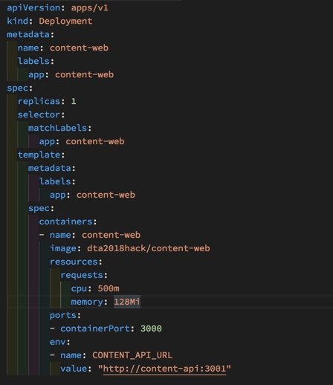
Deployments in Kubernetes
Infra-as-Code a YAML file
Tabs vs. spaces matter
Very sensitive to formatting: indentation, string vs not
Download the VS Code extension!
Notes:
For each container, you have TWO things to deploy…
deployment config
service config
Kubernetes config files are YAML format. (YAML == Yet Another Markup Language)
Easier than XML.
Easier than JSON.
But still picky on things like tabs vs spaces and line indentations.
If you use the VS Code extension for Kubernetes YAML files, you get great intellisense & code-completion.
This will help you avoid common syntax errors that only show up when you try to APPLY the config files.
Kubernetes is managed almost entirely via the Kubectl CLI tool.
Kubectl interacts directly with the Kubernetes Control Plane which manages the cluster.

Slide 61
Challenge 4
Your First Kubernetes Deployment
Deploy the Fab Medical API service and test the API app from a local shell in the pod
Deploy the Fab Medical Web and ensure that the Web app knows where to find the API service deployed previously.
Create a service for the web app that is accessible from outside the cluster.
Test the app and make sure speakers and session lists are showing.

Slide 62
Scaling & High Availability

Slide 63
Scaling Pods
Cluster
Control Plane
Node
Node
Node
Kube stuff
Kube stuff
Kube stuff
Kube stuff
Pod
ratings-web1
Pod
ratings-web3
Pod
ratings-web5
*Azure Managed
Deployment
SCALE pods!
Pod
ratings-web2
Pod
ratings-web4
Pod
ratings-web6
Notes:
Here’s what a rolling update looks like if we update the deployment with new a new version of the app

Slide 64
Scaling Nodes
Cluster
Control Plane
Node
Node
Node
Node
Kube stuff
Kube stuff
Kube stuff
Kube stuff
Kube stuff
Pod
ratings-web1
Pod
ratings-web2
Pod
ratings-web3
Pod
ratings-web4
*Azure Managed
Pod
ratings-api1
Pod
ratings-api2
Pod
ratings-api3
Pod
ratings-web5
az aks scale –name myAKSCluster –g myRG –node-count 4
Notes:
K8S doesn’t manage infrastructure!
You would need to stand up VMs, manually (or scripted) install all the “kube stuff” in the black boxes
Log into the master and add those things
Here’s what it looks like to scale nodes, and then pods!
If K8S was in a state where it had NO resources, it would just fulfill its desired state destiny!

Slide 65
Scaling ”Virtual” Nodes
With Azure Container Instances
Cluster
Azure Container Instances
Control Plane
Node
Node
Kube stuff
Kube stuff
Kube stuff
Pod
ratings-web1
Pod
ratings-web2
Pod
ratings-web3
Pod
ratings-web4
*Azure Managed
Pod
ratings-api1
Pod
ratings-api2
Pod
ratings-api3
Pod
ratings-web5
az aks enable-addons –g myRG –name myAKSCluster
–addons virtual-node –subnet-name myVirtualNodeSubnet
Notes:
ACI is a service that lets you run Containers on Azure Infrastructure.
You don’t worry about VMs. Just run containers… as a service!
Microsoft INNOVATION – virtual nodes
Tell K8S to view ACI as a giant “node” with unlimited resources!

Slide 66
Challenge 5
Scale ‘er up!!!
Modify and re-apply your YAML files to scale your apps.
Scale the web app to 2 instances
Scale the API app to 4 instances
Fix any capacity issues that arise.
Inspect how the load balancer changes its redirection of traffic during scaling.

Slide 67
Updates & Rollbacks

Slide 68
Fab Medical V2
Let’s make it more robust
Replace the backend (content-api) with a new version that retrieves the data from a MongoDB
Add a daemon job (content-init) that runs one time to initialize and populate the MongoDB with the data
This code already exists, you’re just going to package & deploy it!

Slide 69
Challenge 6
Let’s deploy a database!
Deploy MongoDB from a public container registry (hint: DockerHub!)

Slide 70
Rolling Updates & Roll Backs
Cluster
Control Plane
Kube stuff
Service
ratings-web
IP Address
Pod
App V1
Pod
App V2
Pod
App V1
Pod
App V2
Pod
App V1
Pod
App V2
*Azure Managed
Deployment
(with pod updates)
Updated App
Updated App
Updated App
Notes:
Here’s what a rolling update looks like if we update the deployment with new a new version of the app

Slide 71
Blue – The Initial Deployment
Cluster
Control Plane
Node
Node
Node
Kube stuff
Service
ratings-web
IP Address
Pod
App V1
Pod
App V1
Pod
App V1
*Azure Managed
Notes:
This is our current v1 of the running out. We call this our “blue” state.

Slide 72
Green – The New Deployment
Cluster
Control Plane
Node
Node
Node
Kube stuff
Service
ratings-web
IP Address
Pod
App V1
Pod
App V1
Pod
App V1
*Azure Managed
Deployment
(with pod updates)
Service configuration
update
Pod
App V2
Pod
App V2
Pod
App V2
Notes:
Need head room to do this
No need to drain old connections before continuing with the update
This is like Deployment slots in App Service Web Apps

Slide 73
Challenge 7
Rolling Update and Roll-Back
Perform a rolling update to a new version of the Web app
Watch how the update rolls out by testing the Web app.
Roll back to the original version.
Roll back an application
Perform the update again, this using the blue/green methodology.

Slide 74
Storage

Slide 75
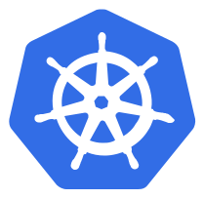


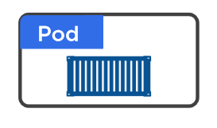
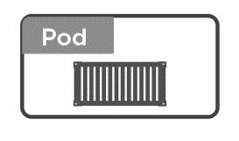
Volumes in Kubernetes
Why we need volumes?
On-disk files in a Container
are
ephemeral
Volume
(state)
Notes:
2 clicks
If pods dies, data dies
Pods only get ephemeral storage
What happens if you need persistence across lifecycle
VOLUMES!

Slide 76
Volumes in Kubernetes
Different Types
Volumes
emptyDir
hostPath
Cloud Volumes
Persisted Volum Claim (PVC)
ConfigMap
Security
….
RAM
HDD /SSD
Notes:
hostPath = folder on node (single node testing only)
<click>

Slide 77
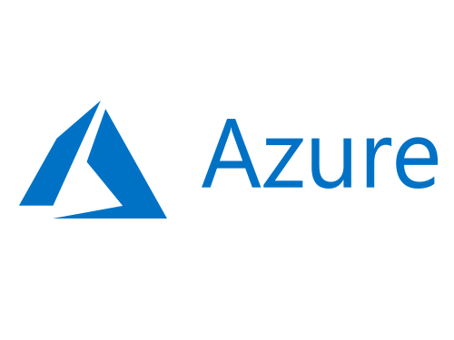

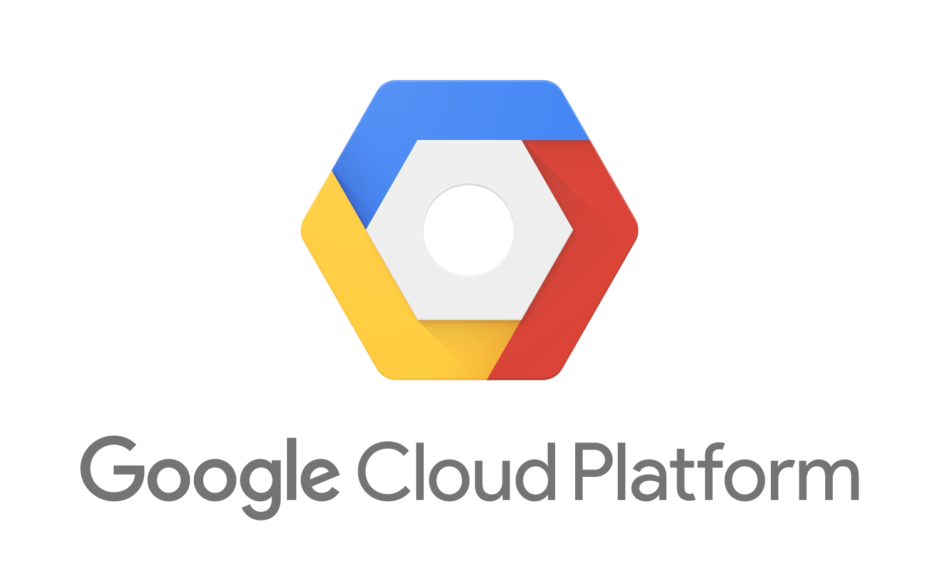
Volumes in Kubernetes
Different Types of Volumes
Volumes
emptyDir
hostPath
Cloud Volumes
Persisted Volum Claim (PVC)
ConfigMap
Security
….
Notes:
Cloud Volumes = storage on cloud providers: ie: Blob
<click>

Slide 78
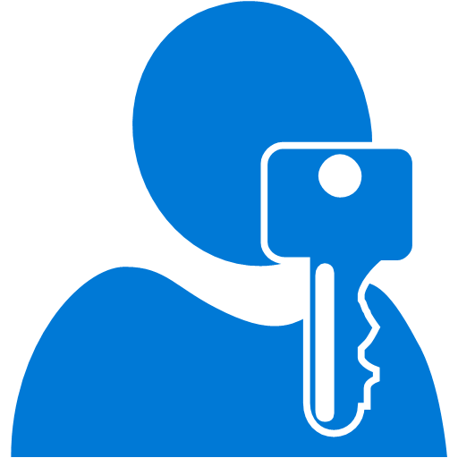

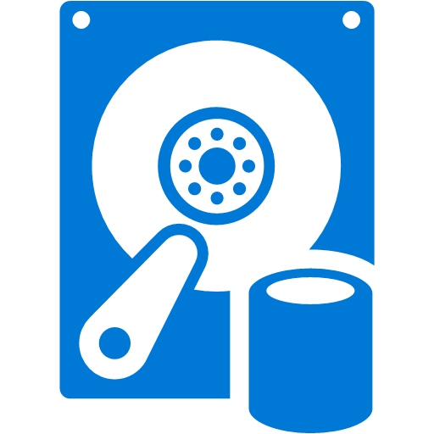
Volumes in Kubernetes
PV vs PVC
Volumes
emptyDir
hostPath
Cloud Volumes
Persisted Volum Claim (PVC)
ConfigMap
Security
….
Cluster Admin
Persisted Volume
(static)
Developer
Storage Class
(dynamic)

Slide 79

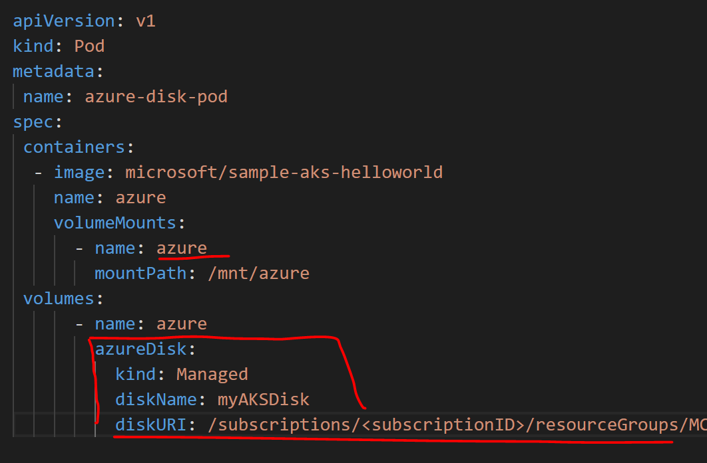
Volumes in Kubernetes
Static Storage in AKS – Azure Disk
az disk create \ --resource-group MC_myResourceGroup_myAKSCluster_eastus \ --name myAKSDisk \ --size-gb 20 \ --query id --output tsv
/subscriptions/<subscriptionID>/resourceGroups/MC_myAKSCluster_myAKSCluster_eastus/providers/Microsoft.Compute/disks/myAKSDisk

Slide 80
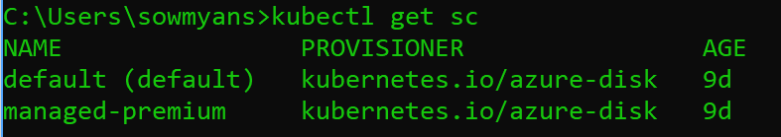
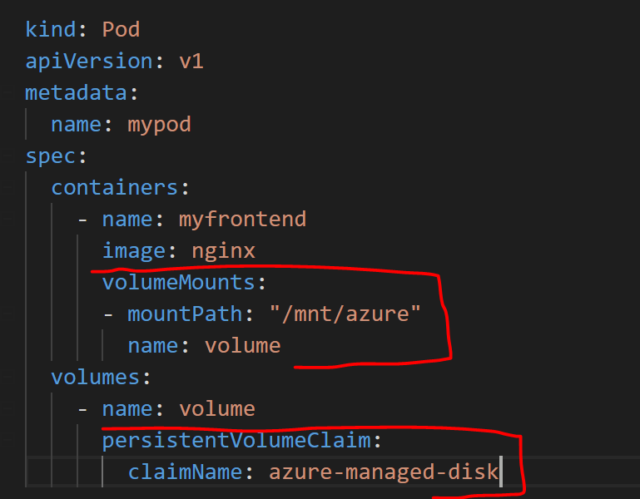
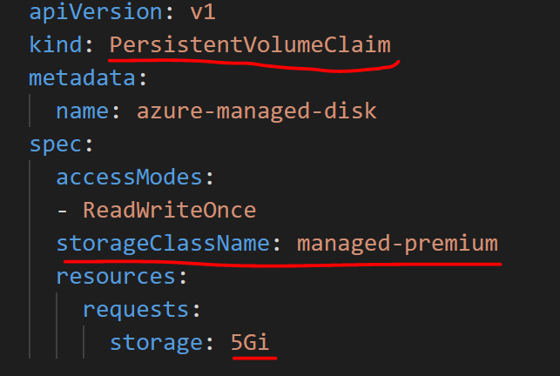
Volumes in Kubernetes
Dynamic Storage in AKS – Azure Disk

Slide 81
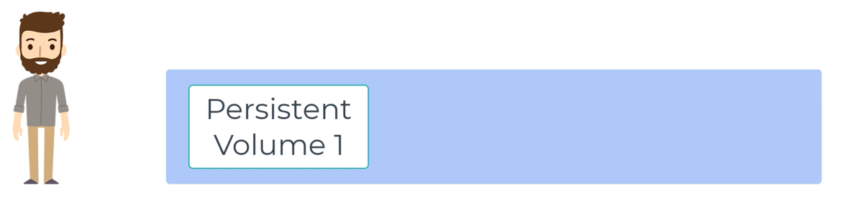
Persistent Volumes - Static
Notes:
PV is storage provisioned by admin.

Slide 82
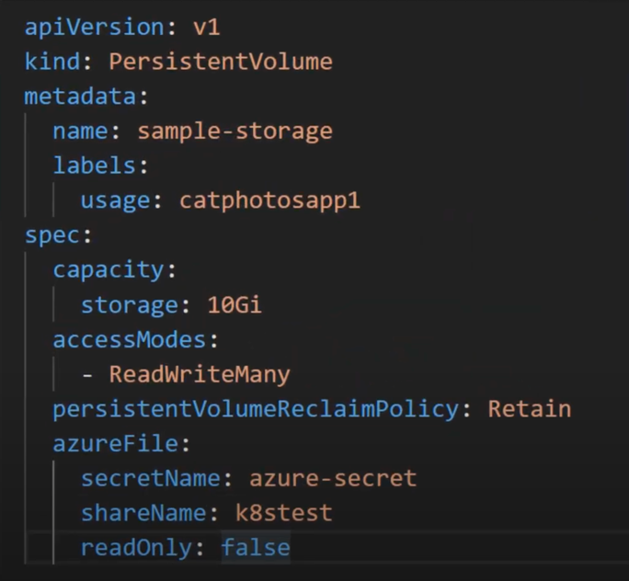
Persistent Volumes - Static
Notes:
PV is storage provisioned by admin.

Slide 83
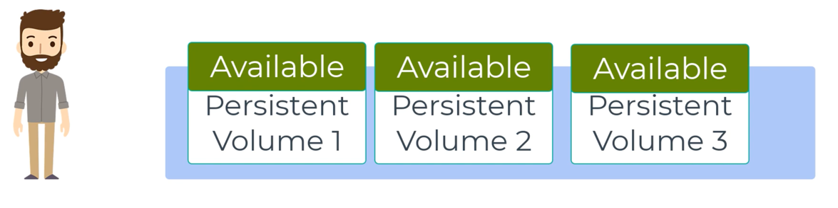
Persistent Volumes - Static
Notes:
PV is storage provisioned by admin.
Cluster of disks like we have a cluster of VMs.

Slide 84
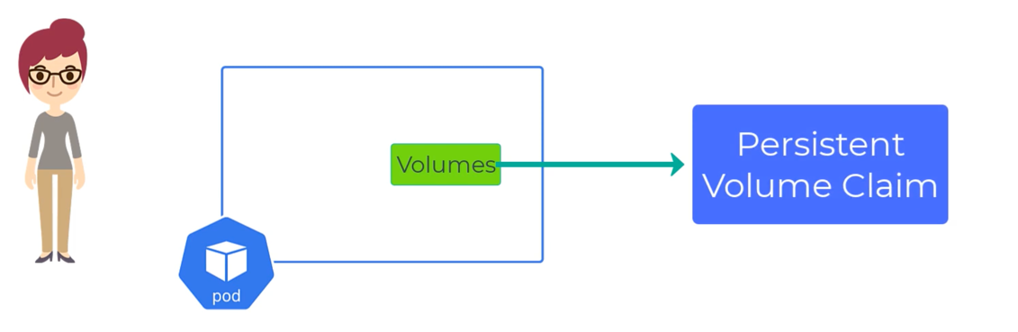
Persistent Volume Claims
Notes:
PVC is a request for storage of certain size and type
Just like: pods with their cpu and memory requests

Slide 85
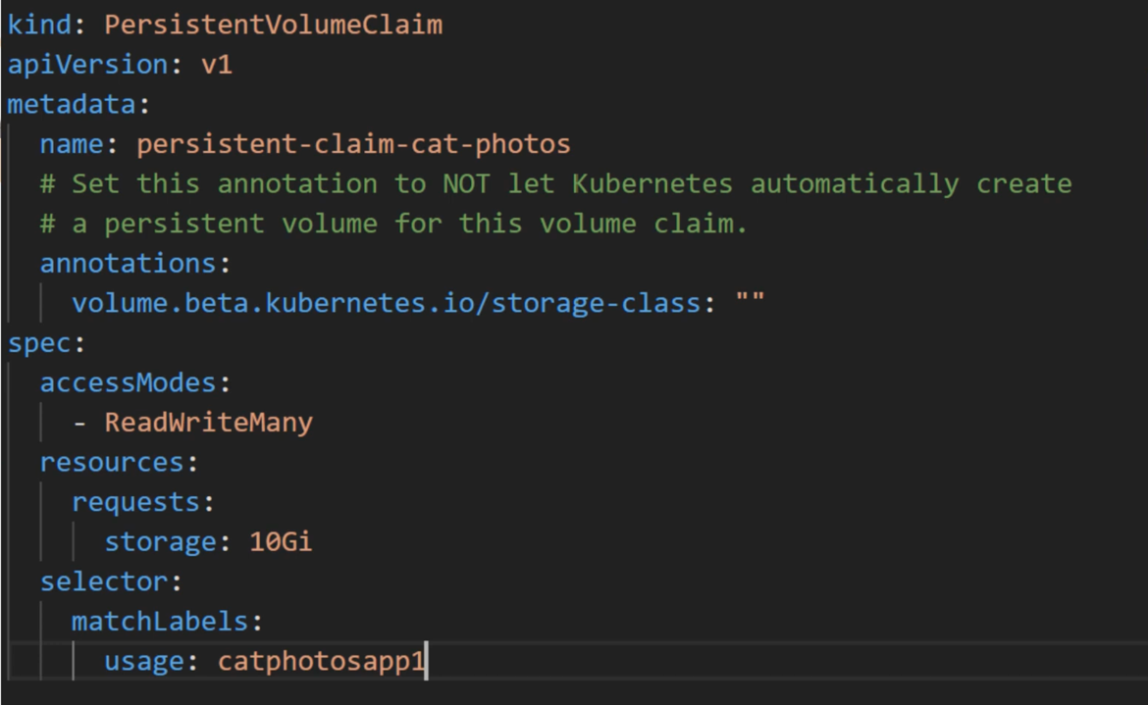
Persistent Volume Claims
Notes:
PVC is a request for storage of certain size and type
Just like: pods with their cpu and memory requests

Slide 86
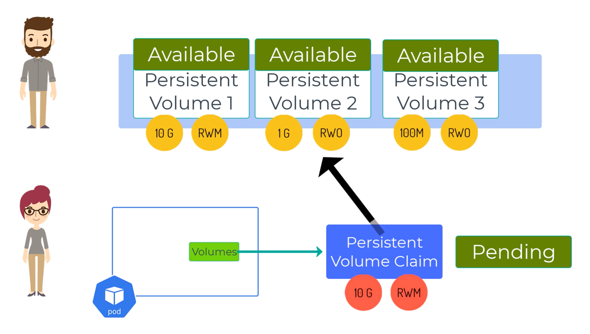
Persistent Volume Claims
Notes:
PVC will search for a PV that matches its needs.
It will remain in Pending state until it does.

Slide 87
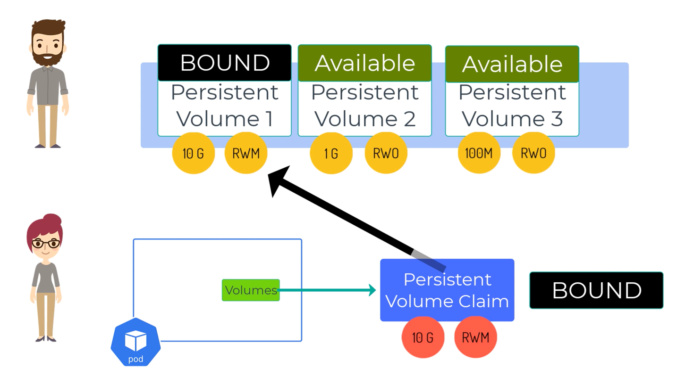
Persistent Volume Claims
Notes:
Once a suitable PV is found, the PVC is “Bound” to the PV

Slide 88
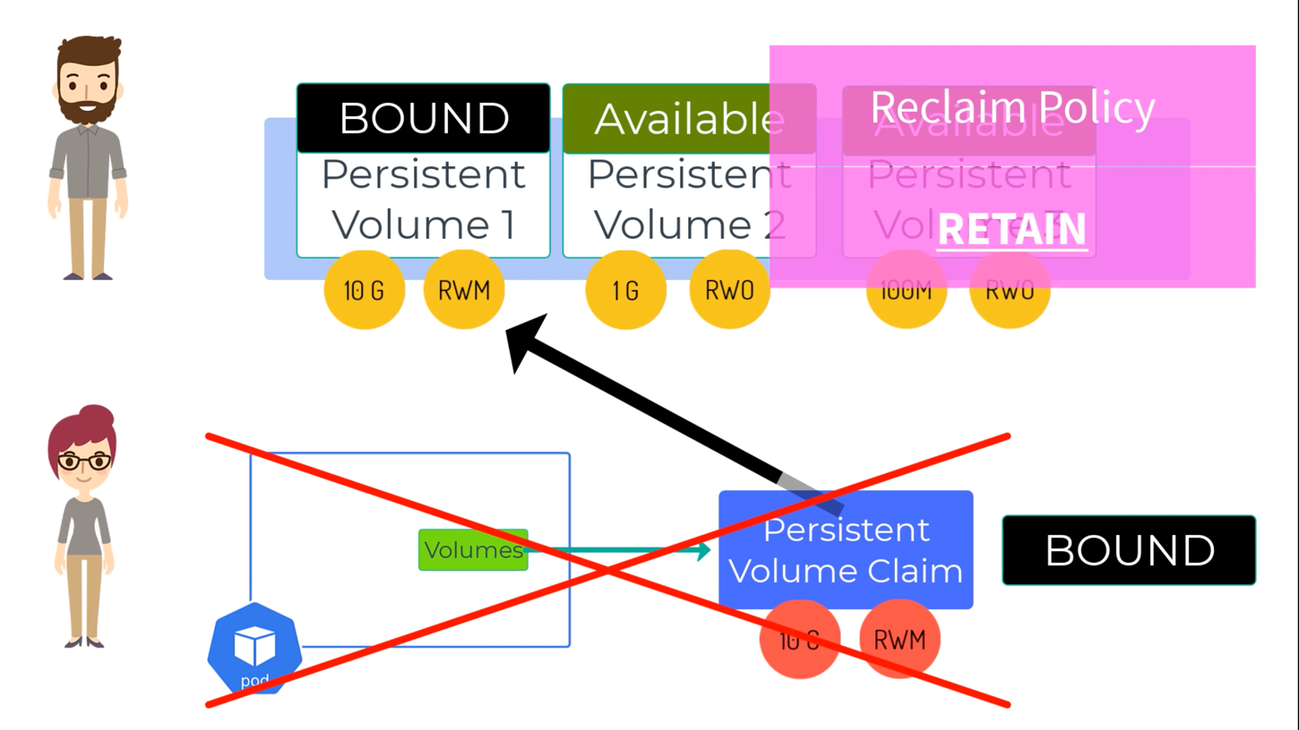
Persistent Volume Claims
Notes:
The reclaim policy tells us what happens to the PV when the PVC is deleted

Slide 89
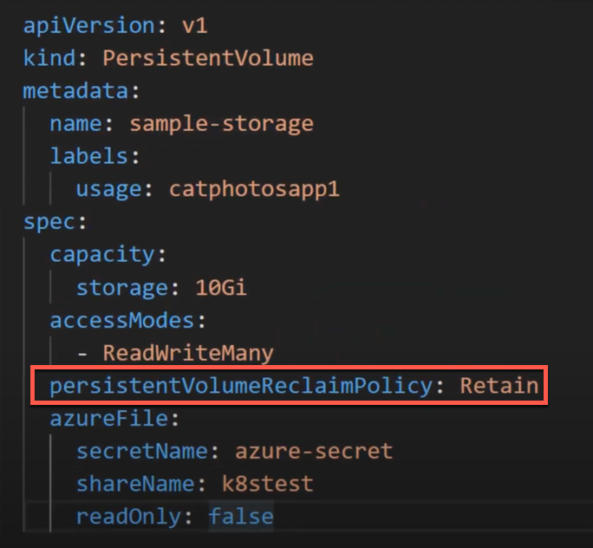
Persistent Volume Claims
Notes:
The reclaim policy tells us what happens to the PV when the PVC is deleted.
Cluster admin set this when they set up the PV cluster.

Slide 90
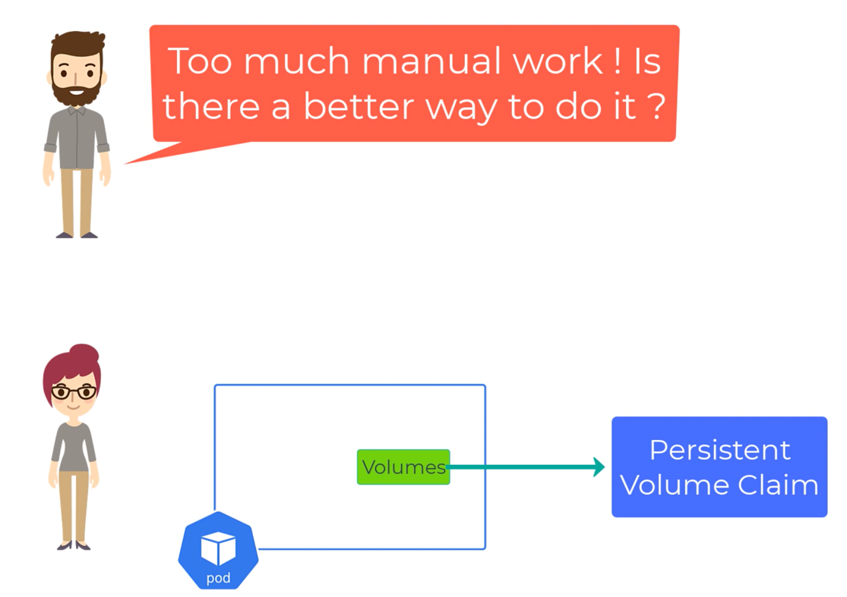
Persistent Volumes
Notes:
How do we make this more dynamic???

Slide 91
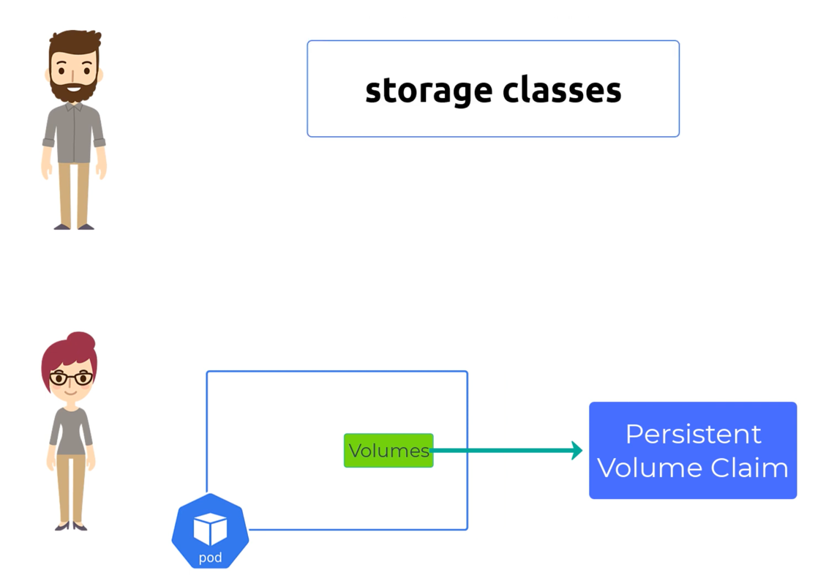
Persistent Volumes - Dynamic
Notes:
… storage classes.

Slide 92
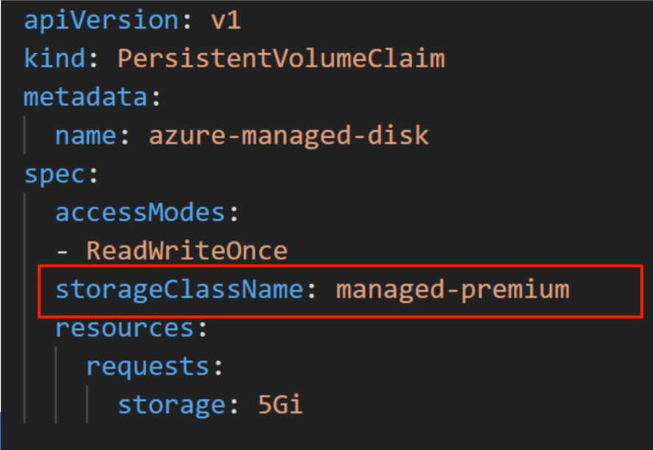
Persistent Volumes - Dynamic
Notes:
When we create a PVC with a storage class, the SC will make sure to dynamically create the type of storage we want.

Slide 93
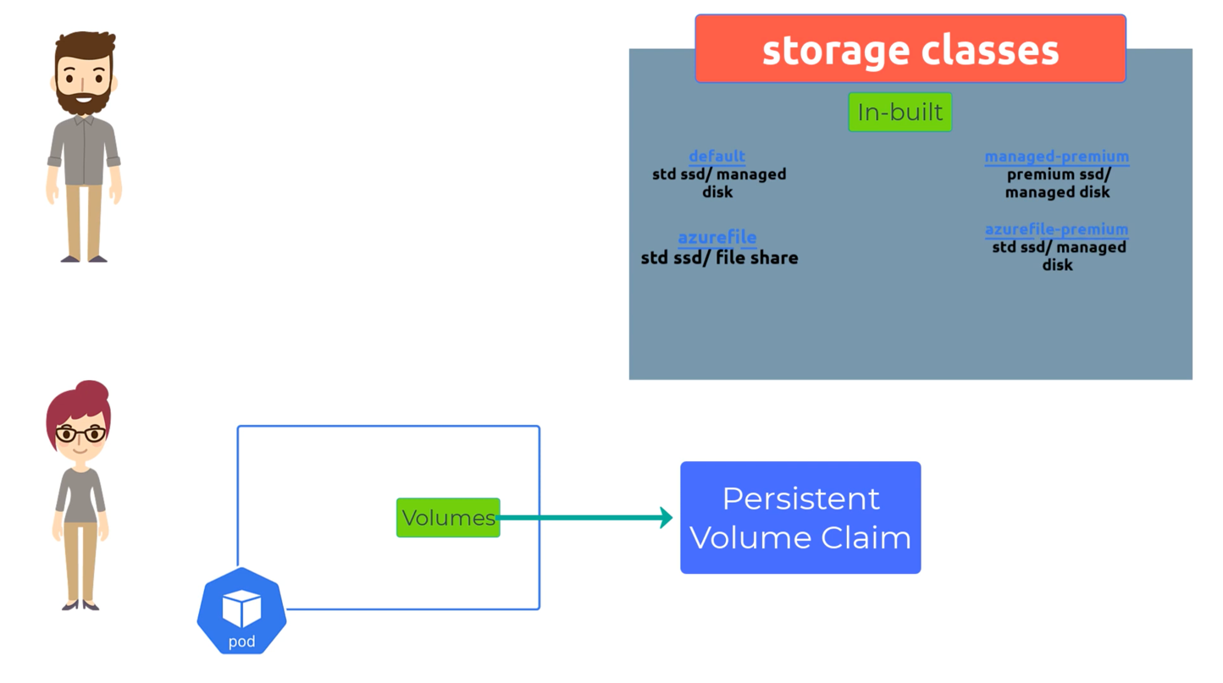
Persistent Volumes - Dynamic
Notes:
There are various storage clusters that come with AKS and more can be created.

Slide 94
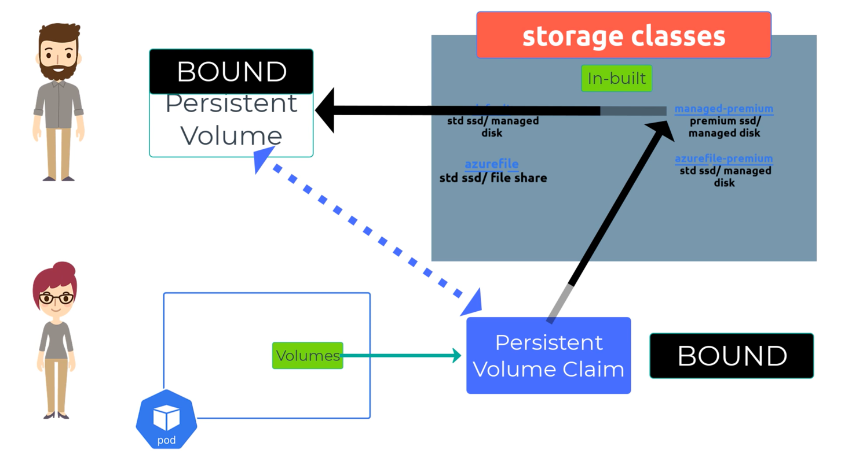
Persistent Volumes - Dynamic
Notes:
Once the PV asks for a managed-premium disk it is provisioned automatically
Ops doesn’t need to be involved.
It will be the exact size asked for
The default retainPolicy is “DELETE”

Slide 95
Challenge 8
Storage
Create Azure Disks
Deploy the mongo Db with persisted storage
Initialized the sample content – speakers & session
Destroy the mongo Db and recreate and verify that the data is persisting

Slide 96
Helm
DevOps for Kubernetes

Slide 97
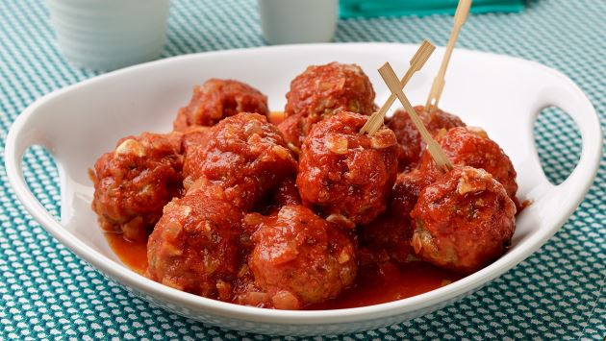
How to Make Meatballs with Kubernetes

Slide 98
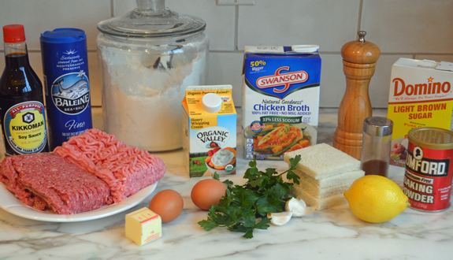
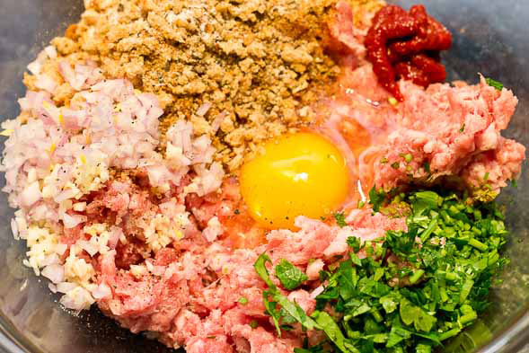
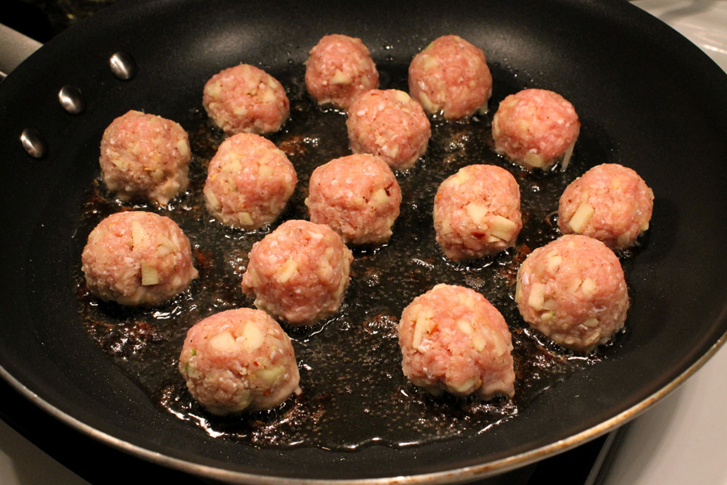
Hard Way – With YAML Files + kubectl

Slide 99
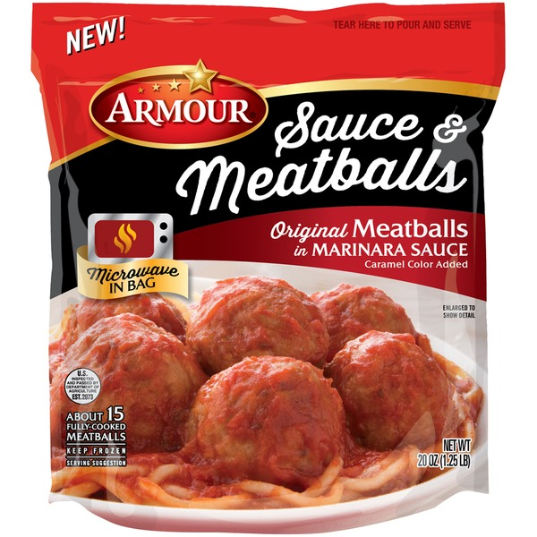
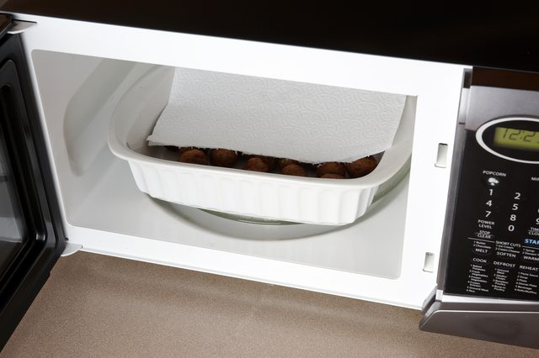
Easy Way – With Helm Charts

Slide 100

Helm
Azure Kubernetes Service (AKS)
The best way to find, share, and use software built for Kubernetes
Azure Container Instances (ACI)
Azure Container Registry
Manage complexity
Charts can describe complex apps; provide repeatable app installs, and serve as a single point of authority
Easy updates
Take the pain out
of updates with in-place upgrades and custom hooks
Simple sharing
Charts are easy to version, share, and host on public or private servers
Rollbacks
Use helm rollback to roll back to an older version of a release with ease
Open Service
Broker API (OSBA)
Release
Automation Tools
Notes:
Think of helm charts like rpm’s or deb’s…. Packaged up unit of deployment.
Makes it easy to install, version and rollback.

Slide 101

Helm
Azure Kubernetes Service (AKS)
Helm Charts helps you define, install, and upgrade even the most complex Kubernetes application
Azure Container Instances (ACI)
services
ci
db
Azure Container Registry
load balancer
custom
…
Chart.yml
Open Service
Broker API (OSBA)
Release
Automation Tools
Notes:
The Chart.yml defines everything.

Slide 102
Helm Charts
Application definition
Consists of:
Metadata
Kubernetes resource definitions
Configuration
Documentation
Stored in chart repository
Any HTTP server that can house YAML/tar files (Azure, GitHub pages, etc.)
Public repo with community supported charts (eg – Jenkins, Mongo, etc.)
Helm (CLI)
Release: Instance of chart + values -> Kubernetes

Slide 103
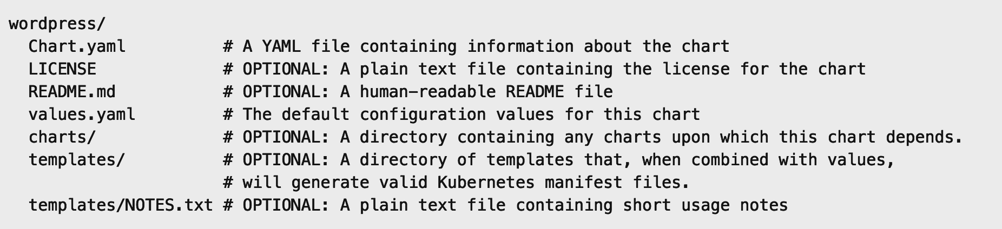
Chart Structure
Layout
  Helm expects a strict chart structure

Slide 104
Helm
values.yaml
The knobs and dials:
  A values.yaml file provided with the chart that contains
  default values
  Use -f to provide your own values overrides
  Use --set to override individual values

Slide 105
Challenge 9A
Meatballs the hard way
Deploy the specified app using the individual yaml files provided
  Deploy the specified app for this challenge using the steps and yaml files provided.
  Verify that the app has been deployed successfully.

Slide 106
Challenge 9B
Meatballs the easy way
Using the Helm Charts from a Local Package
  Convert these yaml files that were just used to deploy the app into a Helm chart
  Create a package and make it available in the local repository.
  Remove the previously deployed app and deploy the helm chart you just created
  Verify that the app has been deployed successfully
  Make a note of the difference in number of steps involved in the deployment using individual yaml files and the Helm chart

Slide 107
Challenge 9C
Meatballs the easy way with Helm (remote w/ACR)
Using Helm chart from remote repo in Azure Container Registry
  Push the Helm chart you just packaged to the remote ACR repo
  Remove the package locally
  Uninstall the app and redeploy it using the Helm chart from the ACR repo
  Verify that the app has been deployed successfully

Slide 108
Networking

Slide 109
Networking in Kubernetes
Kubernetes Networking model introduces 3 methods of communications:
Pod-to-Pod communication directly by IP address. Kubernetes has a Pod-IP wide metric simplifying communication.
Pod-to-Service Communication – Client traffic is directed to service virtual IP by iptables rules that are modified by the kube-proxy process (running on all hosts) and directed to the correct Pod.
External-to-Internal Communication – external access is captured by an external load balancer which targets nodes in a cluster. The Pod-to-Service flow stays the same.
Notes:
When the backend Service is created, the Kubernetes master assigns a virtual IP address, for example 10.0.0.1. Assuming the Service port is 1234, the Service is observed by all of the kube-proxy instances in the cluster. When a proxy sees a new Service, it installs a series of iptables rules which redirect from the VIP to per-Service rules. The per-Service rules link to per-Endpoint rules which redirect (Destination NAT) to the backends.
When a client connects to the VIP the iptables rule kicks in. A backend is chosen (either based on session affinity or randomly) and packets are redirected to the backend. Unlike the userspace proxy, packets are never copied to userspace, the kube-proxy does not have to be running for the VIP to work, and the client IP is not altered.
This same basic flow executes when traffic comes in through a node-port or through a load-balancer, though in those cases the client IP does get altered.

Slide 110


Networking - Pod
Inter-Pod Communication
Notes:
Pods are the unit of deployment in k8s
Each pod get an IP address and each pods can communicate each other in the Pod Network provided by K8s regardless of nodes

Slide 111


Networking - Pod
Inter-Pod Communication
Notes:
There can be one or more containers in a single pod
By default each container can communicate with other via localhost with port number
If we need to access a specific app in a one of those container then can use the Pod IP : Port number

Slide 112


Networking - Service
Why Service?
10.0.10.1
10.0.10.2
10.0.10.3
10.0.10.10
10.0.10.4
Notes:
Why do we have services
Imagine we talk directly… what happens on death?
New pod different IP
<click>

Slide 113


Networking - Service
Why Service?
10.0.10.1
10.0.10.2
10.0.10.3
10.0.10.4
Notes:
Need an abstraction…. With reliable IP/DNS/Port

Slide 114

Networking - Service
How Does Service Work
Name : Foo
Type : API
10.0.10.1
10.0.10.2
10.0.10.3
10.0.10.4
10.0.10.5
10.0.10.6
Name : Foo
Name : Foo
Name : Foo
Name : Foo
Name : Bar
Name : Bar
Type : API
Type : API
Type : API
Type : API
Type : Database
Type : Database

Slide 115
Different Types of Services
ClusterIP (default)
LoadBalancer
NodePort
Notes:
ClusterIP == service is completely internal
LoadBalancer == service gets an external IP. AKS will had setting up an external load balancer for you.
NodePort == a primitive way to get external traffic to your service. No longer used even in dev, we won’t be discussing it.

Slide 116



Networking – Service: Cluster IP
How Does ClusterIP Service Work
Notes:
A ClusterIP service is the default Kubernetes service. It gives you a service inside your cluster that other apps inside your cluster can access. There is no external access
When would you use this?
There are a few scenarios where you would use the Kubernetes proxy to access your services.
Grouping pods into subset of services, e.g all Foo API pods , Foo database pods, Foo Web Front Pods etc..
Debugging your services, or connecting to them directly from your laptop for some reason
Allowing internal traffic, displaying internal dashboards, etc.

Slide 117


Networking – Service: Loadbalancer
How Does LoadBalancer Service Work
Notes:
LoadBalancer == expose a service to the internet.
A LoadBalancer service is the standard way to expose a service to the internet. On AKS, uses the Azure Load Balancer that will give you a single IP address that will forward all traffic to your service.
When would you use this?
If you want to directly expose a service, this is the default method. All traffic on the port you specify will be forwarded to the service. There is no filtering, no routing, etc. This means you can send almost any kind of traffic to it, like HTTP, TCP, UDP, Websockets, gRPC, or whatever.
The big downside is that each service you expose with a LoadBalancer will get its own IP address, and you have to pay for a LoadBalancer per exposed service, which can get expensive!

Slide 118


Networking – Service: NodePort
How Does NodePort Service Work
Notes:
A NodePort service is the most primitive way to get external traffic directly to your service. NodePort, as the name implies, opens a specific port on all the Nodes (the VMs), and any traffic that is sent to this port is forwarded to the service.
Basically, a NodePort service has two difference from a normal “ClusterIP” service. First, the type is “NodePort.” There is also an additional port called the nodePort that specifies which port to open on the nodes. If you don’t specify this port, it will pick a random port. Most of the time you should let Kubernetes choose the port;
There are many downsides to this method:
You can only have once service per port
You can only use ports 30000–32767
If your Node/VM IP address change, you need to deal with that
For these reasons, I don’t recommend using this method in production to directly expose your service. If you are running a service that doesn’t have to be always available, or you are very cost sensitive, this method will work for you. A good example of such an application is a demo app or something temporary.

Slide 119


Networking - Ingress
How Does Ingress Controller Work
Notes:
Layer 7
Sub Domain or path reverse proxy
Implementation == Ingress controller
Nginx == industry standard
Azure App Gateway ingress controller now exists too
Unlike all the previous service examples, Ingress is actually NOT a type of service. Instead, it sits in front of multiple services and act as a “smart router” or entrypoint into your cluster.
You can do a lot of different things with an Ingress, and there are many types of Ingress controllers that have different capabilities.
When would you use this?
Ingress is probably the most powerful way to expose your services, but can also be the most complicated. There are many types of Ingress controllers, from the Google Cloud Load Balancer, Nginx, Contour, Istio, and more.
There are also plugins for Ingress controllers, like the cert-manager, that can automatically provision SSL certificates for your services.
Ingress is the most useful if you want to expose multiple services under the same IP address, and these services all use the same L7 protocol (typically HTTP). You only pay for one load balancer if you are using the native GCP integration, and because Ingress is “smart” you can get a lot of features out of the box (like SSL, Auth, Routing, etc)

Slide 120
AKS Networking
Basic / kubenet
  Provisions its own VNET and only exposes Public IPs
  Pods IPs get only ClusterIPs and accessible only within the cluster
  Publicly exposed services accessible outside the cluster
Advanced / Azure CNI
  Uses an existing VNET and exposes private IPs
  Pods & Services get private IPs
  Network address space design is very important
Notes:
ACI requires Advanced Networking

Slide 121
Container Network Interface (CNI)
CNI (a CNCF project) is a spec for plugins to configure Linux container network interfaces
Wide range of support
  Kubernetes, OpenShift, Cloud Foundry, Mesos, rkt, etc.
Examples
  Calico, Weave, Contiv, etc.
Azure CNI plug-in integrates Azure VNET into kubernetes clusters
Notes:
CNCF = Cloud Native Computing Foundation
https://github.com/Azure/azure-container-networking/blob/master/docs/acs.md

Slide 122
Challenge 10
Networking
Deploy the nginx Ingress Controller
Deploy a web app with an ingress using the nginx ingress controller and custom DNS prefix
Verify the DNS records are created successfully
Test external access of the application using the DNS name of the web app

Slide 123
Monitoring, Logging, & Troubleshooting

Slide 124
Monitoring
Kubernetes monitoring provides us with the ability to view what is happening within the cluster nodes, pods and containers.
Benefits:
  View application logs.
  Identify resource bottlenecks.
  View the cluster's overall performance.
  Review the resource utilization of workloads running on the host that are unrelated to the standard processes that support the pod.
  Understand the behavior of the cluster under average and heaviest loads.
  Identify capacity needs and determine the maximum load that the cluster can sustain.

Slide 125
Logging and Troubleshooting
Viewing full logs for pods and services:
  kubectl logs
There are various ways to troubleshoot:
  Finding out why pods are failing:
    kubectl describe pod
  Getting a bash shell into a running container in a pod:
    kubectl exec

Slide 126
Application Health and Readiness
Kubelets on workers use liveness and readiness probes to know when to restart a container or start directing traffic
  Liveness check: when to restart
  Readiness check: when to forward Service traffic to a pod
Notes:
Look at liveness
Look at readiness

Slide 127
Monitoring
What Indicators Matter in Kubernetes
Cluster health: total number of nodes, pods, etc
Node health: available compute resources, health
Application health
Tooling Examples
  Datadog
  Prometheus
  InfluxData
  Cloud-specific: OMS (Azure), CloudWatch (AWS)
Notes:
https://docs.datadoghq.com/integrations/kubernetes/

Slide 128
Logging
Pod logs: applications must log to standard out!
Cluster-wide event logs
Logging forwarder solutions
  fluentd
  logstash
Log indexers
  OMS Log Analytics
  Splunk
  ELK stack

Slide 129
Challenge 11
Deploying Monitoring Tools and Troubleshooting
Find the logs for your application’s containers
Start a bash shell into a container and check the list of running processes
Find out if your pods had any errors.
Enable Azure Monitoring for Containers
Install Fluentd and Kibana packages

Slide 130
Thank You for Attending!
https://aka.ms/wth
Notes:
Thank students for attending and share the link to the What The Hack website with them.

