Slide 1
Intro to Aspire
Speaker Name
Role, Company
@social

Slide 2

Modern apps are like being in a
Big city without a map
Editor/IDE
Frontends
Services
Agents + AI
Env
> Operating systems
> Shells + terminals
> Coding agents
> Extensions
> Endless languages + frameworks
> Databases + storage
> Auth
> Caches + queues
> Messaging
> Models, deployments, frameworks
> Secrets/tokens/keys
> Provisioning parameters
> Non-source-controllable assets
> Changing ports and dependencies
Backends
Observability
> Microservices, monoliths, containers, VMs
> Different data pipelines for different parts of the app
Manifests + Scripts
Deployment handoff
> Manifest languages (YAML, JSON, Dockerfiles)
> Hard-to-read scripts (Bash, pwsh)
> README.md, internal wikis, "tribal knowledge"
> Manual deployments
> Automated CI/CD
> Enterprise devops workflow

Slide 3
Complex dev,
complex deploy
Dev Loop
Deployments
> Impossible to "clone and run“
> No easy way to add new services
> Local dev does not reflect actual running system
> Coding agents can’t see the entire system
> Fragile, always-changing assets
> Complicated handoffs for architecture changes
> "Only in prod" observability
> Configuration drift becomes challenging

Slide 4
Aspire is an agent-ready, code-first tool to compose, debug, and deploy any distributed app.

Slide 5
What is Aspire?
Aspire is an agent-ready, code-first tool to compose, debug, and deploy any distributed app.
5
Frontend
4
Web API
Code-first development and deployment experience maps your entire distributed app.
Agents have knowledge about every detail of your system.
Over one hundred integration packages designed to simplify connections to popular services, platforms and stacks.
Visualize all your logs, endpoints, and resources in a single dashboard.
3
Cache
2
Database
1
Cloud service
Notes:
Aspire helps you cut through the chaos of complex distributed systems by providing a code-first experience for local development, debugging, and seamless deployment. With no rewrites, Aspireify any existing system.
Aspire fuels your coding agents with knowledge about every detail of your system, from writing code, to debugging issues through detailed Open Telemetry traces and logs so you can build and debug faster.
Hundreds of integration packages are designed to simplify connections to popular services, platforms and stacks. Each one handles compute resource setup and provides standardized patterns for health checks, telemetry, and configuration.
Visualize your entire stack in a Dashboard -- your command center. Powered by OpenTelemetry it automatically collects traces, metrics, and structured logs from every resource in your AppHost and surfaces them through a rich, interactive UI.

Slide 6
What is Aspire?
The important parts
Aspire CLI
The CLI provides an interactive, agent-ready control plane so you can create, run and deploy distributed apps seamlessly.
> aspire init
Your agent-ready control plane
Aspire AppHost
Aspire Integrations
Aspire Dashboard
Define your stack in code
Plug in anything, ship faster
Your app, at a glance
The AppHost is the map for your distributed app. It is the code-first place where you declare your application’s services and their relationships.
Aspire integrations are a curated suite of over one hundred packages that make it easy to connect your cloud-native applications with popular services.
The Aspire dashboard is powered by OpenTelemetry and collects traces, metrics, and structured logs and surfaces them through a rich, interactive UI and an MCP server for agents.
Notes:
The CLI provides an interactive, agent-ready control plane so you can create, run and deploy distributed apps seamlessly. Use the Aspire CLI to streamline development workflows and coordinate distributed services.
Thie AppHost is the map for your distributed app. It is the code-first place where you declare your application’s services and their relationships. Describe the architecture in code and Aspire handles local orchestration so you can focus on building features.
Aspire integrations are a curated suite of over one hundred packages that make it easy to connect your cloud-native applications with popular services and provide essential cloud-native capabilities through automatic setup and standardized configuration.
The Aspire Dashboard is your command center. Powered by OpenTelemetry it automatically collects traces, metrics, and structured logs from every resource in your AppHost and surfaces them through a rich, interactive UI and an MCP server for agents.

Slide 7
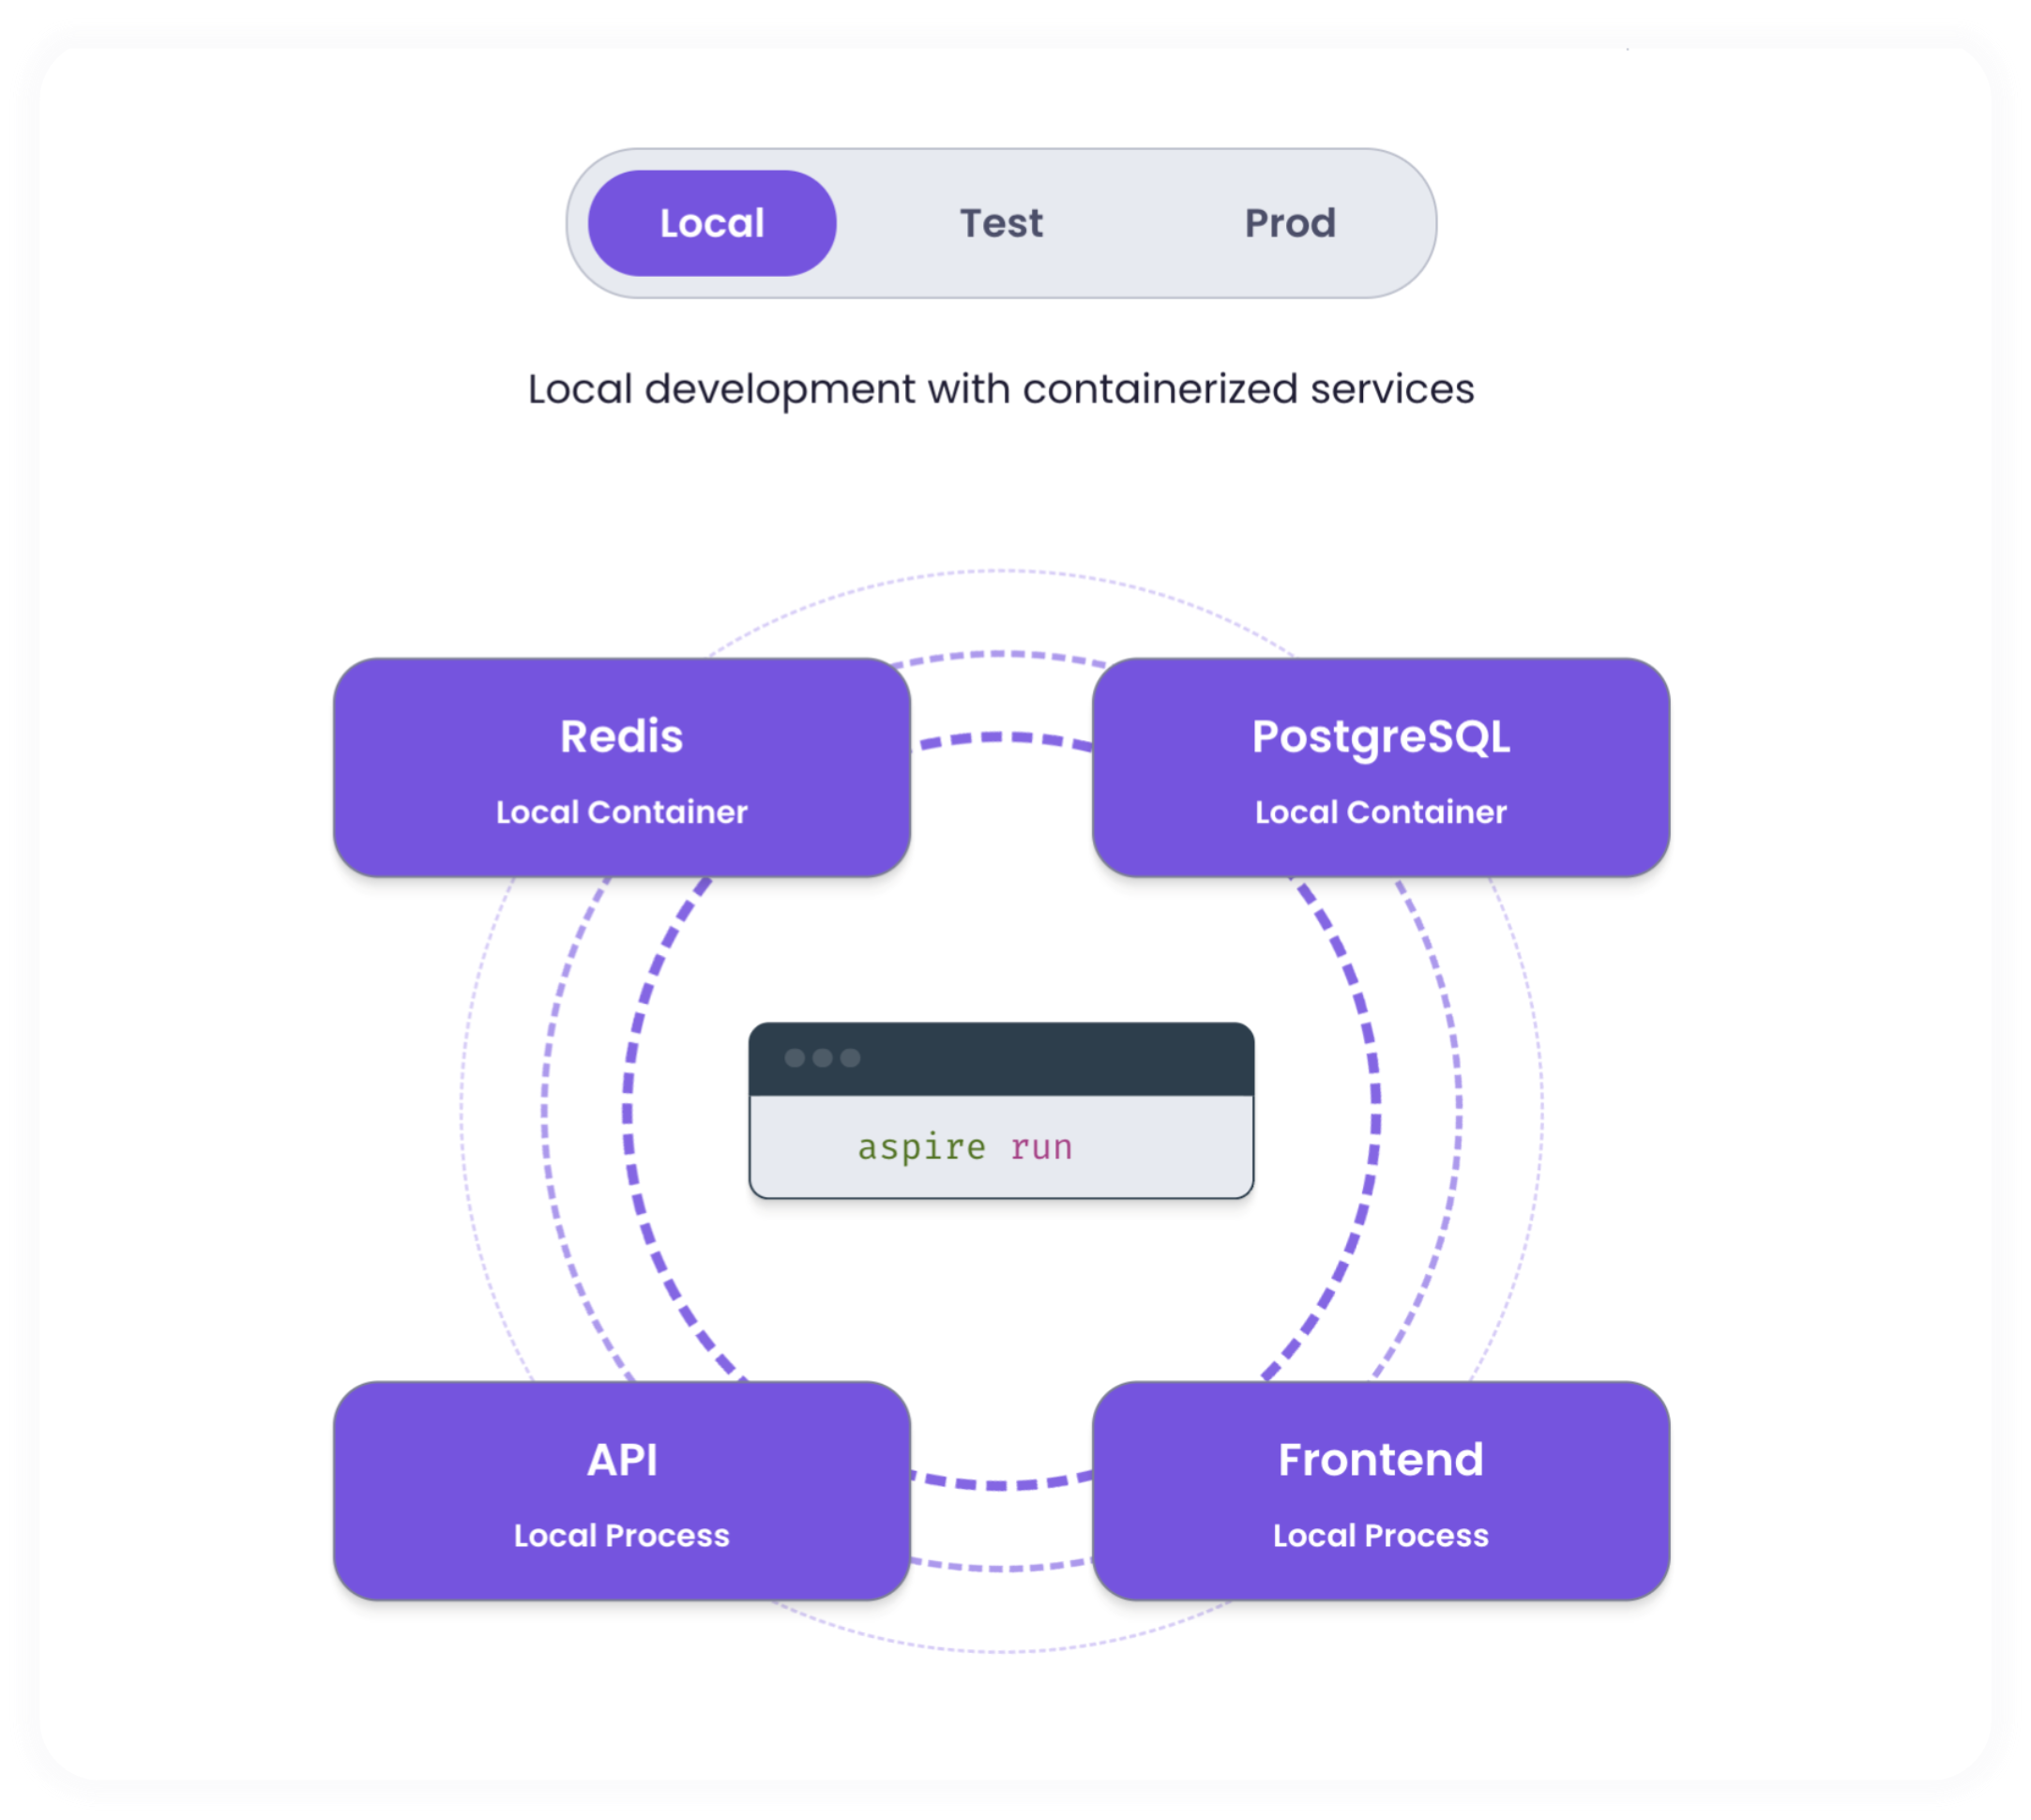
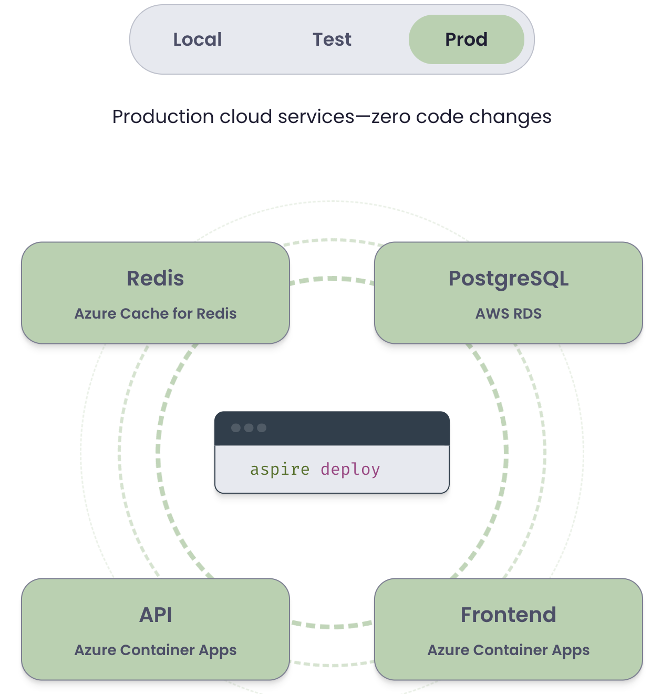
App Host + CLI
Dev first, ops friendly
Clone and run any repo, add new services in one command, and deploy – or hand off to your deployment pipeline – without code changes, from one CLI.
Notes:
NOTE: The diagram animates from “aspire run” to “aspire deploy” on click

Slide 8
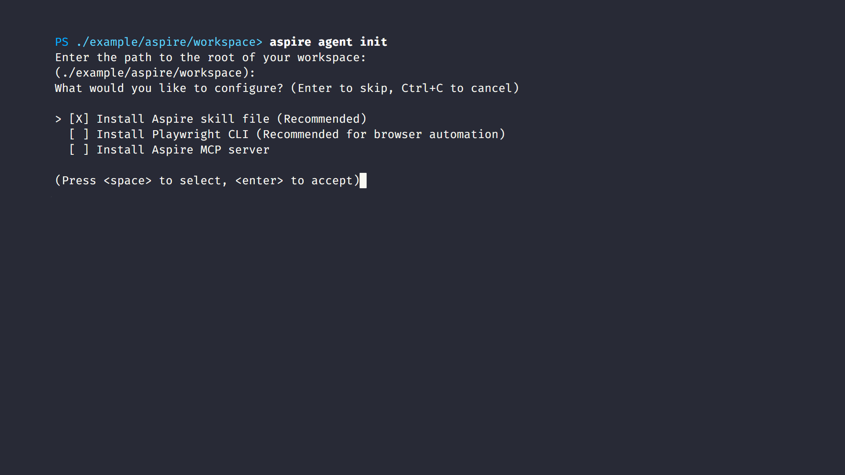
Agent-ready CLI
Ready for any coding agent
The Aspire CLI automatically gives context to your preferred coding agents, providing them with knowledge about your system to help you develop and debug faster.

Slide 9
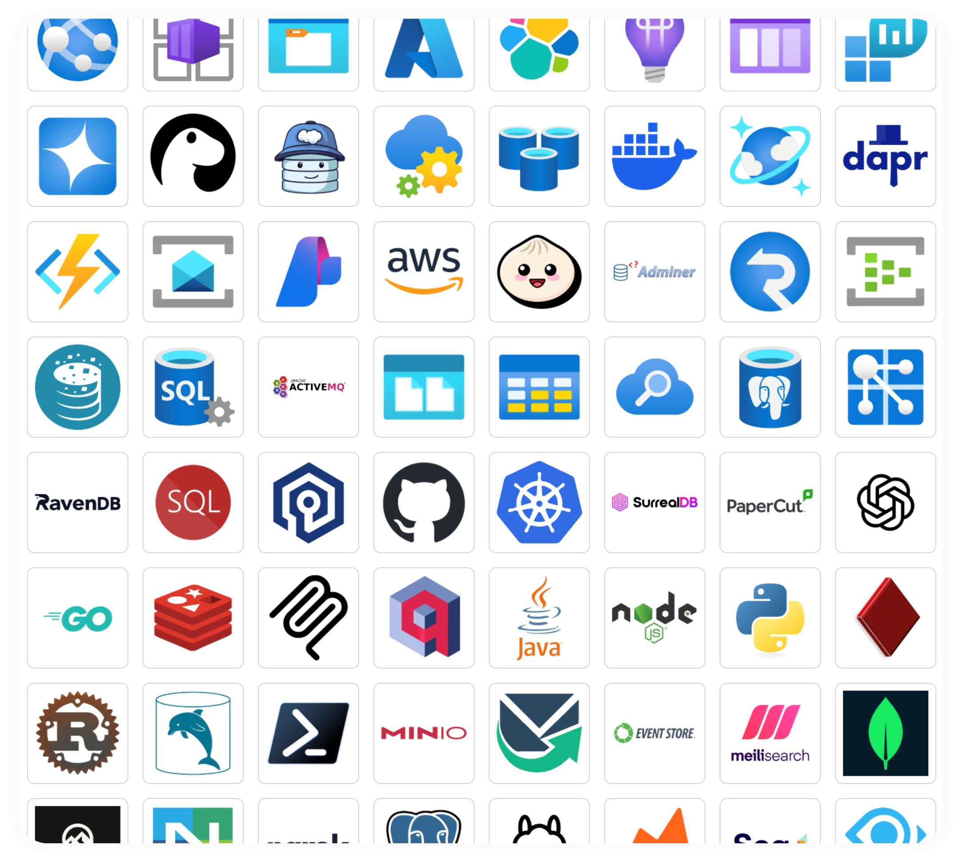
Integrations
Building blocks, not black boxes
Choose from hundreds of prebuilt packages or bring your own. Bootstrap and run any type of container, CLI, or AI agent with a few lines of code.

Slide 10
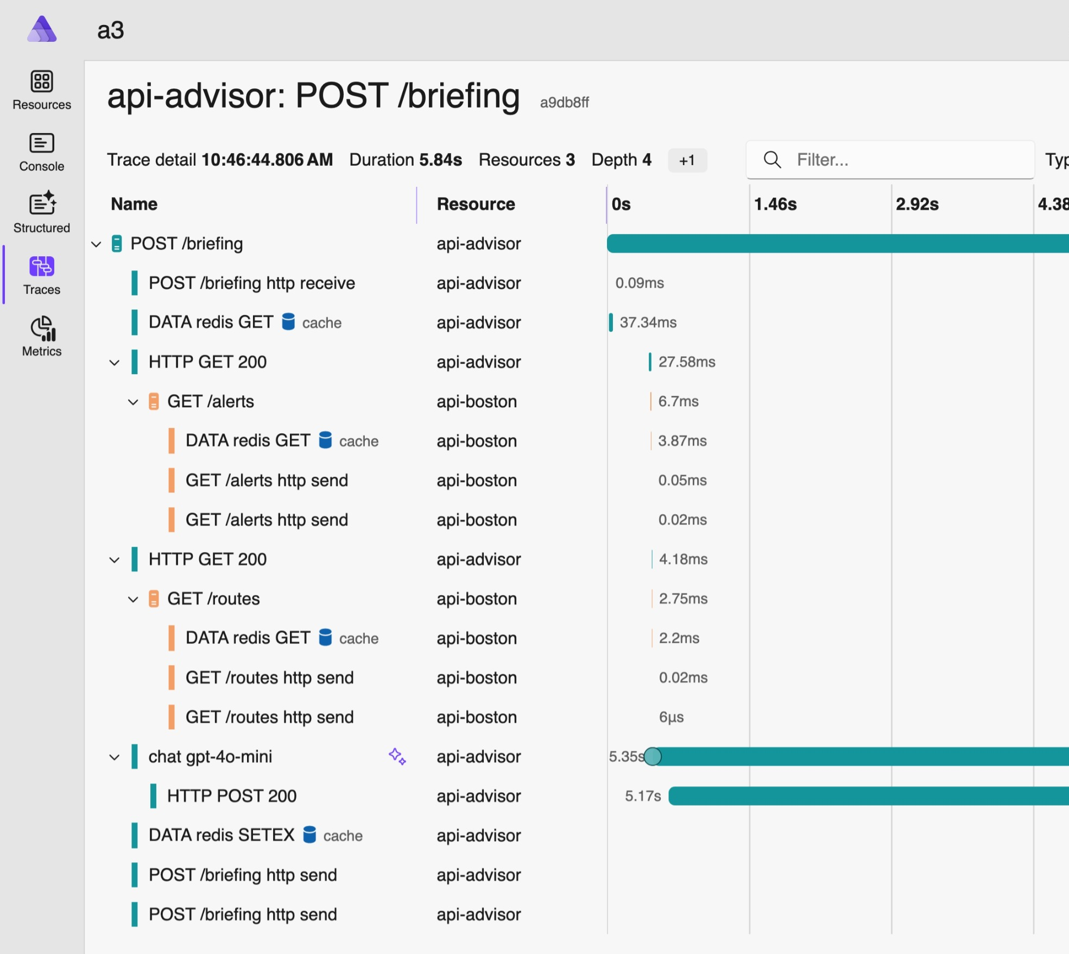
Dashboard
Observability from the start
Logs, traces, health checks—all wired up automatically. OpenTelemetry included with zero setup.

Slide 11
Demo

Slide 12
Thank you

Slide 13
Intro to Aspire
Speaker Name
Role, Company
@social

Slide 14

Modern apps are like being in a
Big city without a map
Editor/IDE
Frontends
Services
Agents + AI
Env
> Operating systems
> Shells + terminals
> Coding agents
> Extensions
> Endless languages + frameworks
> Databases + storage
> Auth
> Caches + queues
> Messaging
> Models, deployments, frameworks
> Secrets/tokens/keys
> Provisioning parameters
> Non-source-controllable assets
> Changing ports and dependencies
Backends
Observability
> Microservices, monoliths, containers, VMs
> Different data pipelines for different parts of the app
Manifests + Scripts
Deployment handoff
> Manifest languages (YAML, JSON, Dockerfiles)
> Hard-to-read scripts (Bash, pwsh)
> README.md, internal wikis, "tribal knowledge"
> Manual deployments
> Automated CI/CD
> Enterprise devops workflow

Slide 15
Complex dev,
complex deploy
Dev Loop
Deployments
> Impossible to "clone and run“
> No easy way to add new services
> Local dev does not reflect actual running system
> Coding agents can’t see the entire system
> Fragile, always-changing assets
> Complicated handoffs for architecture changes
> "Only in prod" observability
> Configuration drift becomes challenging

Slide 16
Aspire is an agent-ready, code-first tool to compose, debug, and deploy any distributed app.

Slide 17
What is Aspire?
Aspire is an agent-ready, code-first tool to compose, debug, and deploy any distributed app.
5
Frontend
4
Web API
Code-first development and deployment experience maps your entire distributed app.
Agents have knowledge about every detail of your system.
Over one hundred integration packages designed to simplify connections to popular services, platforms and stacks.
Visualize all your logs, endpoints, and resources in a single dashboard.
3
Cache
2
Database
1
Cloud service
Notes:
Aspire helps you cut through the chaos of complex distributed systems by providing a code-first experience for local development, debugging, and seamless deployment. With no rewrites, Aspireify any existing system.
Aspire fuels your coding agents with knowledge about every detail of your system, from writing code, to debugging issues through detailed Open Telemetry traces and logs so you can build and debug faster.
140+ integration packages are designed to simplify connections to popular services, platforms and stacks. Each one handles compute resource setup and provides standardized patterns for health checks, telemetry, and configuration.
Visualize your entire stack in a Dashboard -- your command center. Powered by OpenTelemetry it automatically collects traces, metrics, and structured logs from every resource in your AppHost and surfaces them through a rich, interactive UI.

Slide 18
What is Aspire?
The important parts
Aspire CLI
The CLI provides an interactive, agent-ready control plane so you can create, run and deploy distributed apps seamlessly.
> aspire init
Your agent-ready control plane
Aspire AppHost
Aspire Integrations
Aspire Dashboard
Define your stack in code
Plug in anything, ship faster
Your app, at a glance
The AppHost is the map for your distributed app. It is the code-first place where you declare your application’s services and their relationships.
Aspire integrations are a curated suite of over one hundred packages that make it easy to connect your cloud-native applications with popular services.
The Aspire dashboard is powered by OpenTelemetry and collects traces, metrics, and structured logs and surfaces them through a rich, interactive UI and an MCP server for agents.
Notes:
The CLI provides an interactive, agent-ready control plane so you can create, run and deploy distributed apps seamlessly. Use the Aspire CLI to streamline development workflows and coordinate distributed services.
The AppHost is the map for your distributed app. It is the code-first place where you declare your application’s services and their relationships. Describe the architecture in code and Aspire handles local orchestration so you can focus on building features.
Aspire integrations are a curated suite of hundreds of packages that make it easy to connect your cloud-native applications with popular services and provide essential cloud-native capabilities through automatic setup and standardized configuration.
The Aspire dashboard is your command center. Powered by OpenTelemetry it automatically collects traces, metrics, and structured logs from every resource in your AppHost and surfaces them through a rich, interactive UI and an MCP server for agents.

Slide 19
App Host + CLI
Dev first, ops friendly
Clone and run any repo, add new services in one command, and deploy – or hand off to your deployment pipeline – without code changes, from one CLI.
Notes:
NOTE: The diagram animates from “aspire run” to “aspire deploy” on click

Slide 20
Agent-ready CLI
Ready for any coding agent
The Aspire CLI automatically gives context to your preferred coding agents, providing them with knowledge about your system to help you develop and debug faster.

Slide 21
Integrations
Building blocks, not black boxes
Choose from hundreds of prebuilt packages or bring your own. Bootstrap and run any type of container, CLI, or AI agent with a few lines of code.

Slide 22
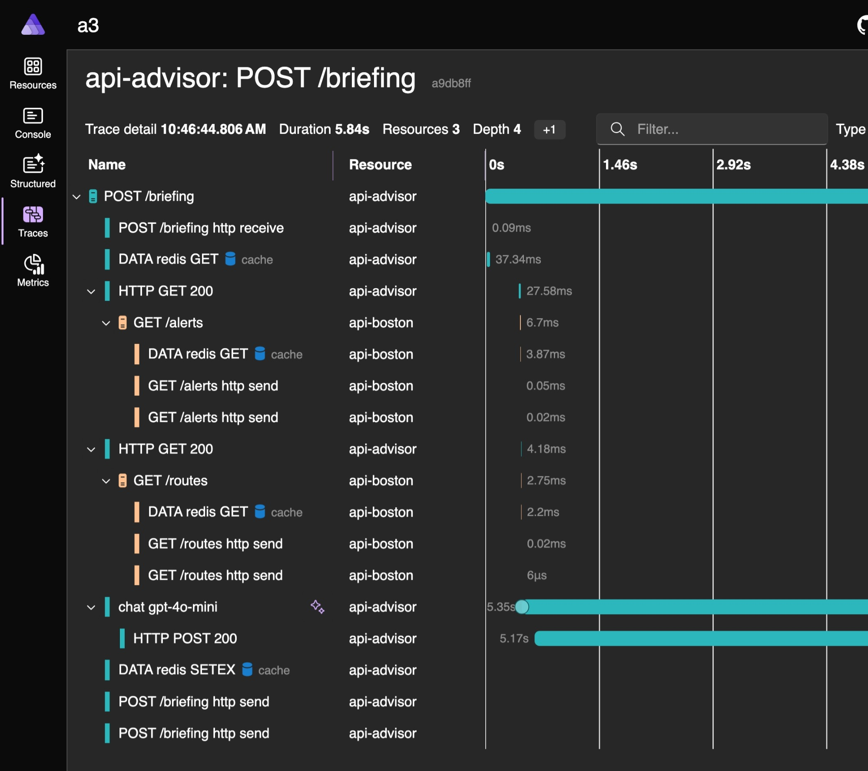
Dashboard
Observability from the start
Logs, traces, health checks—all wired up automatically. OpenTelemetry included with zero setup.

Slide 23
Demo

Slide 24
Thank you

Slide 25
Your icon library

Slide 26
Your icon library
You can recolor these icons to match your theme. Avoid using the icons too large.
Get more icons

Slide 27
Your icon library
You can recolor these icons to match your theme. Avoid using the icons too large.
Get more icons

