Slide 2
Introduction to Deep Learning for Computer Vision
Speaker Name
http://aka.ms/cvworkshop
Title
Speaker Name
Title
Notes:
Link to published module on Learn: https://docs.microsoft.com/en-us/learn/modules/learn-pr/

Slide 3
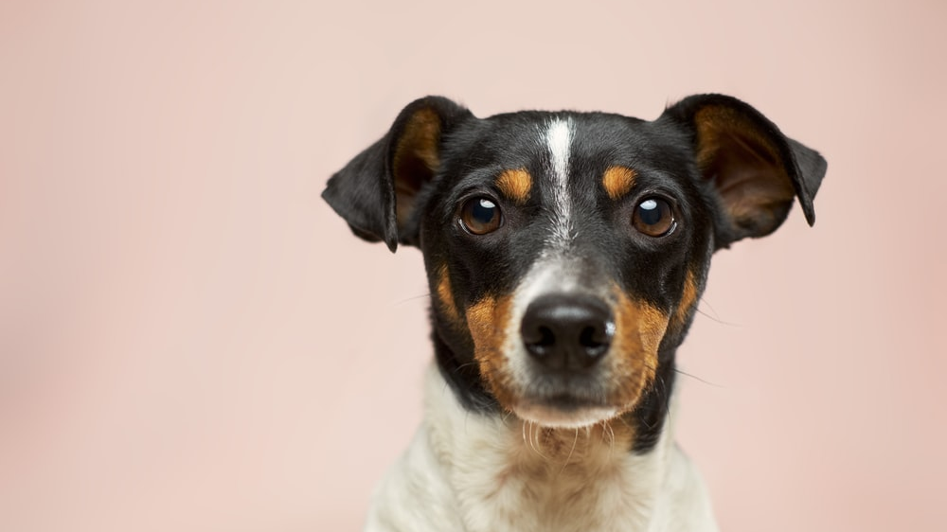
Goal
Imagine pet care center that receives many breeds of cats and dogs every day. Nurses need to feed them according to their breeds. We will train a model that can be used to recognize breed of a pet.

Slide 4
Learning objectives
Learn about neural networks in general
Learn about computer vision tasks most commonly solved with neural networks
Understand how Convolutional Neural Networks (CNNs) work
Train a neural network to recognize pets breeds from faces
OPTIONAL: Train a neural network to recognize breeds from original photos using Transfer Learning

Slide 5
Prerequisites
Basic knowledge of Python and Jupyter Notebooks
Some familiarity with PyTorch/TensorFlow framework, including tensors, basics of back propagation and building models
Understanding machine learning concepts, such as classification, train/test dataset, accuracy, etc.
To Learn:
Read: http://eazify.net/nnintro
Introduction to PyTorch: http://aka.ms/learntorch/intro
Introduction to TensorFlow: http://aka.ms/learntf/keras

Slide 6
Introduction to Neural Networks

Slide 7
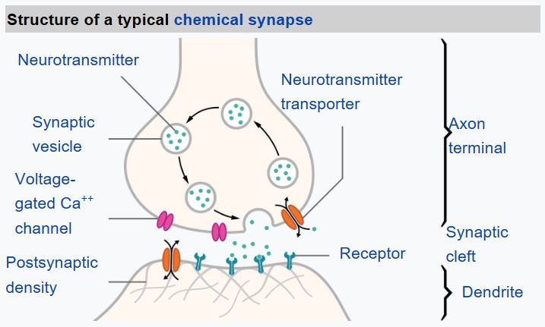
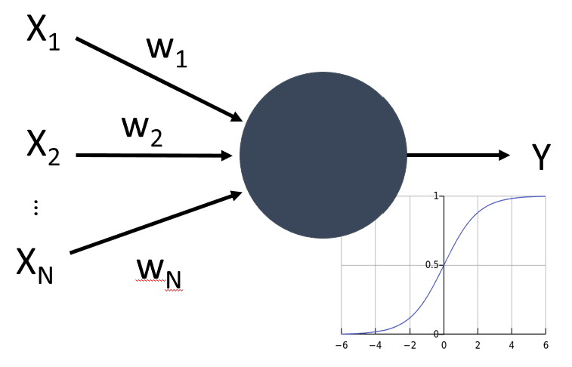
Neural Networks are inspired by our Brain
http://eazify.net/nnintro
Real Neuron
Artificial Neuron

Slide 8
Tensors
$$\left({z_{1} \atop z_{2}}\right)=\left(\begin{matrix}w_{11} & w_{12} & w_{13} \\ w_{21} & w_{22} & w_{23}\end{matrix}\right)\left(\begin{aligned}x_{1} \\ x_{2} \\ x_{3}\end{aligned}\right)+\left({b_{1} \atop b_{2}}\right)$$
X₁
w₁₁
w₁₂
$$z=Wx+b$$
Z₁
w₂₁
X₂
Sizes: Z – 2x1, W – 2x3, X - 3x1, b – 2x1
w₂₂
Z₂
w₃₁
Computing in minibatches (bs=9):
w₃₂
$$\left({z_{91} \atop z_{92}}\right)$$
$$\left(\begin{aligned}x_{91} \\ x_{92} \\ x_{93}\end{aligned}\right)$$
X₃
…
$$\left({z_{21} \atop y_{2}}\right)$$
…
$$\left({z_{11} \atop z_{12}}\right)=\left(\begin{matrix}w_{11} & w_{12} & w_{13} \\ w_{21} & w_{22} & w_{23}\end{matrix}\right)\left(\begin{aligned}x_{11} \\ x_{12} \\ x_{13}\end{aligned}\right)+\left({b_{1} \atop b_{2}}\right)$$
Sizes: Z – 9x2x1, W – 2x3, X – 9x3x1, b – 2x1

Slide 9
Softmax and Loss
$$L\left(w,b\right)=CrossEntropy\left(Softmax\left(wx+b\right),y\right)→min$$
$$W^{(i+1)}=W^{(i)}−η\frac{∂L}{∂W}$$
$$b^{(i+1)}=b^{i}−η\frac{∂L}{∂b}$$
Loss
X₁
w₁₁
w₁₂
Z₁
P₁
Y₁
w₂₁
Softmax
Loss
X₂
w₂₂
Z₂
P₂
Y₂
w₃₁
w₃₂
X₃
Network output
Probabilities
Expected output
Input values

Slide 10
Neural Network Frameworks
Two main things neural network frameworks do:
Operate on Tensors efficiently (using GPU if possible)
Offer automatic differentiation (calculate gradients)
Also: load datasets, transform data, optimization algorithms, built-in network layers, etc.
First mainstream framework
A lot of code on GitHub / Samples
Includes Keras – “Deep Learning for Humans”
Easier to start with
Quickly gaining popularity
Provides deeper understanding of neural network mechanics

Slide 11
Let’s Get to Work!
https://aka.ms/learntf/vision
https://aka.ms/learntorch/vision

Slide 12
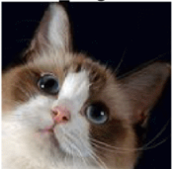
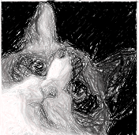
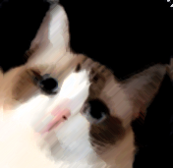
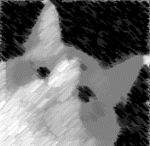
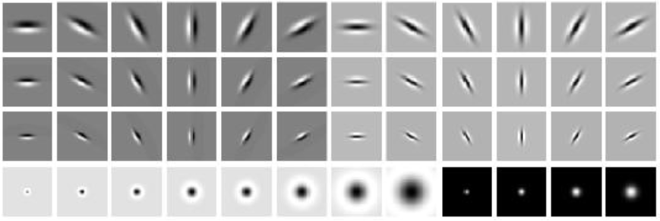
Convolutional Neural Networks
Cat
Classifier
Dog

Slide 13
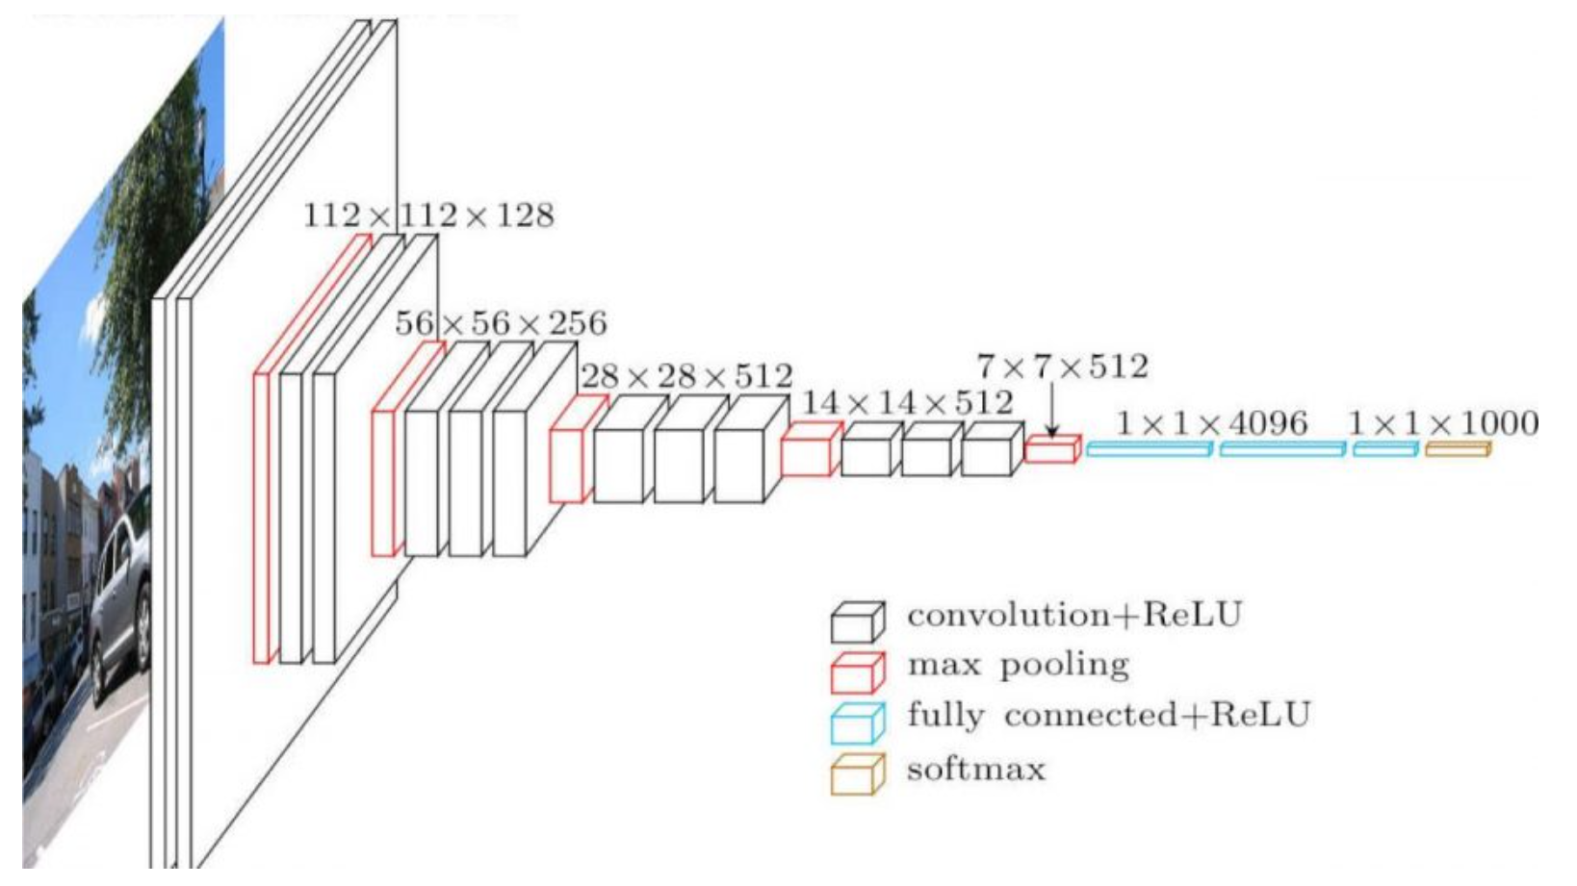
Pyramid Architecture

Slide 14
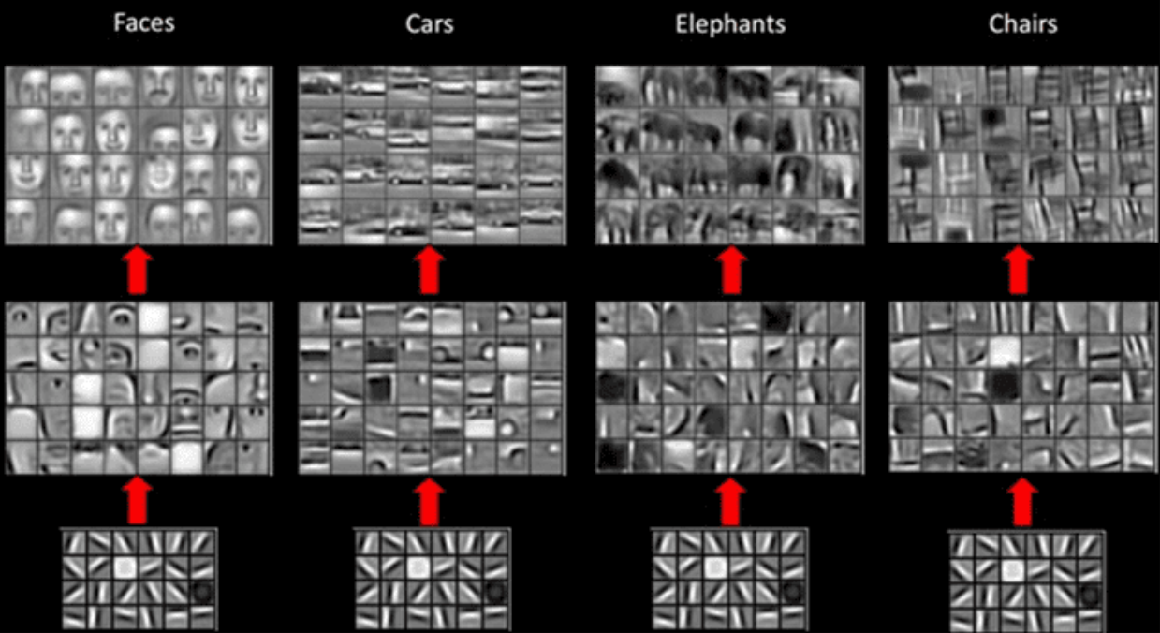
Hierarchical Feature Extraction

Slide 15
Project 1: Pet Face Recognition

Slide 16
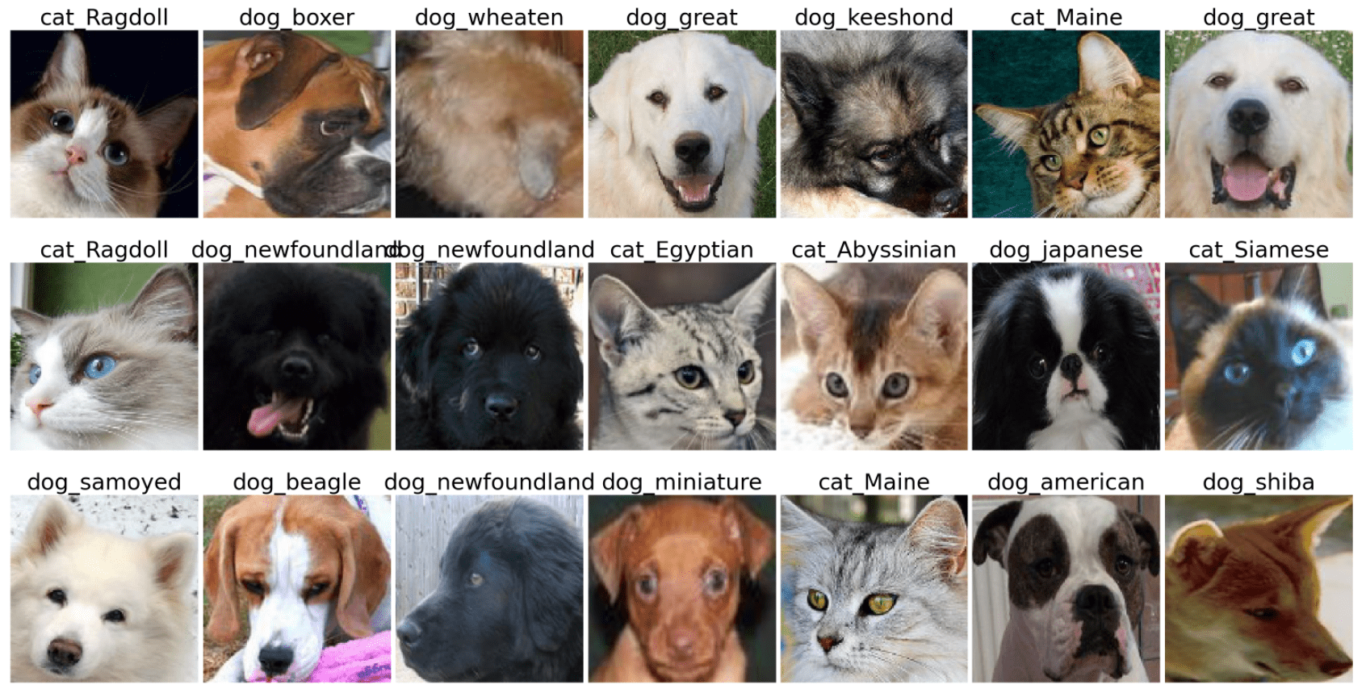
Project 1: Pet Face Recognition

Slide 17
Get Data
!wget https://mslearntensorflowlp.blob.core.windows.net/data/petfaces.tar.gz
!tar xfz petfaces.tar.gz
!rm petfaces.tar.gz
Notes:
One of the successful branches of artificial intelligence is computer vision, which allows computer to gain some insights from digital images and/or video. Neural networks can be successfully used for computer vision tasks.
Imagine you're developing a system to recognize printed text. You've used some algorithmic approach to align the page and cut out individual characters in the text, and now you need to recognize individual letters. This problem is called image classification, because we need to separate input images into different classes. Other examples of such a problem would be automatically sorting post-cards according to the image, or determining product type in a delivery system from a photograph.
In this module, we'll learn how to train image classification neural network models using PyTorch, one of the most popular Python libraries for building neural networks. We'll start from simplest model - a fully connected dense neural network - and from a simple MNIST dataset of handwritten digits. We'll then learn about convolutional neural networks, which are designed to capture 2D image patterns, and switch to more complex dataset, CIFAR-10. Finally, we'll use pre-trained networks and transfer learning to allow us to train models on relatively small datasets.
By the end of this module, you'll be able to train image classification models on real-world photographs, such as cats and dogs dataset, and develop image classifiers for your own scenarios.

Slide 18
Neural Network Training
Load data into tensors
Resize images
Normalize images
Split into batches
- torchvision.datasets.ImageFolder
- tf.keras.preprocessing.
image_dataset_from_directory
Run training loop
Train neural network for an epoch
Evaluate on test dataset
Train for several epochs
Feel free to use training code from Learn Module
Keras: model.compile+model.fit

Slide 19
Overfitting
50% Accuracy
Is it good?

Slide 20
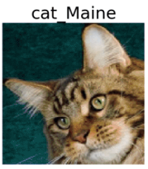
[Optional] Top-k Accuracy
cat_Egyptian
cat_Maine
cat_Siamese
dog_Pekinese

Slide 21
Knowledge check

Slide 22
Question 1
What is a convolution layer?
A special activation function for images
An image preprocessing layer that normalizes and prepares image before the dense layer
A layer that runs a small windows across the image to extract patterns
Notes:
Explanation: Correct

Slide 23
Question 1
What is a convolution layer?
A special activation function for images
An image preprocessing layer that normalizes and prepares image before the dense layer
A layer that runs a small windows across the image to extract patterns
Notes:
Explanation: Correct

Slide 24
Question 2
How do the number of parameters in a convolutional layer and dense layer correlate?
A convolutional layer contains more parameters
A convolutional layer contains less parameters
Notes:
Explanation: Correct, a convolutional layer contains small filters that have the same weights for the whole image

Slide 25
Question 2
How do the number of parameters in a convolutional layer and dense layer correlate?
A convolutional layer contains more parameters
A convolutional layer contains less parameters
Notes:
Explanation: Correct, a convolutional layer contains small filters that have the same weights for the whole image

Slide 26
Question 3
If the size of an input color image is 200x200, what would be the size of the tensor after applying a 5x5 convolutional layer with 16 filters?
16x196x196 (PT) or 196x196x16 (TF)
3x196x196 (PT) or 196x196x3 (TF)
16x3x200x200 (PT) or 200x200x16x3 (TF)
48x200x200 (PT) or 200x200x48 (TF)
Notes:
Explanation: This is correct

Slide 27
Question 3
If the size of color image is 200x200, what would be the size of the tensor after applying a 5x5 convolutional layer with 16 filters?
16x196x196 (PT) or 196x16x16 (TF)
3x196x196 (PT) or 196x196x3 (TF)
16x3x200x200 (PT) or 200x200x16x3 (TF)
48x200x200 (PT) or 200x200x48 (TF)
Notes:
Explanation: This is correct

Slide 28
Question 4
Which layers do we apply to significantly reduce spatial dimension in multi-layered CNN?
Convolution
Flatten
MaxPooling
Notes:
Explanation: Pooling layers (such as MaxPooling or AveragePooling) are used to decrease the dimension, usually by a factor of 2

Slide 29
Question 4
Which layers do we apply to significantly reduce spatial dimension in multi-layered CNN?
Convolution
Flatten
MaxPooling
Notes:
Explanation: Pooling layers (such as MaxPooling or AveragePooling) are used to decrease the dimension, usually by a factor of 2

Slide 30
Question 5
Which layer is used between convolutional base of the network and final linear classifier?
Convolution
Flatten
MaxPooling
Sigmoid
Notes:
Explanation: Flatten is used to reshape spatial tensor into a linear vector

Slide 31
Question 5
Which layer is used between convolutional base of the network and final linear classifier?
Convolution
Flatten
MaxPooling
Sigmoid
Notes:
Explanation: Flatten is used to reshape spatial tensor into a linear vector

Slide 32
Congratulations!
You have completed the main part of the workshop!
However, if you want to continue… go on!

Slide 33
[Optional] Project 2: Pet Face Recognition

Slide 34
Oxford Pets IIIT
!wget https://mslearntensorflowlp.blob.core.windows.net/data/oxpets_images.tar.gz
!tar xfz oxpets_images.tar.gz
!rm oxpets_images.tar.gz
Notes:
Explanation: Number of classes in pre-trained network is not important since we are training our own final classifier

Slide 35
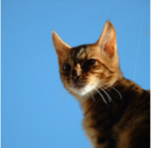
Transfer Learning
VGG
Cat
Classifier
Dog
Pre-trained on ImageNet
Feature vector
Notes:
Explanation: Number of classes in pre-trained network is not important since we are training our own final classifier

Slide 36
Knowledge check

Slide 37
Question 1
For transfer learning, we are using a VGG-16 network pre-trained on 1000 classes. What is the number of classes we can have in our network?
Any
1000
2
less than 1000
Notes:
Explanation: Number of classes in pre-trained network is not important since we are training our own final classifier

Slide 38
Question 1
For transfer learning, we are using a VGG-16 network pre-trained on 1000 classes. What is the number of classes we can have in our network?
Any
1000
2
less than 1000
Notes:
Explanation: Number of classes in pre-trained network is not important since we are training our own final classifier

Slide 39
Summary and Further Steps

Slide 40
Wow!
We have learnt how to classify arbitrary breeds of cats and dogs with ~85% accuracy (~96% top-3) from 37 classes!
Next:
Learn how to deploy the model on Azure Functions or Azure ML Cluster
Create complete mobile application that can recognize breeds of cats/dogs:
Using Mobile-Net and local inference
Using model deployed on Azure
Learn how to deal with text in PyTorch or TensorFlow
Notes:
In this module, you have learned how convolutional neural networks work, and how they can capture patterns in 2D images. In fact, CNNs can also be used for finding patterns in 1-dimensional signals (such as sound waves, or time series), and in multi-dimensional structures (for example, events in videos, where some patterns are repeated across frames).
Also, CNNs are simple building blocks for solving more complex computer vision tasks, such as Image Generation. Generative Adversarial Networks can be used to generate images similar to the ones in the given dataset, for example, they can be used to produce computer-generated paintings. Similarly, CNNs are used for object detection, instance segmentation, etc. Learning how to implement neural networks to solve those problems is the subject of a separate course, and we suggest that you continue your journey of mastering computer vision!

