Slide 1
Workshop: Building A Mood Journal PWA
Beth Pan
SWE | APS | Microsoft
@beth_panx

Slide 2
Beth Pan
SWE | APS | @beth_panx
Notes:
Speaker profile

Slide 3
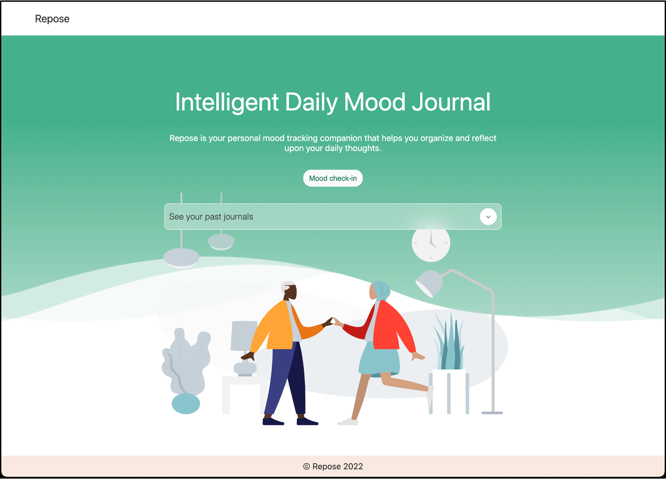
Notes:
This is the final look of the app that we will build following this workshop. It is a mood journal web app that helps you keep track of your daily mental health. It also takes advantage of some advanced features as a PWA such as it can be installed on native platforms and work offline. Let's take a look now on how we can achieve all of these!

Slide 4
Agenda
Part I: Introduction to PWAs
Part II: PWAs on native platforms like Windows
Part III: Build a mood journal PWA
Notes:
Today's agenda includes:

Slide 5
Part I: Introduction to PWA

Slide 6
PWAs are websites that are progressively enhanced to function like installed, native apps on supporting platforms, while functioning like regular websites on other browsers.
Notes:
This means that PWA combines the best of the web and compiled apps.
Almost all the modern browsers are behind PWA
PWAs run in browsers, like websites.
But PWAs also have access to app features;
Another thing to note is that PWAs have a much lower cross-platform development cost than compiled apps that require a specific codebase for each platform, such as a separate codebase for Android, for iOS, and for each desktop operating system.

Slide 7
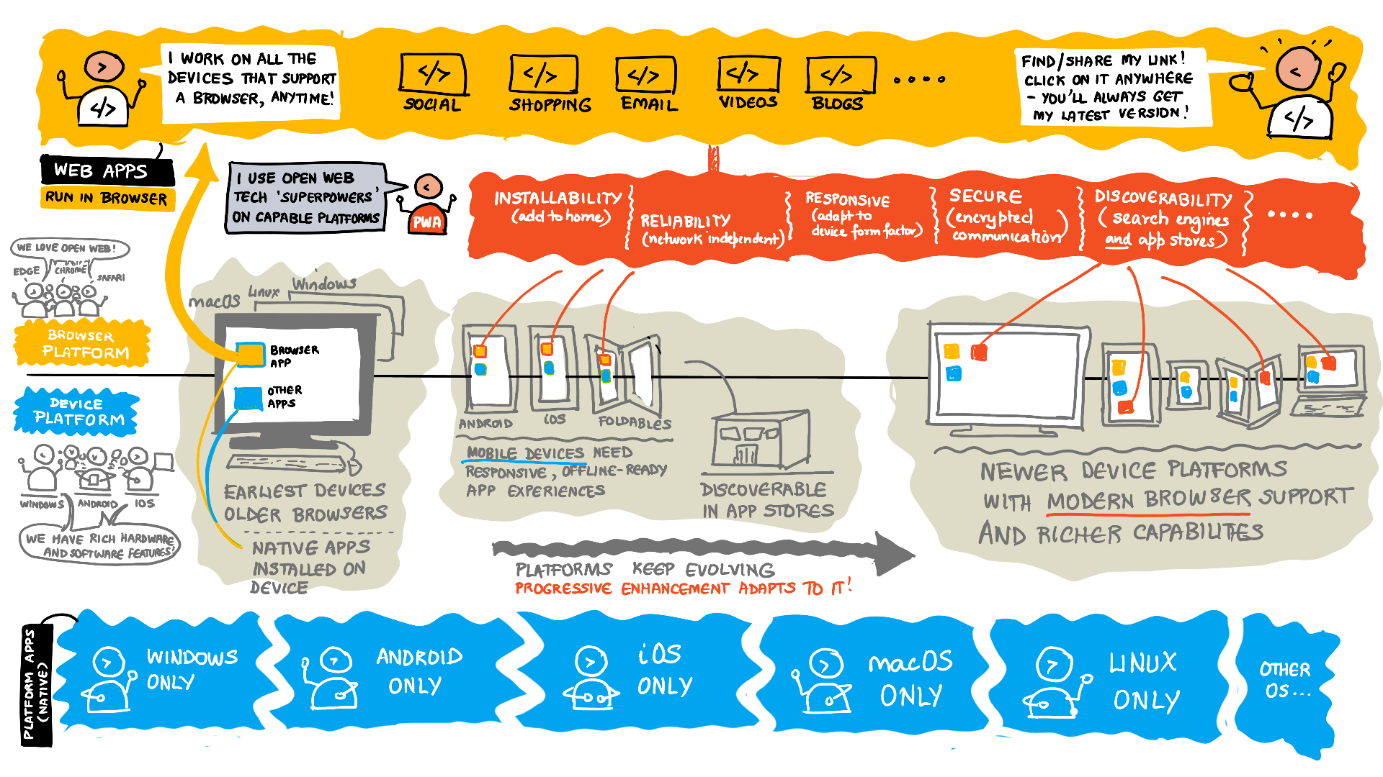
Notes:
Here is a brief artwork that explains what PWA is: on the top as websites, and on the bottom as platform-specific apps. There used to be a distinct line separating those. Progressive Web Apps (PWAs) takes the best of both worlds, provide access to open web technologies, and in turn provide cross-platform interoperability. PWAs provide your users with an app-like experience that's customized for their devices.

Slide 8
🔎 Discoverable
🛠️ Installable
🔊 Re-engageable
📶 Network-independent
Why PWA?
📱 Progressive
🔒 Safe
📐 Responsive
🔗 Linkable
Notes:
So why do we want to build PWAs?
Here are some of the most exciting reasons:
Discoverable
Your app is discoverable from web search results and supporting app stores.

Slide 9
🔎 Discoverable
🛠️ Installable
🔊 Re-engageable
📶 Network-independent
Why PWA?
📱 Progressive
🔒 Safe
📐 Responsive
🔗 Linkable
Notes:
Installable
They can be pined and launched from the home screen, Start menu, and Taskbar. Just like other native apps.

Slide 10
🔎 Discoverable
🛠️ Installable
🔊 Re-engageable
📶 Network-independent
Why PWA?
📱 Progressive
🔒 Safe
📐 Responsive
🔗 Linkable
Notes:
Re-engageable
PWAs can receive push notifications, even when the app isn't active.

Slide 11
🔎 Discoverable
🛠️ Installable
🔊 Re-engageable
📶 Network-independent
Why PWA?
📱 Progressive
🔒 Safe
📐 Responsive
🔗 Linkable
Notes:
Network-independent
They work offline and in low-network conditions.

Slide 12
🔎 Discoverable
🛠️ Installable
🔊 Re-engageable
📶 Network-independent
Why PWA?
📱 Progressive
🔒 Safe
📐 Responsive
🔗 Linkable
Notes:
Progressive
The user experience of these apps scales up or down with device capabilities.

Slide 13
🔎 Discoverable
🛠️ Installable
🔊 Re-engageable
📶 Network-independent
Why PWA?
📱 Progressive
🔒 Safe
📐 Responsive
🔗 Linkable
Notes:
Safe
The app provides a secure HTTPS endpoint and other user safeguards.

Slide 14
🔎 Discoverable
🛠️ Installable
🔊 Re-engageable
📶 Network-independent
Why PWA?
📱 Progressive
🔒 Safe
📐 Responsive
🔗 Linkable
Notes:
Responsive
They adapt to the user's screen size or orientation and input method.

Slide 15
🔎 Discoverable
🛠️ Installable
🔊 Re-engageable
📶 Network-independent
Why PWA?
📱 Progressive
🔒 Safe
📐 Responsive
🔗 Linkable
Notes:
Linkable
You can share and launch the app from a standard link.

Slide 16
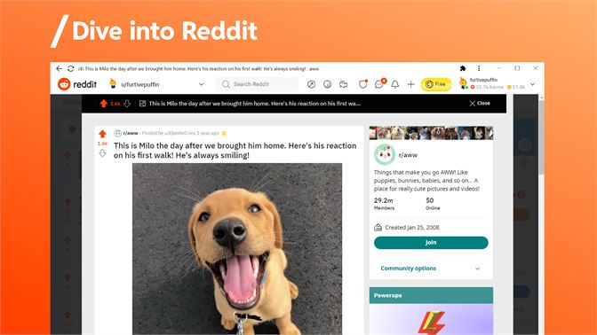
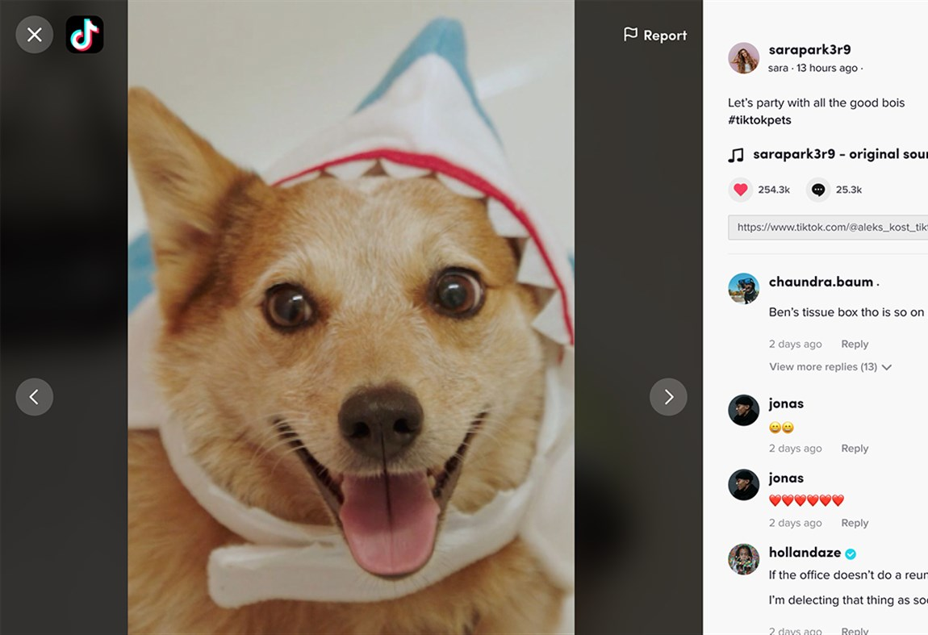
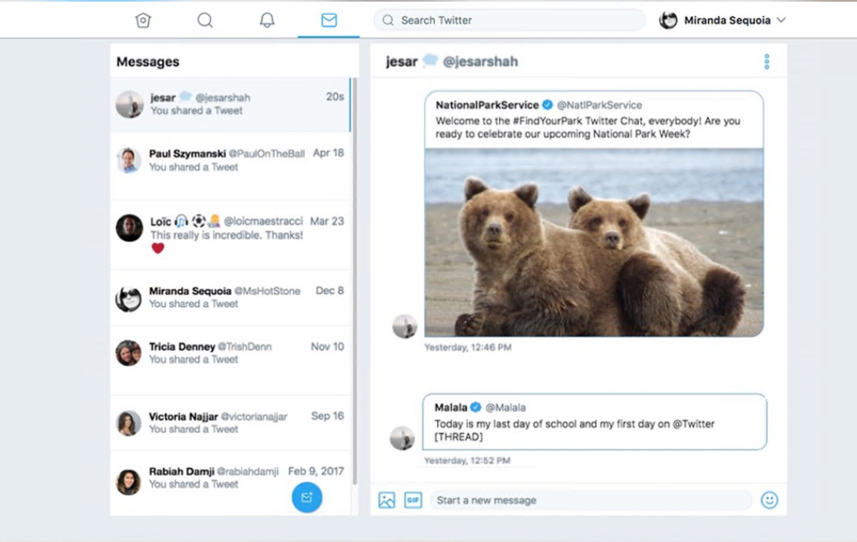
PWAs in real world
Notes:
Here are some of the examples we have today as PWAs:
Reddit, TikTok, Twitter
And so many more like Starbucks, tinder, Uber, West Elm, etc.
These PWAs all started with a great web experience and then enhanced their experience for performance, resilience, installation, and engagement

Slide 17
Part II: PWA + Native Platforms (Windows)
Notes:
Now that we talked about what is a PWA, how they take the best features of both web and native platforms, let's change gear and look at specifically what Windows can do with PWAs

Slide 18
PWA combines the best of the web and compiled apps
A PWA can still work when the device is offline.
PWAs can be installed on the operating system.
PWAs support push notifications and periodic updates.
PWAs can access hardware features.
Notes:
Because PWAs combines the best of the web and compiled apps, there are some great benefit that simple web apps can't achieve: such as working offline, being installed just like an app, support native capabilities like push notifications and periodic updates, and work with hardware features. Remember these are not restricted to Windows only, you can utilize these on platforms like Android, and iOS as well.

Slide 19
Handle files.
Share content with other apps.
Access the clipboard.
Sync data and fetch resources in the background.
Access device hardware such as Bluetooth and USB.
Store content in databases.
Take advantage of hardware accelerated graphics.
Use CSS layouts, animations, and filters to create advanced designs.
Run near-compiled performance code with WebAssembly.
Deep integration with the desktop operating system
Notes:
And the advanced capabilities that desktop operating system bring to the table are abundant. Your web app now will be able to do all of these functionally:

Slide 20
When installed… PWAs are just like other apps on Windows
A PWA can be added to the Start menu.
A PWA can be pinned to the Taskbar.
PWAs can handle files.
PWAs can run when the user signs in.
PWAs can be submitted to the Microsoft Store where millions of Windows users can discover and easily install them alongside other Windows apps.
Notes:
Specifically on Windows, PWAs are just like other apps! They can...

Slide 21
Part III: Build a mood journal PWA
Notes:
Now that we have had a brief introduction of what is Progressive Web Apps and why build them, and especially how they can utilize Windows as a native platform to do more, let's get into the core of the workshop and actually make a very simple PWA with some of the coolest tools we have to offer.

Slide 22
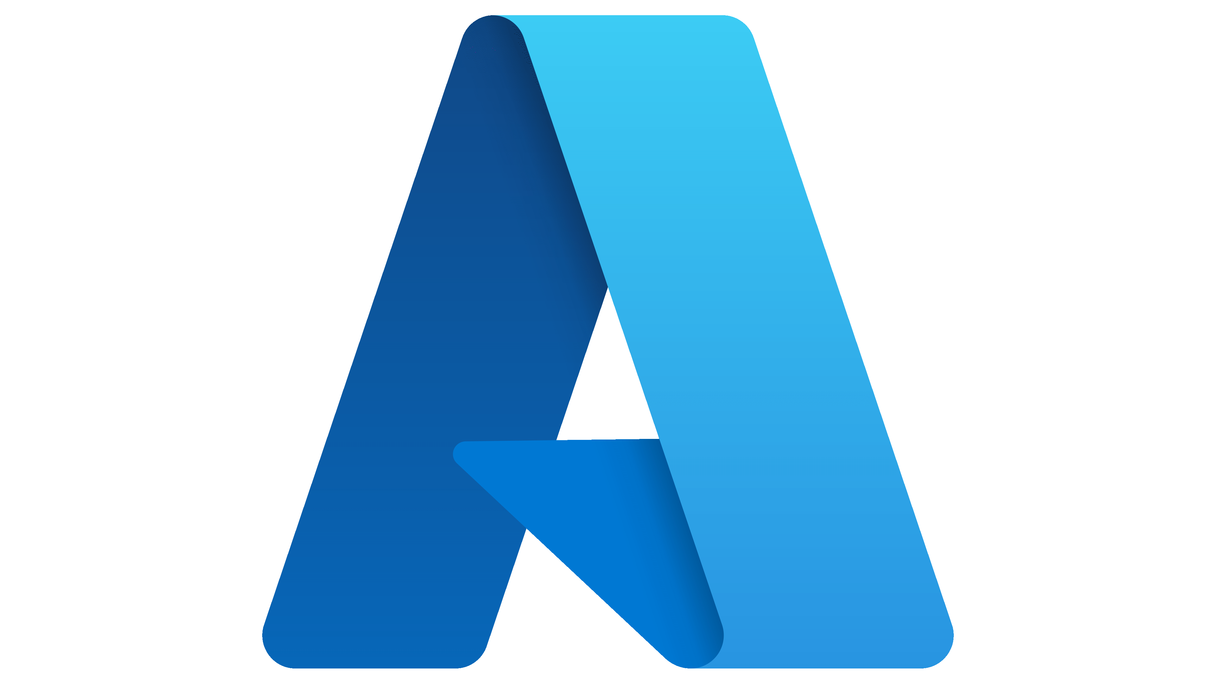
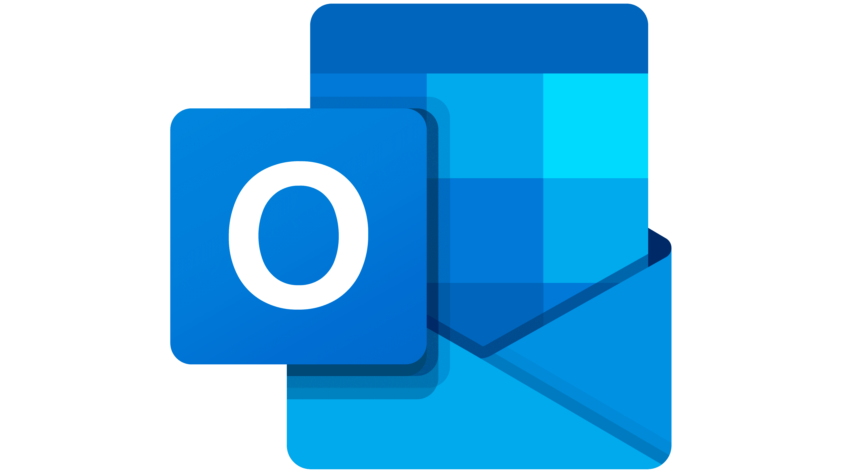
What you’ll need
A modern web browser like Microsoft Edge
A code editor like Visual Studio Code
Git
Node.js
+
+
+
*Optional:
GitHub account
Azure account
Microsoft account
Notes:
A modern web browser like Microsoft Edge. PWAs are supported on most modern browsers but to facilitate this workshop we will be using Microsoft Edge.
A code editor such as Visual Studio Code.
Git to clone sample solutions.
Node.js to run the sample solutions.
Basic knowledge of HTML, CSS, and JavaScript. If you need to brush up on your web skills, you can checkout this Microsoft Learn Module or this workshop.
A GitHub account if you want to collaborate and have your code pushed to a repo
An Azure account if you want to deploy your app to a secure endpoint
A Microsoft account if you want to setup a developer profile in order to publish your app to the Microsoft Store on Window.

Slide 23
Demo: Create a new PWA using PWA Studio

Slide 24
Web Manifest
Service Workers
HTTPS
Notes:
PWAs are not created with a single technology. They represent a new philosophy for building web apps, involving some specific patterns, APIs, and other features. It's not that obvious if a web app is a PWA or not from first glance. An app could be considered a PWA when it meets certain requirements, or implements a set of given features: works offline, is installable, is easy to synchronize, can send push notifications, etc.
There are three core functionalities that can help enable a lot of these PWA characteristics.

Slide 25
- Use a hosting service that supports HTTPS by default.
Azure, AWS, GitHub, etc.
- Use your own hosting provider
and create the required certificates using free services like Let’s Encrypt.
HTTPS
Notes:
This is to make sure the connections between the user, the app, and your server are secured against any third parties trying to get access to sensitive data.

Slide 26
Demo: Deploy a PWA to Azure Static Web App

Slide 27
{ "name": "HackerWeb", "short_name": "HackerWeb", "start_url": ".", "display": "standalone"
}
Web
Manifest
Notes:
A web application manifest, provides information about a web application in a JSON text file, necessary for the web app to be downloaded and be presented to the user similarly to a native app

Slide 28
Demo: Add/Modify Web App Manifest

Slide 29
📝
Registration
🛠
Installation
Service
Workers
⏳
Activation
Notes:
Service Workers are a special type of Web Worker with the ability to intercept, modify, and respond to all network requests using the Fetch API. Service Workers can access the Cache API, and asynchronous client-side data stores, such as IndexedDB, to store resources.
From development perspective, there are 3 lifecycle events that we need to handle.
Registration is when The browser registers the service worker, kicking off the Service Worker lifecycle.
Installation happens when The browser triggers install as the first event to the Service Worker. It can use this for pre-caching resources.
Activation is when The browser sends the activate event to indicate that the service worker has been installed. This service worker can now do clean up actions and ready itself to handle functional events.

Slide 30
Demo: Register A Service Worker

Slide 31
CacheFirst
💻
Browser
🛠
Service Worker
🗄
Cache
Service
Workers
☁️
Internet
Notes:
There are a handful of handler options you can pass into runtimeCaching as part of VitePWA configuration. The CacheFirst strategy is one of them. PWA Studio uses this strategy by default and it enables offline support.
For matching requests, the process goes like this:
The request hits the cache. If the asset is in the cache, serve it from there.
If the request is not in the cache, go to the network.
Once the network request finishes, add it to the cache, then return the response from the network.

Slide 32
Demo: Enable Push Notifications

Slide 33
Demo: Audit and Package a PWA

Slide 34
Resources
PWA on Microsoft Edge docs:
https://aka.ms/learn-pwa/workshop/edge-docs
Learn PWA in 30 days:
https://aka.ms/learn-pwa/30Days-blog
MDN:
https://developer.mozilla.org/en-US/docs/Web/Progressive_web_apps
Google:
https://web.dev/learn/pwa/

Slide 35
Thank you!

